Slide 1
Palliative Operations

Slide 2
Systemic–Pulmonary Artery Shunt
Indication
1. Complex anomaly with severe cyanosis, irritability, hypoxic episode
2. Critically ill neonates or infants due to decreased pulmonary blood flow
3. Facilitating growth of hypoplastic pulmonary artery

Slide 3
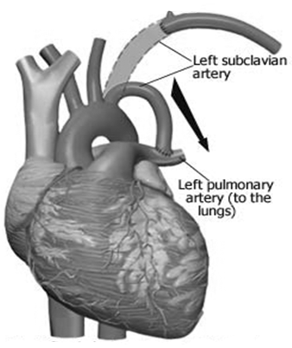
Classic BT shunt
Subclavian artery to PA anastomosis
Advantages
  No prosthetic material
  PBF limited by subclavian artery
  Growth potential of shunt
Disadvantages
  Longer operative dissection time
  Phrenic nerve injury
  PA : pulled up and kink
  Technical difficulties during takedown
  Possible arm ischemia

Slide 4
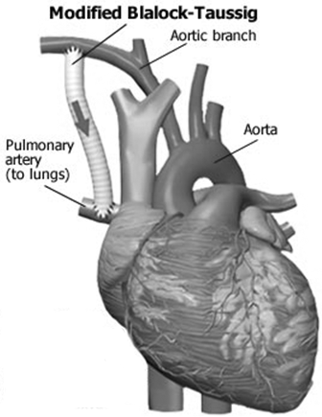
Modified BT shunt
Prosthesis between subclavian artery and PA
Advantages
  Preservation of subclavian artery
  Fewer technical problems with anastomosis, including ease of insertion and takedown
  Greater PA growth with less distortion of PA
  Low shunt failure rate
Disadvantages
  Serous fluid leakage, seroma, graft infection

Slide 5
Modified BT shunt
Median sternotomy (vs thoracotomy)
Advantages
  less demanding for shunt construction with greater control of vessels without lung compression
  CPB use, PDA control
  distal anastomosis to MPA, even flow distribution
  low complication, single scar
Disadvantages
  Adhesions at sternal reentery

Slide 6
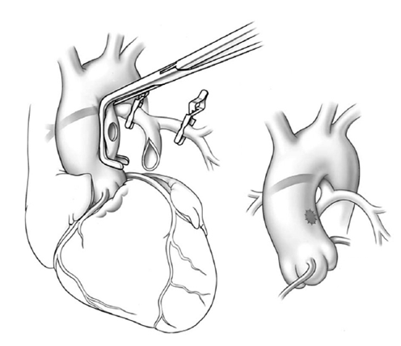
Melbourne Shunt

Slide 7
Surgical Strategy for BT Shunt
Operative Timing
Thoracotomy vs Sternotomy
On vs Off CPB
Selection for shunt size/body weight (SV vs BV)
PA size and morphology (diminutive, discontinuous, asymmetric)
  Pulmonary coarctation of uneven PBF (no touch vs reconstruction)

Slide 8
Surgical Strategy for BT Shunt
Selection for prox shunt site to control overflow (innominate, subclavian, carotid, aorta)
  Abnormalities of aortic arch branching
    right arch and mirror-image head vessels with PDA from lt innominate a. placement of shunt from innominate a. involve ductal tissue at proximal shunt site.
    left arch with aberrant right subclavian a.
    other options for a proximal shunt site would have been carotid artery or ascending aorta.
Selection for distal shunt site to avoid preferential ipsilat. PA growth (Branch PA, MPA)
  Antegrade PBF from RVOT of contralateral PA growth

Slide 9
Current Results of BT Shunt
Two Thousand BT Shunts: A Six-Decade Experience - Johns Hopkins, ATS 2007 -
SV - Obstructive TAPVR, AVVR, Low Bwt, Preop. poor condition
BV - Op. mortality : 6.7%, Interstage mortality : 7 - 13% (STS database)
Hemodynamic instability

Slide 10
Alternative Methods to Avoid BT Shunt
Biventricle
  Early one stage total correction
  Palliative RV-PA shunt
  PDA stent in duct-dependent pulmonary circulation for even PA growth
SV
  RV-PA shunt
  PDA stent in duct-dependent pulmonary circulation for even PA growth
  Hybrid approach
    Bilateral PA banding with PDA stent

Slide 11
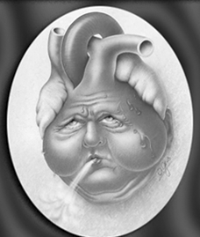
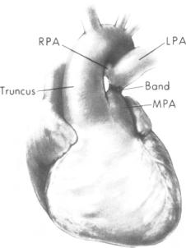
PA banding
Aims
  To decrease volume of L-R shunt and thus work of LV, and decrease PBF and prevent PVOD.
    Sick infants less than 6 months of age, or more, with intractable congestive failure and failure of growth, or with those complex lesions unsuitable for primary repair in infancy

Slide 12
PA banding
Indication
  Control of congestive heart failure
    Multiple muscular VSDs : "Swiss cheese"
    Single or multiple VSDs with CoA or IAA
    Unbalanced AVC, potential for 2-ventricle repair
  Protection of pulmonary vascular bed
    Single ventricle for Fontan operation
  Preparation of LV for arterial switch operation
    d-TGA, older than 1 month
    d-TGA, previous atrial switch
    l-TGA, for double switch procedure

Slide 13
Adjustment Technique
Trusler’s rule
Circumference
  20 + 1 mm for each kg of Bwt
    noncyanotic, nonmixing lesion
    VSD without bidirectional shunting
  24 + 1 mm for each kg of Bwt
    mixing lesion
    VSD with bidirectional shunting
  22 + 1 mm for each kg of Bwt
    SV for Fontan

Slide 14
Adjustment Technique
Distal PAP
- FiO₂ 0.5 : 30 to 50% of SAP, SaO₂ of 85 to 90%
- FiO₂ 0.6 in SV : 50% of SAP, SaO₂ of 75 to 85%
- systolic PAP : 30 to 40 mmHg
- mean PAP : 20 to 30 mmHg
SAP 10 mmHg increase, no bradycardia, no hypoxemia for 10 minutes

Slide 15
Median sternotomy
More precise band placement & anchoring
Intracardiac procedures requiring CPB
Malposed or transposed GA
RPA : acute angle - risk of impingement
MPA : dilatation & thin wall - risk of tearing
Placed away from PV to avoid dysplastic changes & distortion
Safe placement of PA band
  Encircling aortopulmonary trunk followed by encircling aorta
Fixation to two opposite sites of PA wall to avoid poorly positioned band & band migration
Atrial septectomy for restrictive atrial communication

Slide 16
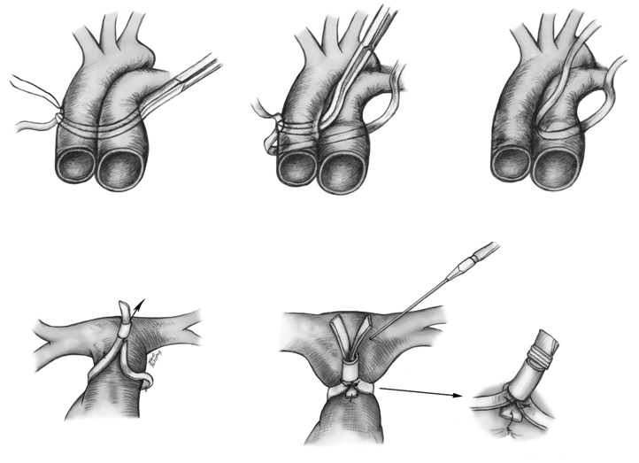
Median sternotomy

Slide 17
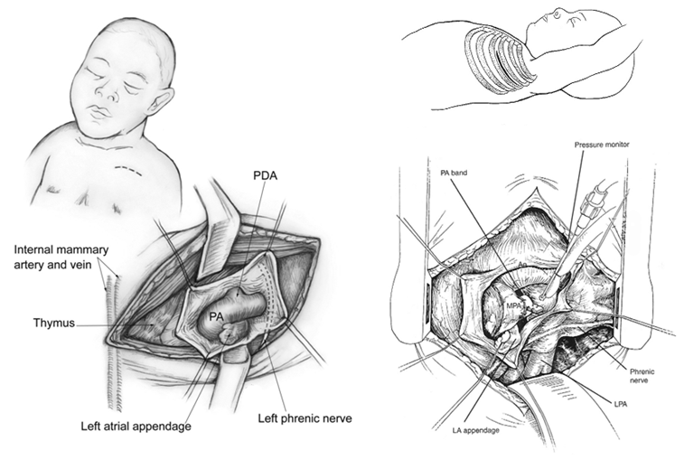
Thoracotomy minimal adhesions
lt ant. mini-thoracotomy, 2nd or 3rd ICS lt lateral thoracotomy, 3rd or 4th ICS

Slide 18
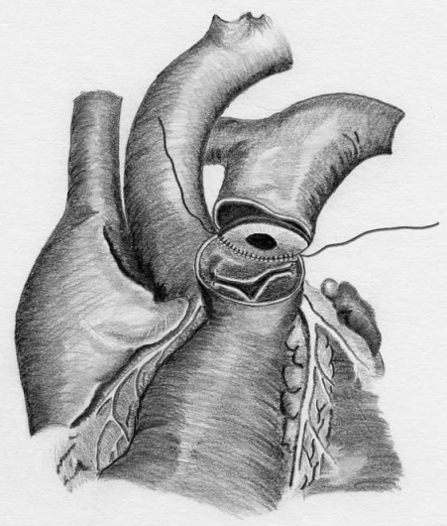
Internal PAB

Slide 19
Internal PAB
Advantages
  predictable and reproducible band aperture, without anatomic complications, such as migration or internal remodeling
  protecting pulmonary vasculature and providing satisfactory substrate for performance of a second-stage repair later in life
  open technique under direct vision - injury or distortion of PV or branch PAs is unlikely
  percutaneous balloon dilation for systemic arterial desaturation
Disadvantages
  requirement for CPB
  tightening of PAB - more complex requiring CPB
  increases duration of CPB
  bleeding from PAB suture line in MPA

Slide 20
Postoperative Management
Gradual resolution of CHF
  decreased L-R shunt, PBF
  improved hemodynamics, BP, LV output
EchoCG evaluation - band tightness, band gradient, band position, and overall cardiac function
Excessive banding - hypotension, bradycardia, ischemic EKG changes
Adjustable PAB - rapid loosening of band with hemoclip remover in ICU
Staged banding

Slide 21
Follow-up
Pulmonary overcirculation are monitored for 3-6 months → more definitive repair
  earlier definitive repair in severe RVH in response to PAB
LV training
  serial echoCG for readiness of LV
  EchoCG : LV mass index, ventricular septal geometry. L-R septal bowing

Slide 22
PA banding
  Complications
  Branch PA stenosis (RPA)
  PV distortion, thickening → PR
  Coronary artery obstruction (LCx, abnormal coronary pattern)
  Ineffectual banding, Band loosening
    Later resorption of infoldings and remodeling of arterial wall restore greater internal cross-sectional area
  PA erosion, aneurysm, rupture, hemolytic anemia, localized thrombus
  Disadvantages
  Failure to control adequate pulmonary blood flow
  Changes in the ventricular geometry
    ventricular hypertrophy, subaortic stenosis, BVF narrowing
  Changes of cardiac diastolic & systolic function

Slide 23
Subaortic Stenosis
Potential for subaortic stenosis
  SV with ventriculoarterial discordance
    DILV with TGA
    Tricuspid atresia with TGA
  50% of aortic arch anomalies
  Restrictive bulboventricular foramen (BVF)
PAB may cause rapid progression of SAS
  Contraindication of PAB
    BVF > 15-20 mmHg, BVF index < 2 cm²/m²
Damus-Kaye-Stansel (DKS) & shunt

Slide 24
Subaortic Stenosis
In neonate, moderate sized BVF (1∼2 cm²/m²) and CoA
  Initial PAB with CoA repair
  4∼6 months : BCPS with DKS procedure
Indication of DKS according to ventricular outflow tract diameter index
  in neonate, < 60%
  after PAB, < 70%
  at Fontan, < 120%
    After Fontan, 60∼70% ventricular volume decrease
    DKS indication at Fontan : presence of PG, narrow systemic ventricular outflow tract (< AV diameter)

Slide 25
Subaortic Stenosis
Post-PAB Subaortic Stenosis
  Adversely affect future Fontan outcome
  Ventricular hypertrophy and subendocardial ischemia
  Duration of PAB : independent risk factor
  Resection of obstruction or DKS procedure
  Early BCPS

Slide 26
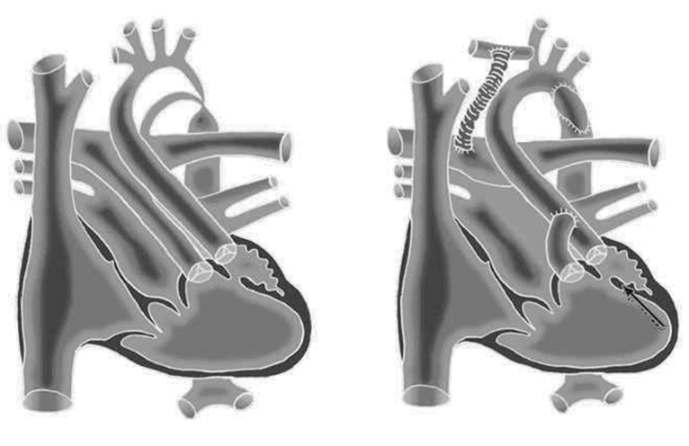
LVOTO & CoA
DKS
DKS with CoA repair

Slide 27
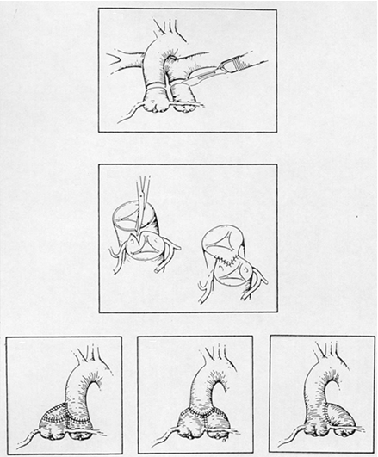
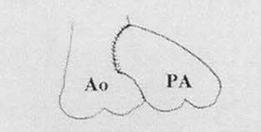
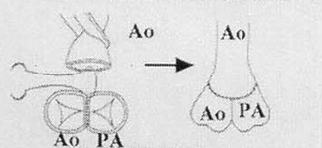
DKS
End-to-side anastomosis
Double-barrel anastomosis

Slide 28
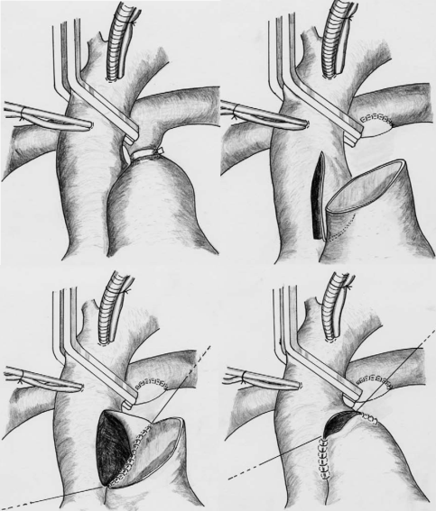
DKS

Slide 29
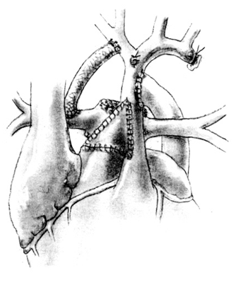
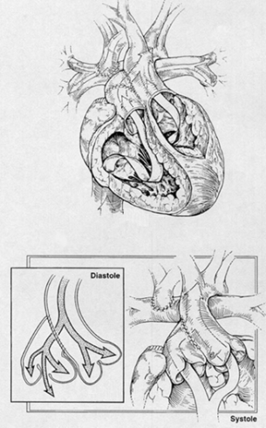
DKS
BT shunt
BCPS

Slide 30
SV with Systemic Ventricular Outflow Tract Obstruction
Disease Entity
  DILV with TGA
  Tricuspid atresia with TGA
  Unbalanced ventricle in Taussig-Bing anomaly
  Crosscross AV valve
  DORV or TGA with mitral atresia
  Corrected TGA with lt sided AV valve atresia
with subaortic stenosis
with or without CoA, IAA, arch hypoplasia

Slide 31
Short-Term Initial PA Banding
Advantages
  Simplicity (Avoid CPB, brain ischemia)
  Low mortality
  At a later time, complex surgical intervention
    physiologically and technically better tolerated
  Low incidence of semilunar valve insufficiency, PA distortion
Disadvantages
  Silent killer of Fontan operation
    Ventricular hypertrophy
    Diastolic dysfunction
    Bulboventricular foramen narrowing
  Banding migration
  PA or PV distortion

Slide 32
Initial Palliation by DKS
  When morphological subaortic stenosis is definite at neonate, ascending aorta and aortic arch is small and antegrade blood flow is weak - primary DKS or Norwood is necessary
Indication of primary neonatal DKS
  aortic arch anomaly
  very small VSD
  ductal dependant systemic circulation

Slide 33
Initial Palliation by DKS
Advantage
  Early relief of obstruction (prophylactic bypass surgery)
  Protect pulmonary vasculature
  Avoid ventricular hypertrophy
  Minimize neoaortic valve regurgitation
  Less reoperation
  Suitable for preFontan status
Disadvantage
  Early mortality
  Complex postoperative care
  Risk of complex operation in neonatal period
  Significant morbidity (neurologic insult)
  Semilunar valvular dysfunction

Slide 34
DKS vs Norwood
DKS
  useful initial palliative procedure for SV with subaortic stenosis
  potential for subaortic stenosis
  not severe seminular valve regurgitation
Modified Norwood procedure > DKS procedure
  arch obstruction and small ascending aorta (< dm 4 mm)
  very small ascending aorta with arch obstruction
    technically difficult to create DKS connection

Slide 35
Alternative Procedures
Palliative arterial switch operation
  Advantages
    early initial relief of aortic obstruction
      avoid irreversible myocardial hypertrophy and geometric changes
      improve heart compliance
    avoid complication of PA banding
  Disadvantages
    unpredictable PBF (later shunt or banding)

Slide 36
Alternative Procedures
  Enlargement of bulboventricular foramen or VSD
  Direct relief of subaortic obstruction
  Disadvantages
    Heart block
    Coronary injury
    Ventricular dysfunction
    Recurrent subaortic stenosis
    Late aneurysm formation
LV Apical to Aortic Conduits
  Bypass subaortic area
  Lack long-term durability
    Valvular degeneration
    Distortion with somatic growth

Slide 37
Norwood Operation
Creation of unrestricted pathway
  RV to aortic arch
  descending aorta
  coronary circulation
Systemic to pulmonary shunt / RV-PA conduit
Removal of interatrial septum

Slide 38
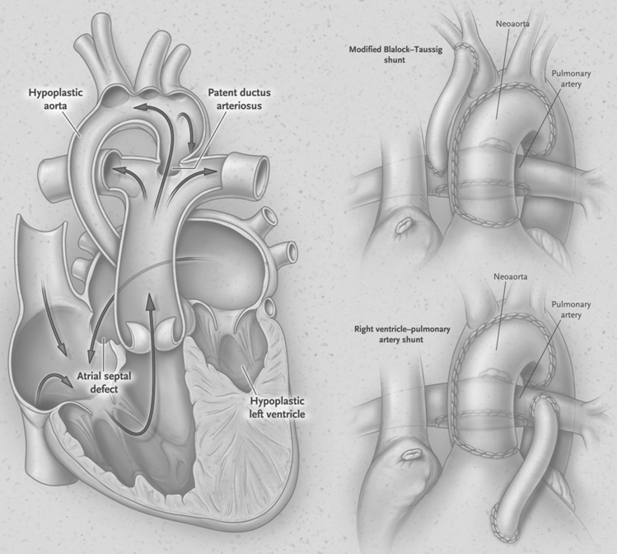

Slide 39
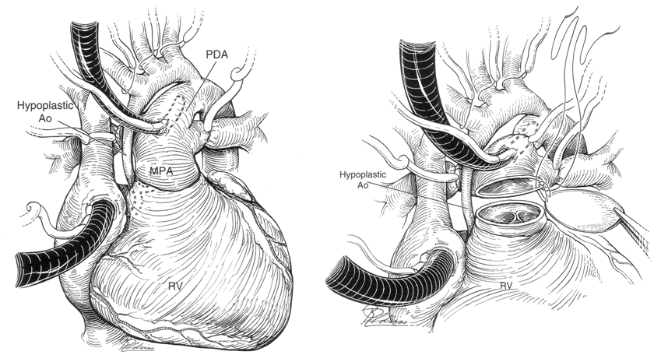
Norwood Procedure (1)

Slide 40
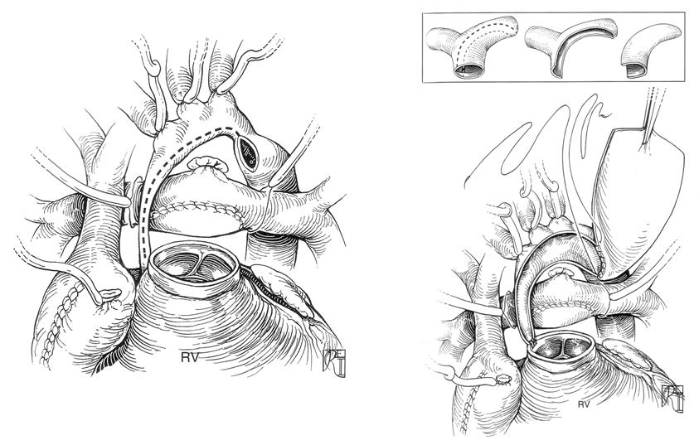
Norwood Procedure (2)

Slide 41
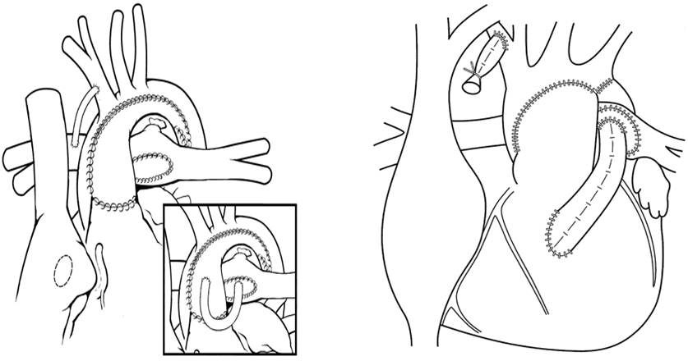
Norwood Procedure (3)
BT shunt
RV-PA Conduit

Slide 42
BT shunt in Norwood
BT shunt provides continuous forward flow to PA during both systole and diastole, causing diastolic retrograde flow in descending aorta and coronary arteries.
Because coronary blood flow occurs primarily during diastole, “coronary steal” may cause myocardial ischemia and circulatory instability, which in turn may lead to death in hospital or during the period between Norwood procedure and stage II.

Slide 43
BT shunt in Norwood
Ventricular dysfunction
  Postoperative coronary artery steal and decreased diastolic blood flow
Volume overload and ventricular dilatation by pulmonary overflow
Decompensation by vicious cycle
  Low cardiac output syndrome, Hemodynamic instability by ventricular dysfunction, possibility of mortality
VAD assist
  CO increase
  Qp:Qs balance
  Improve hypoxia
  Improve postoperative hemodynamic course and mortality

Slide 44
RV-PA shunt in Norwood
Theoretical advantage of RV-PA shunt
  elimination of diastolic runoff, reducing the potential for coronary steal, which may thus lead to a lower perioperative and interstage mortality.
Potential disadvantages
  negative effect on RV function, arrhythmias or aneurysm formation related to ventriculotomy, additional volume load due to regurgitation from nonvalved RV-PA shunt, impaired growth of pulmonary artery, and need for earlier stage II procedure.

Slide 45
RV-PA shunt in Norwood
Advantage
  Maintain better ventricular function, better tolerance for pulmonary overflow
    Postoperative high coronary perfusion pressure
    Avoid coronary artery steal and decreased diastolic blood flow
  Better postoperative course
  Greater resistance to physiologic insults such as cardiopulmonary arrest
  Lower risk of graft thrombosis
  Less operative mortality
  Less interstage mortality
  Better in low birth weight babies
  Better at smaller center

Slide 46
RV-PA shunt in Norwood
Disadvantage
  RV incision, RV volumeload → TR, ↓ PA growth
  Ventriculotomy, PI → Arrhythmia, Ventricular dysfunction
  Hypoxia
    Postoperative ventilator care
      Requirement for high FiO2
      Requirement for large minute ventilation
    Conversion to BT shunt for hypoxia
    Earlier 2nd stage operation for hypoxia
  Possibility of sudden death

Slide 47
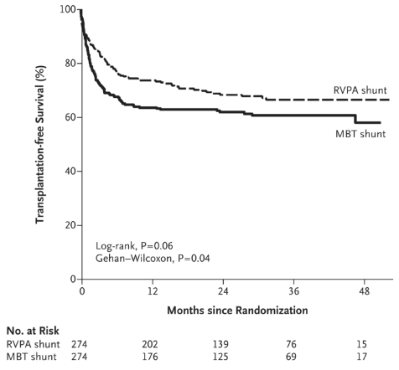
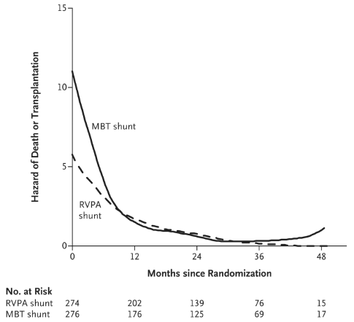
BT vs RV-PA Shunt
in Norwood

Slide 48
Perioperative Mx in Norwood
Poor preoperative condition
Restrictive PFO, High fixed Rp
  Preoperative balloon atrial septostomy
  Wait for 48 hours to decrease PVR and improve preoperative condition before operation
VAD, ECMO assist to recover pulmonary function by decreasing PVR after operation
Postoperative Mx
  Recommend to use phenoxybenzamine (afterload reducing agent)
  Continuous systemic venous oxygen saturation and lactate level which suggest systemic oxygen delivery
    Early Dx and medical/surgical correction for hemodynamic instability

Slide 49
Ideal Strategy for HLHS
Large volume centers with “constant” exposure:
  currently doing well with stage I (90% hospital survival) with both MBTS and RV-PA conduit
  A more discriminating approach depending on anatomy and risk factors may improve outcomes further
    2V repair for AS/MS,
    Heart Tx for AA/MS with LV-coronary fistulae
    RV-PA conduit for high-risk very low birth weight or premature babies
    Hybrid stage I for patients with contraindications to CPB, late presentation, infections, additional cardiac or genetic anomalies
Lower volume centers with “occasional” exposure:
  RV-PA conduit
  Hybrid Stage I

Slide 50
Mitral Steosis-Aortic Atresia
Patients with MS-AA and LV-coronary artery fistulae represent a newly identified group at significantly increased risk
Further prospective studies are required to better understand this subgroup of patients and to recommend a modification in their surgical management
Recommend cardiac angiography before Stage I palliation in patients with MS-AA and echocardiographic findings of LV-CAs fistulae
Possible surgical alternatives include hybrid stage I palliation and heart transplantation

Slide 51
High risk for Norwood
High-risk neonates undergoing a stage I Norwood operation still face a mortality of 20% to 50%.
Risk factors
- presentation with shock
- birth weight < 2.5 kg
- prematurity (< 34 weeks)
- < 2mm ascending aorta
- poor ventricular function
- Tricuspid regurgitation
- intact or restrictive atrial septum
- additional cardiac anomalies
- serious noncardiac genetic malformations

Slide 52
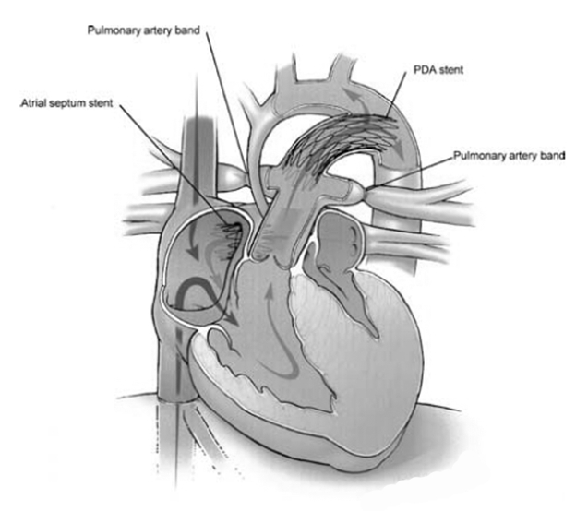
Hybrid Stage I

Slide 53
Technique for Hybrid
In the cath lab
Median sternotomy
1.5 mm wide 3.5 mm PTFE graft for bilateral PA banding
Purse-string suture at MPA
Self-expandable stent
If atrial septum is restrictive, atrial communication can be enlarged by using self-expandable stent placed via peratrial approach under TEE guidance.

Slide 54
Protocol for Hybrid
Hybrid stage I procedure early after birth
Routine postoperative management
Echo at least weekly, even after discharge
Cardiac cath at 6 weeks to check the position of the stent(s) and bands → If the atrial septum is restrictive, it is stented or dilated at that time.
The stage II procedure at 12 to 24 weeks of age

Slide 55
Pros & Cons for Hybrid
Pros
  Avoidance of neonatal CPB
  Avoidance of early neonatal trauma due to prolonged hospitalization
  Long-term neurologic issue
Cons
  Possibility of coronary malperfusion or cerebral malperfusion if the isthmus or a portion of the transverse arch becomes stenotic
  Preductal coarctation
  Banding the branch PA may lead to stenosis or distortion.
  Reliable atrial septostomy is difficult to achieve
    not rely on atrial stents for more than 3 months

Slide 56
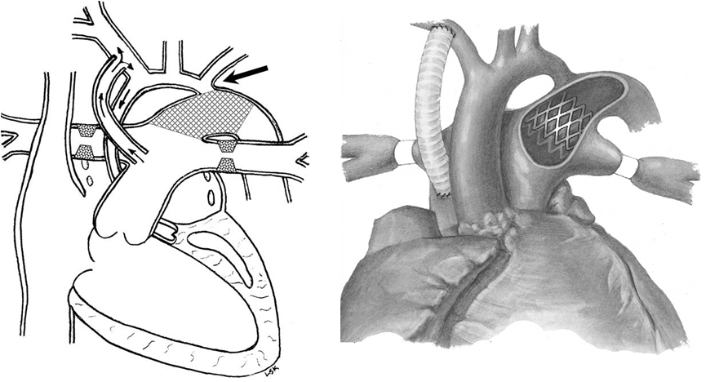
Hybrid Stage I with Reverse Shunt
For development of preductal retrograde coarctation in aortic atresia

Slide 57
RV-PA shunt in biventricular repair
RV-PA shunt is potential alternative to BT shunt.
  extensive use in HLHS, higher diastolic BP, greater resistance to physiologic insults, improve outcomes, particularly in low Bwt
  palliative RV-PA conduit in biventricular hearts with MAPCAs, to encourage growth of diminutive central PAs .
Advantages of RV-PA shunt
  proximal shunt location in abnormal aortic arch branching
  PBF occurs only during cardiac systole; diastolic runoff resulting in lower diastolic and coronary perfusion pressure does not occur.
  larger shunt than BT shunt : decrease shunt stenosis.
  lower risk of interstage mortality than BT shunt

Slide 58
RV-PA shunt in biventricular repair
Disadvantages of RV-PA shunt
  Use of CPB without ACC, short period of cardiac arrest for proximal anastomosis to avoid air embolism
  Ventriculotomy
  Risk for sudden death
Exclusion criteria : important coronary artery crossing RVOT
In complex biventricular heart, it is applicable in low birth weight neonates with abnormal aortic arch branching.
Partial clipping of shunt with subsequent balloon dilation to prolong palliation.
Patients who will have ventriculotomy for RV-PA conduit.

Slide 59
RV-PA shunt in biventricular repair
Primary complete repair is now the preferred approach to many heart defects in neonates and infants.
Early complete repair remains a challenge in TOF with PA, TOF with AVSD, and TGA with PA.
TOF
  Excellent results for early primary repair of TOF.
    Infants with TOF underwent palliation in 62% (STS) and 70% (EACTS).
  TOF with PA is a significant risk factor for reoperation and death
    Early or late mortality occurred in 19%
    Initial palliation with shunt is used in all TOF with PA.

Slide 60
RV-PA shunt in biventricular repair
TOF with AVSD
  TOF with AVSD have not generally undergone repair in early infancy.
  Mean age at repair was 3.5 to 4.5 years, with the youngest patients to undergo complete repair ranging from age 5 months to 1.5 years.
  In TOF with AVSD, initial palliation with shunt in 55% to 82%.
Other indications for RV-PA shunt
  Hypoxia early after shunt - Need for additional shunt
  Need for large shunt in older child or adult
  Need for shunt in progressive AR

