Slide 1
Pulmonary Atresia Intact Ventricular Septum
Yun Hee Chang
Division of Pediatric Cardiac Surgery
Department of Thoracic & Cardiovascular Surgery
Seoul St. Mary’s Hospital, Catholic University of Korea

Slide 2
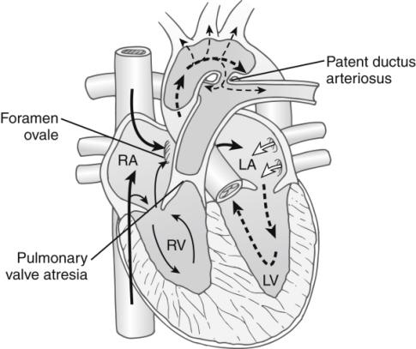
Anatomy and Pathophysiology
Definition
- Isolated atresia of right ventricular outlet
Characteristics
- Striking heterogeneity of RV
Partitioning; inlet, trabecular, outlet
Functional size of RV
- Peculiar coronary artery circulation

Slide 3
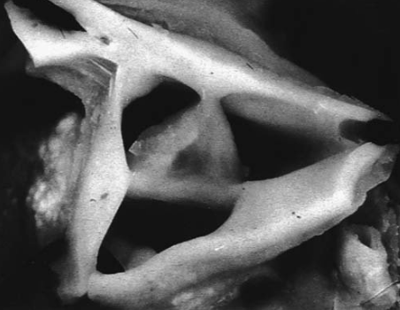
Pulmonary Valve
Sinus valsalva : often normally formed
PV cusps : fused along their usual lines of separation
often quite thickened
sometimes cartilaginous

Slide 4
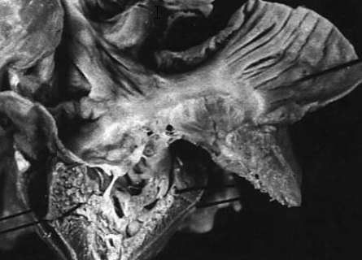
Tricuspid Valve
Nearly Normal Tricuspid Valve

Slide 5
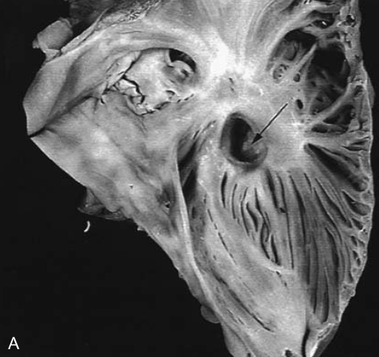
Severely stenotic tricuspid valve

Slide 6
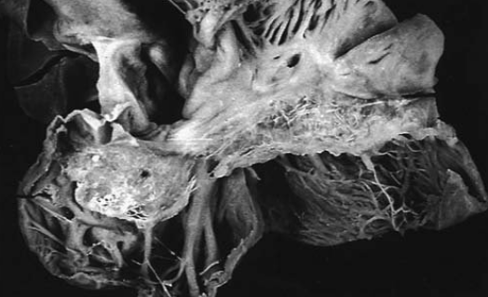
Severely Dysplastic Tricuspid Valve

Slide 7
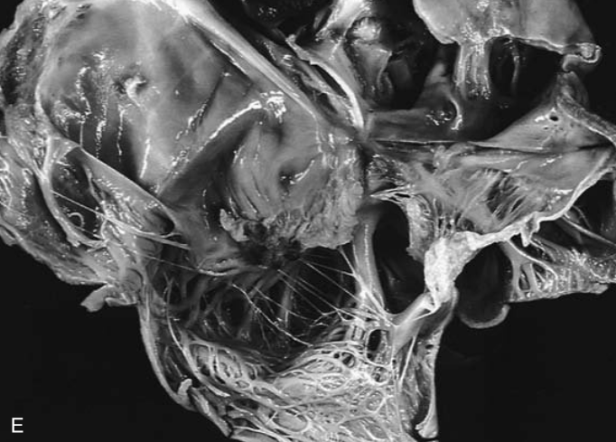
Ebstein’s Anomalies of Tricuspid Valve

Slide 8
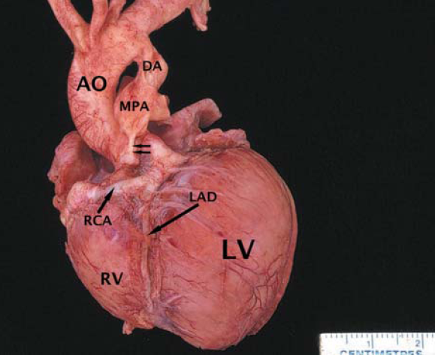
Right Ventricle
Varying degree of RV hypoplasia
[Tripartite] Inlet+trabecular+outlet
[Bipartite] Inlet+outlet, inlet+trabecular
[Monopartite] Inlet

Slide 9
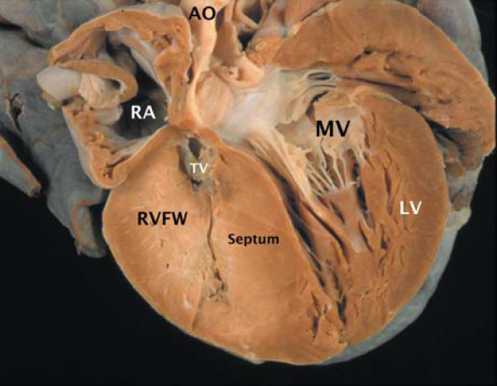
Varying degree of RV hypertrophy
- RV cavity size is reduced
- Suprasystemic RV pressure
- Rapid progression of RV endocardial fibroelastosis

Slide 10
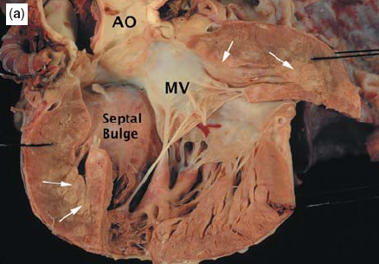
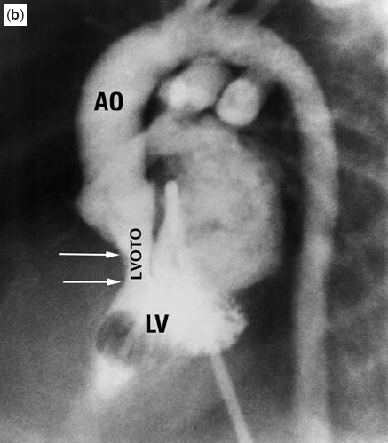

Slide 11
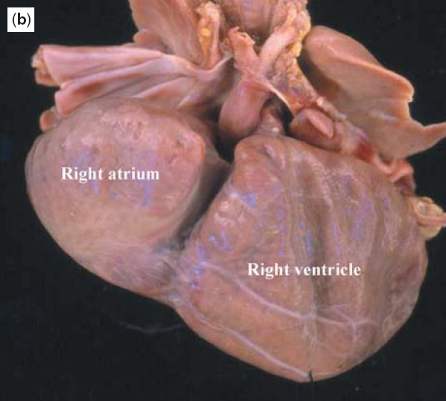
Thinned & Dilated RV

Slide 12
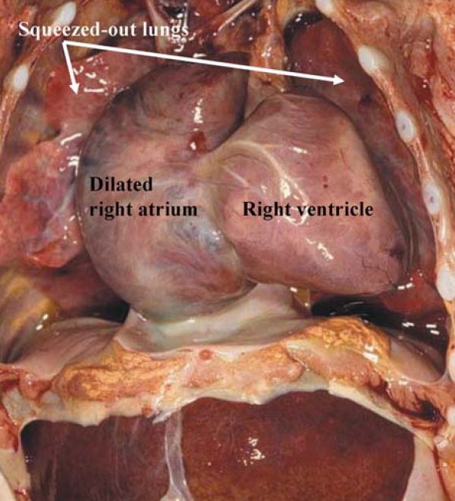

Slide 13
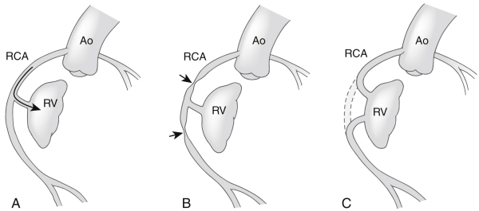
Coronary artery abnormalities occur in 30 – 60%
Fistula alone
RV streal phenomenon
Fistula plus stenoses steal or ischemia
Fistula plus interruptions isolation & infarction

Slide 14
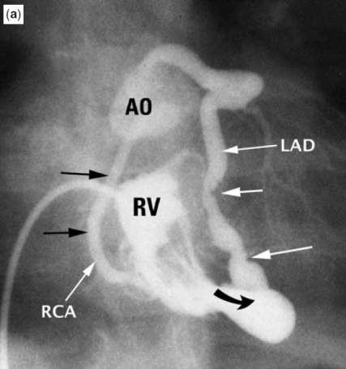
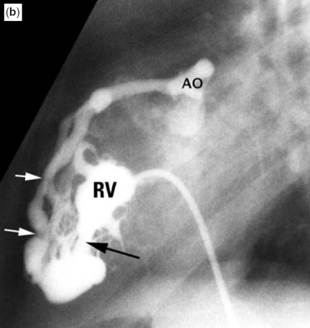
Fistulae with stenoses

Slide 15
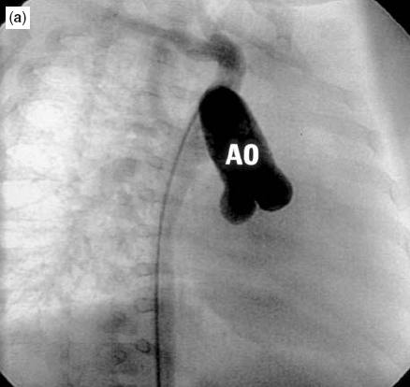
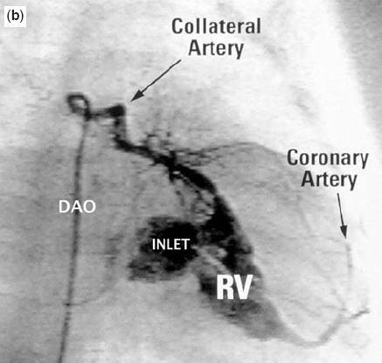
Atresia of the aortic orifices of both coronary arteries

Slide 16
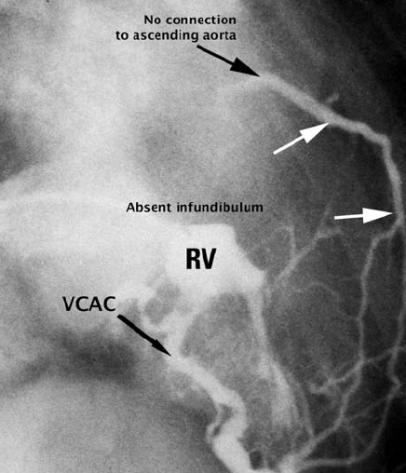
Atresia of the aortic orifices of left coronary arteries

Slide 17
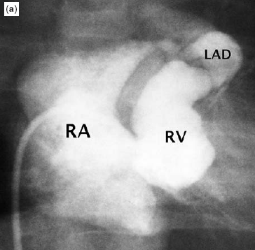
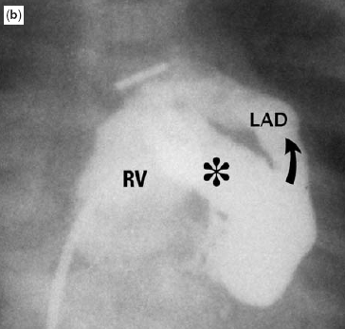
Massive coronary arterial – to – right ventricular fistulas

Slide 18
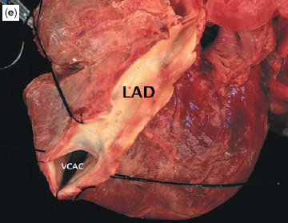

Slide 19
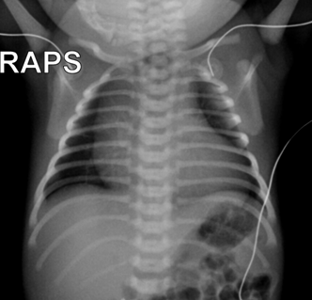
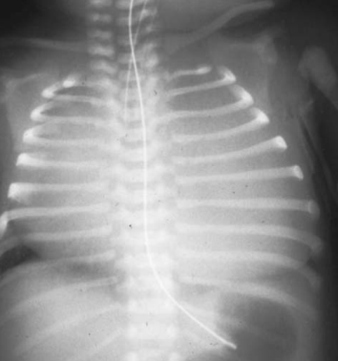
Clinical Features
Cyanosis and hypoxemia coincident with functional and anatomic closure of Patent Ductus Arteriosus
Chest Radiograph
- Heart is mildly enlarged or fills the entire chest cavity

Slide 20
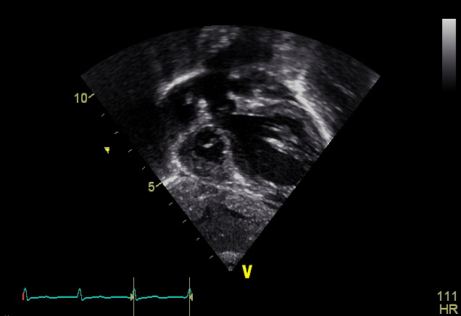
Echocardiographic Features
Severe RV hypoplasia

Slide 21
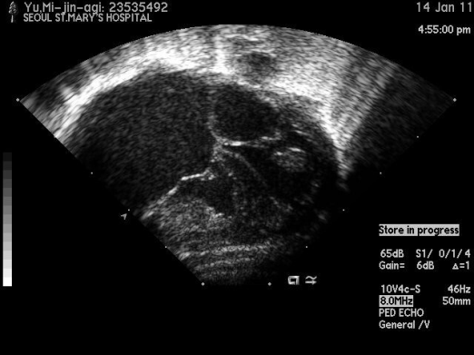
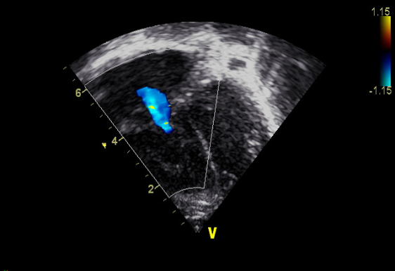
Mild RV hypoplasia

Slide 22
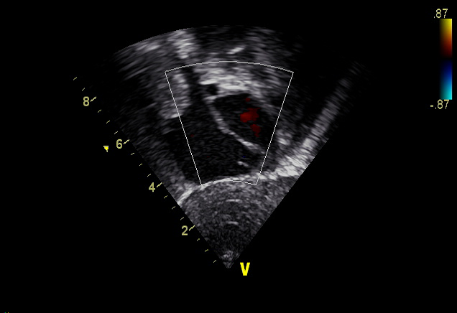
Right to Left shunt Through Patent Foramen Ovale

Slide 23
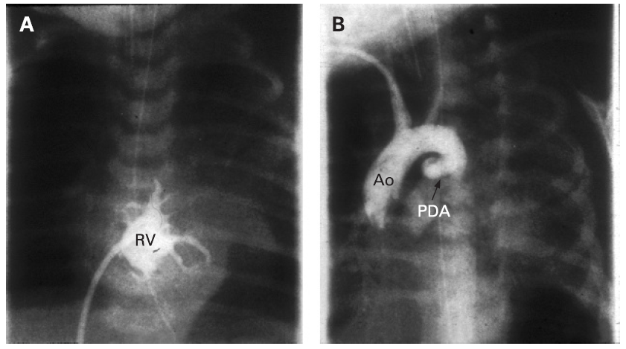
Angiographic Features

Slide 24
Surgical management
Parameter/Surgical Management | Degree of Right Ventricular Hypoplasia
 | Mild | Moderate | Severe
Tricuspid Z- value | > - 2 | -2 to -4 | < -4
RV Morphology | Tripartite | Bipartite | Unipartite
Infundibular Cavity | Present | Intermediate | Absent
RV dependent Coronary circulation | Rare | Possible | Common
Surgical Palliation | Trans-annular patch ± shunt | * Trans-annular patch + shunt | Shunt only
Definitive Operation | Two-ventricle repair | § Two – ventricle repair, 1 & ½ ventricle repair | Fontan
* No RV decompression of RV dependent coronary circulation
§ Fontan of RV dependent coronary circulation

Slide 25
Initial Palliation
The purpose
- Relief of ductal dependency by providing a reliable source of pulmonary blood flow
- Establishing antegrade blood flow to promote the growth of the right side of the heart

Slide 26
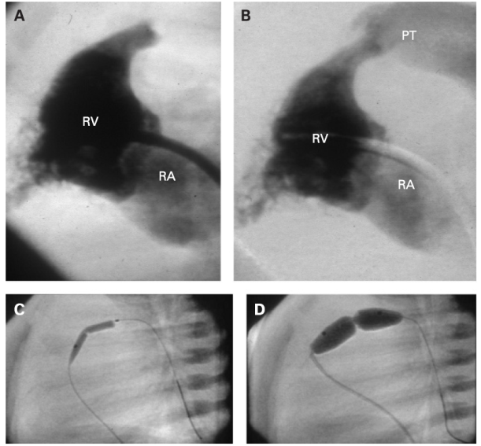
Trans-catheter pulmonary valvotomy

Slide 27
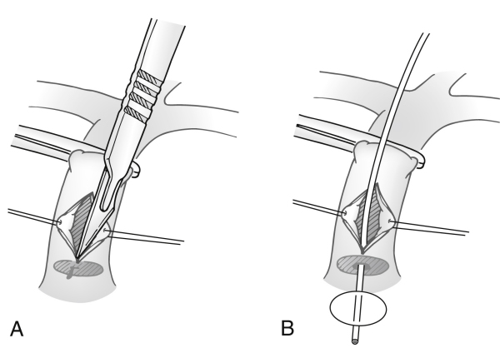
Open pulmonary valvotomy

Slide 28
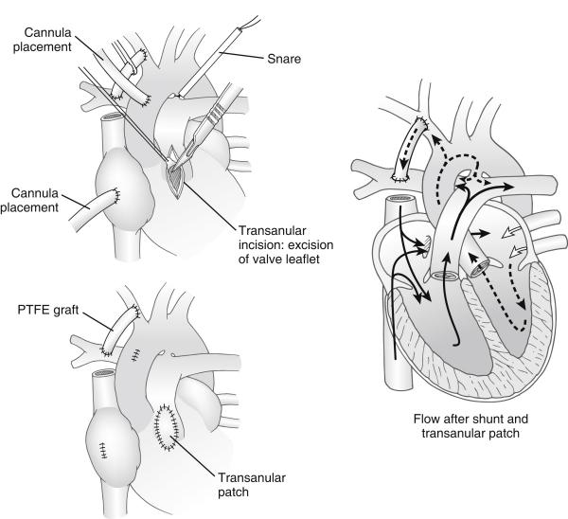
Trans-annular patch AND/OR
systemic-to-pulmonary artery shunt

Slide 29
Definitive Procedures
Two- ventricle Repair

Slide 30
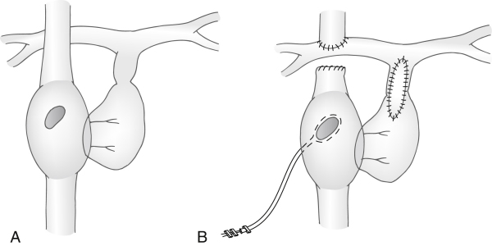
One- and –a- half Ventricular Repair

Slide 31
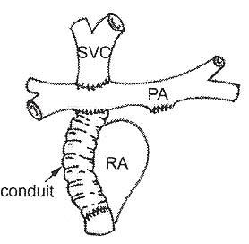
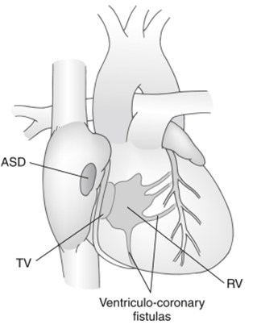
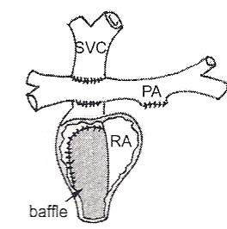
One- Ventricle Repair

Slide 32
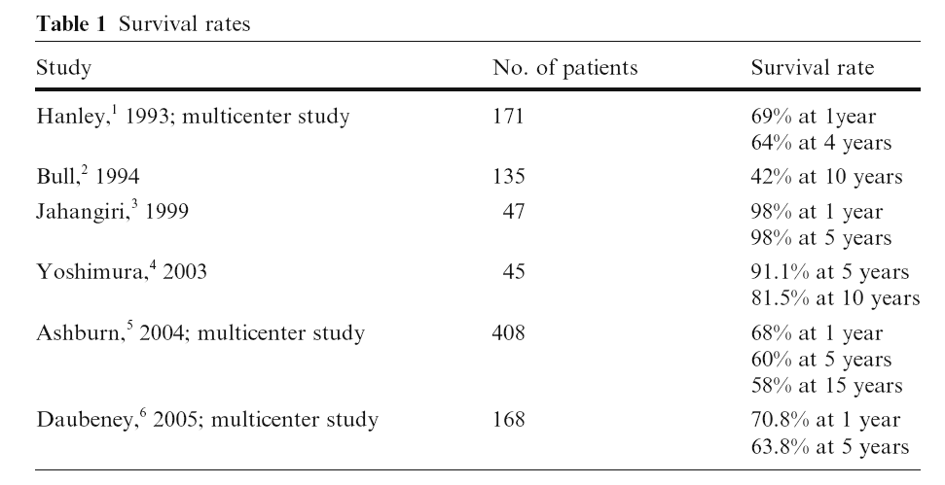
Surgical Outcomes

