Slide 1

Mitral Valve:
When and How to repair and replace?
June 2nd, 2011
Kyung-Hwan Kim, MD, PhD
Department of Thoracic and Cardiovascular Surgery
Seoul National University Hospital, Seoul, South Korea

Slide 2
Contents
Surgical anatomy of mitral valve
Valve repair in primary MR including ring annuloplasty
  Mainly in Degenerative
Role of valve replacement in MR
Valve replacement in MS
Prosthetic valve
Summary
Notes:
The contents I will cover today is from surgical anatomy through various valve repair to outcome and conclusions.

Slide 3
Mitral Valve Anatomy related to Repair Concept

Slide 4
Notes:
Annulus is the hinge point of MV and has 3-d structure with the trigone and commissure being the most lowest part. Fibrous annular tissue exists only along posterior leaflet and there is no annulus fibrosus in the ant leaflet.

Slide 5
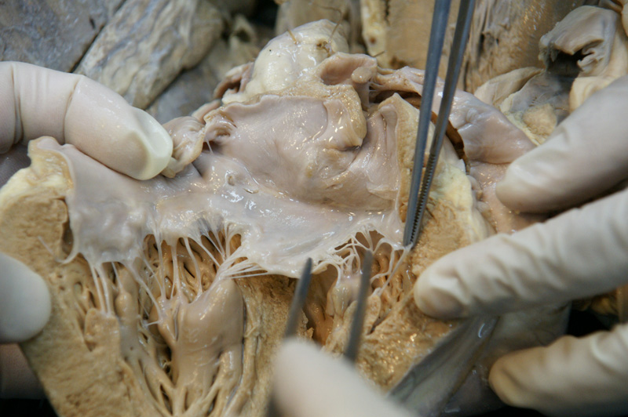
수술장 사진 추가
Notes:
Mitral valve is located btw LA and LV surrounded by left circumflex a and coronary sinus posteriorly. And aortomitral curtain with His bundle anteriorly. You can see the location of AMVL and aortic valve.
Mitral valve is a very complex structure and consists of annulus leaflet chordae and papillary m. it is not an isolated structure but part of the left ventricle. You can see the trigones and commissures in autopsy heart.

Slide 6
Notes:
Mitral valve annulus 의 plane 은 aortic valve annulus 와 120도 정도의 각을 이루는데, 이렇게 함으로써 left ventricle inflow chamber 로 혈액이 잘 쏟아져 들어올 수 있도록 하게 됩니다.

Slide 7
The Valve Reconstruction Paradox
Although recognized as the preferred technique in mitral and tricuspid valve surgery, valve reconstruction is used in only 35% of patients worldwide, whereas in select institutions, it is used in 95% of patients.
Alain Carpentier
Notes:
The contents I will cover today is from surgical anatomy through various valve repair to outcome and conclusions.

Slide 8
Preliminary Conditions for Valve Repair
Surgeon should be psychologically and technically prepared to carry on a valve reconstruction.
Surgeon should understand the difference between “palliative techniques” and “reconstructive techniques”.
Notes:
The contents I will cover today is from surgical anatomy through various valve repair to outcome and conclusions.

Slide 9
1957-1965 Palliative Techniques
Notes:
Historically, many surgeons tried to repair MV with various methods.
It is quite surprising that these old techniques are still being used by quite a lot of surgeons.

Slide 10
1983-Reconstructive Valve Surgery
Three Fundamental Principles
Preserve or restore free leaflet motion
Create large surface of coaptation
Remodel the annulus
A. Carpentier. JTCS 1983;86(3):323-37
Notes:
The contents I will cover today is from surgical anatomy through various valve repair to outcome and conclusions.

Slide 11
Reconstructive Valve Surgery Results
Freedom from reoperation :
  Degenerative valve ds : 93% at 25 years(LR:0.5%/pt/yr)
  Ischemic valve ds : 75% at 10 years
  Rheumatic valve ds : 50% at 25 years(LR:2.1%/pt/yr)
Freedom from hemorrhage and TE
  Hemorrhage: 98% freedom at 15 years
  Thromboembolism : 94% freedom at 15 years
Braunberger. Circulation 2001
Notes:
The contents I will cover today is from surgical anatomy through various valve repair to outcome and conclusions.

Slide 12
Valve Reconstruction Made Simple
Proceed to comprehensive valve analysis
Valve analysis – Pathological Triad
  Etiology : Cause of disease
  Lesions : Resulting from the disease
  Dysfunction : Resulting from the lesions
Notes:
The contents I will cover today is from surgical anatomy through various valve repair to outcome and conclusions.

Slide 13
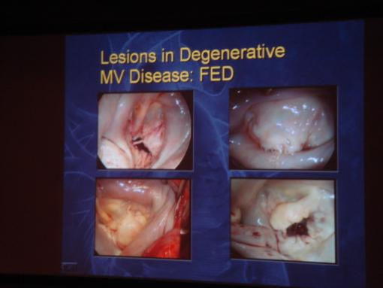
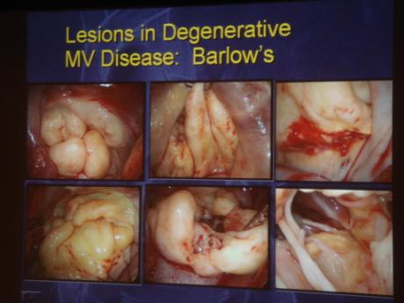
Etiology of MR
Primary MR:
  Degenerative
    Fibroelastic deficiency(FED)
    Barlow ds(billowing valve)
    Marfan
  Endocarditis
  Rheumatic
  Calcified valve
Secondary MR : problem of LV
  Ischemic
  DCMP
Notes:
Etiology of MR is primary and secondary.
Secondary MR is problem of LV: ischemic or DCMP.
Due to time limitation, I would like to focus on the aspects of primary MR: degenerative, ….
Degenerative MR has two definite etiologies: FED and Barlows ds, the myxomatous degeneration.

Slide 14
Age < 60 yrs
Long history of murmur > 5 yrs
Excess of tissue
Billowing valve
Myxoid degeneration
Barlow 1965
Age > 60 yrs
Brief history of murmur (few yrs)
No exccess of tissue
No billowing
Collagen, elastin degeneration
Carpentier 1974
JTCS 1980;79(3):338-48
Notes:
Etiology of MR is primary and secondary.
Secondary MR is problem of LV: ischemic or DCMP.
Due to time limitation, I would like to focus on the aspects of primary MR: degenerative, ….
Degenerative MR has two definite etiologies: FED and Barlows ds, the myxomatous degeneration.

Slide 15
Natural Course of MR
Annual mortality of asymptomatic MR
  6.3%/yr
  After 10yr : 90% died
Occult LV dysfn frequently predates symptoms in severe MR
Medical Tx can produce
  Congestive heart failure
  Atrial fibrillation
  Need for surgery
  Death
Notes:
Natural course of MR is very malignant.
Annual mortality of asymptomatic MR is 6%, and after 10yrs, 90% dies from this disease.
Frequently, occult LV dysfn appears earlier than subjective symptoms in severe MR.
Medical Tx has a limited role and therefore, surgery is necessary to solve this problem.

Slide 16
Benefits of MV repair over MVR
Preservation of own valve within heart
No need of anticoagulation
Lower risk of prosthetic infection
Lower risk of LV rupture – a fatal complication of MV replace
  Resection of subvalvular structure during MVR : a risk factor
    J Heart Valve Dis 2008;17:42-47
Notes:
Although valve replacement was the main therapy (20 years ago), nowdays the standard treatment has changed to valve repair.
Benefits of repair over replacement is….
Preservation of own valve within heart
No need of anticoagulation
Lower risk of infection and LV rupture – a fatal complication of MV replace.

Slide 17
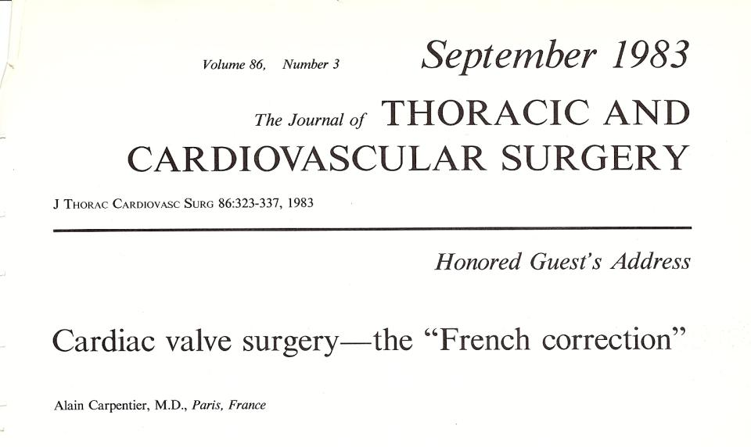
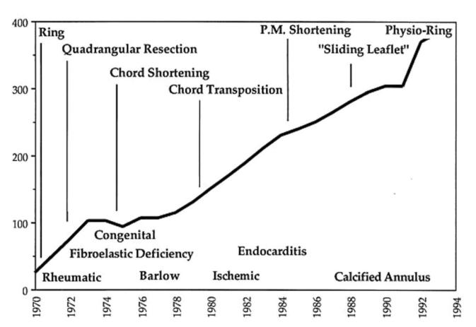
Excellent Contribution
Notes:
Dr Alain Carpentier had developed MV reconstruction and it had been accepted widely by most surgeons.
In 1983, he addressed such technique as French correnction in American Meeting.
He invented many useful techniques including the annuloplasty rings.

Slide 18
For Adequate Repair…
Excellent exposure of MV
Adequate valve analysis
Repair using reproducible techniques, one lesion-one technique
Saline test for valve leakage
TEE confirmation
Notes:
For adequate repair, following items are essential.
Excellent exposure of MV
Adequate valve analysis
Repair using reproducible techniques, one lesion-one technique
Saline test for valve leakage
TEE confirmation

Slide 19
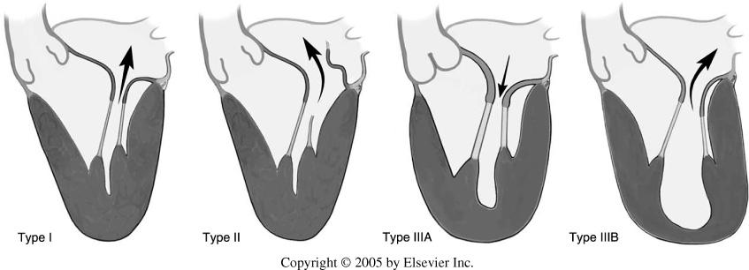
Carpentier’s Classification(by Echo – Functional Classification)
Type I : normal leaflet motion, annular dilatation, leaflet perforation
Type II : leaflet prolapse, papillary or chordae rupture, leaflet redundancy
Type IIIa : restricted leaflet opening, restricted leaflet during cardiac cycle d/t rheumatic change
Type IIIb : restricted leaflet closure, restricted leaflet during systolic phase d/t papillary muscle displacement
Notes:
We evaluate MR according to Carpentier’s classification.
Type I : annular dilatation
Type II : papillary or chordae rupture, leaflet redundancy
Type IIIa : restricted leaflet during cardiac cycle d/t rheumatic change
Type IIIb : restricted leaflet in ischemic MR

Slide 20
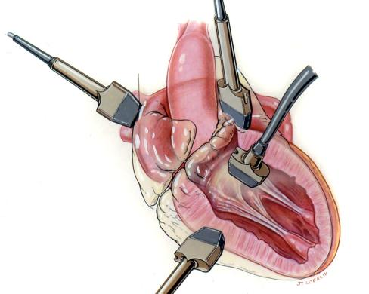
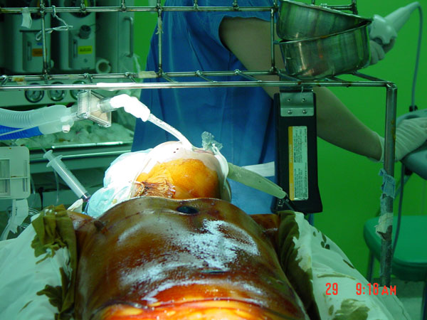
Use of TEE

Slide 21
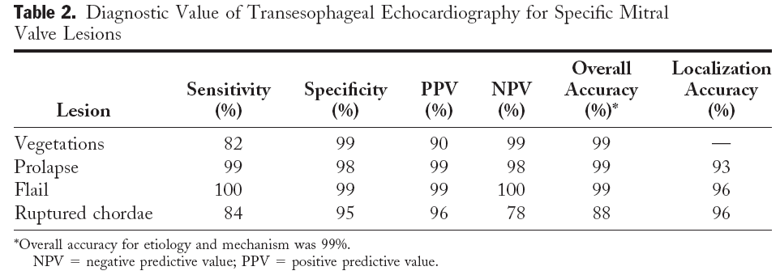
MV Repair and Use of Intraoperative TEE
Intraoperative real time visualization
Identified lesion on TEE is related to surgical outcome.
(JACC, 1999;34:1129-36)
Notes:
When we repair MV, TEE should always be prepared in operating room.
Role of intraoperative TEE is priceless. And identified lesion on TEE is related to surgical outcome.

Slide 22
Notes:
정상적인 mitral valve 는 atrial side 에서 보았을 때 닫혀 있을 때 kidney shape 를 띠며 leaflet 은 fully mobile 하고, coaptation surface 가 충분히 넓으면서 free edge 가 annulus 보다 낮은 높이에 위치합니다.

Slide 23
Prolapse or Billowing?
Notes:
The contents I will cover today is from surgical anatomy through various valve repair to outcome and conclusions.

Slide 24
Valve Reconstruction Made Simple
Proceed to valve reconstruction in an organized manner
  Confirm valve dysfunction using the functional classification
  Identify the lesions
  Correct all the lesions according to the One Lesion One Technique Principle
Notes:
The contents I will cover today is from surgical anatomy through various valve repair to outcome and conclusions.

Slide 25
1. Confirm valve dysfunction: Assessing pliability, Assessing motion by Reference Point Method

Slide 26
2. Identify the lesions
Intraoperative valve analysis: Lesions
Type I : Annular distension, leaflet perforation
Type II : Chordae rupture, chordae elongation
Type II : Papillary m rupture, papillary m elongation
Type IIIa : Commissure fusion, subvalvular thickening
Type IIIb: Myocardial infarction, ventricular dilatation
  3. Correct all the lesions
  according to the One Lesion One Technique Principle
Notes:
The contents I will cover today is from surgical anatomy through various valve repair to outcome and conclusions.

Slide 27
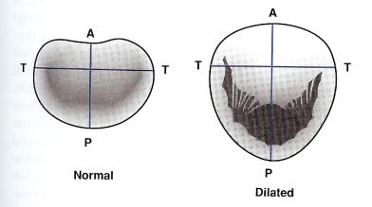
Mitral Ring Annuloplasty
Use of prosthetic rings to remodel(refashion) annulus, which is invariably distorted, distended, and eccentric
Remodeling concept by Carpentier(1969) and Duran: Distorted annulus requires restorative structural support
  ⇓ tension on suture lines
  ⇑ leaflet coaptation
  Prevent recurrent dilatation
Sizing, placement, and fixation are keys to remodeling the annulus

Slide 28
Annulus
Part of fibrous skeleton
  firmest in aortomitral fibrous continuity
Not a simple circumferential fibrous ring !
  flexible and changes shape
  Can reduce in size by 20 – 40%
3-D saddle shape
  Curvature reduces mechanical stress on the leaflets

Slide 29
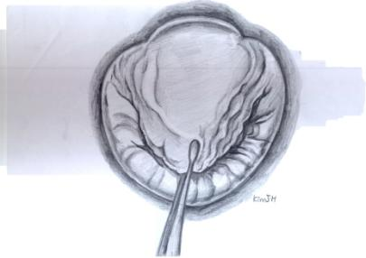
Fibrous Trigone
Part of cardiac skeleton, intimately related to ant annulus, contiguous with AoV curtain
Anchoring points for ring annuloplasty

Slide 30
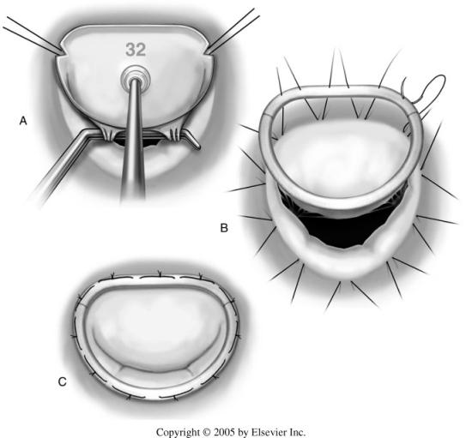
Ring Sizing Easily and Rationally
Intercommissural distance
> Intertrigonal distance
Ant leaflet size or height
  Free edge of the leaflet must not extend more than 1mm beyond the inferior edge of the sizer

Slide 31
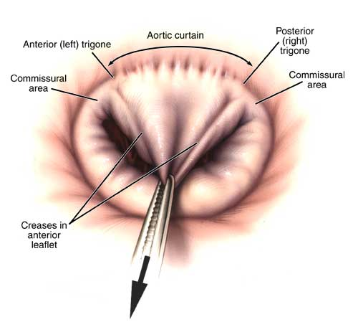
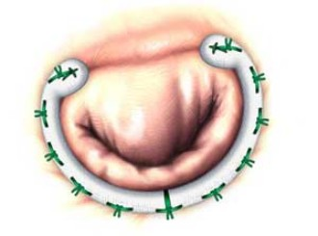
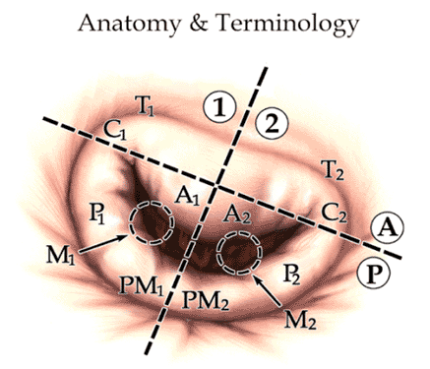
Where is trigone?

Slide 32
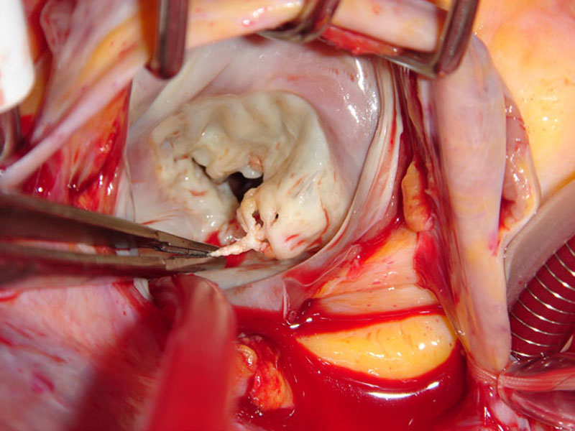

Slide 33
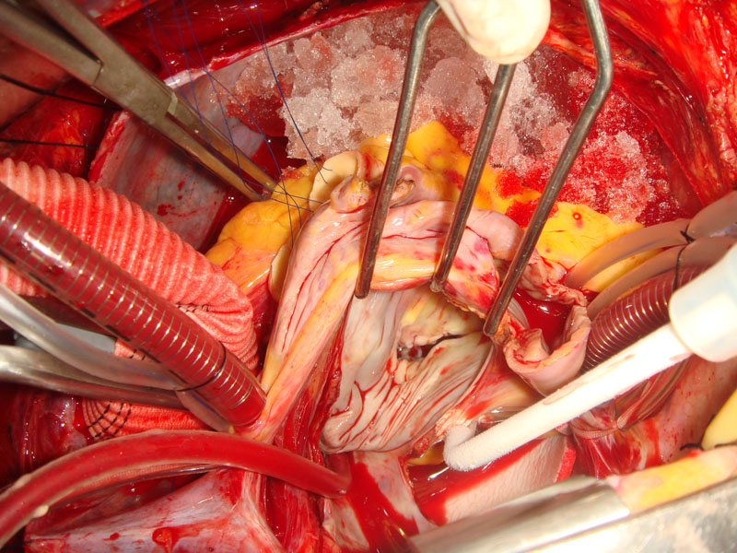
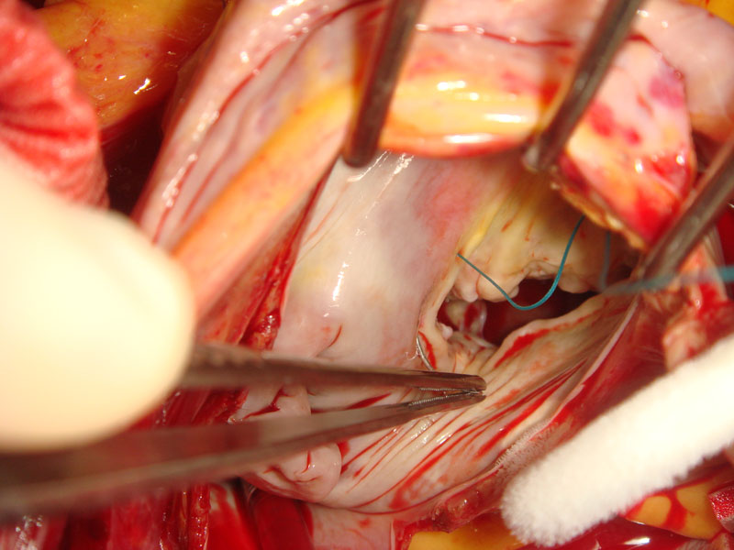

Slide 34
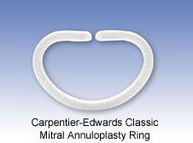
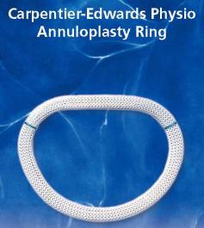
Rings for MR : Etiology-specific
General classification
  Full ring
  Partial C ring
  Totally flexible ring
  Totally rigid ring
Commercially available mitral rings
  Carpentier rings : classic, physio I/II, Myxo
  Duran rings : flexible, ancore
  Cosgrove ring
  St. Jude Seguin ring
  IMR ring(ischemic MR)
1968
1992
Notes:
Various rings are available and they have etiology specific design.

Slide 35
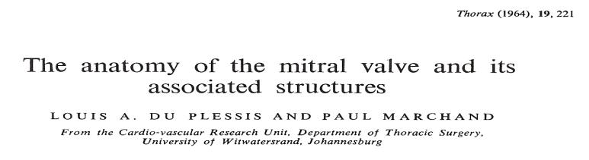
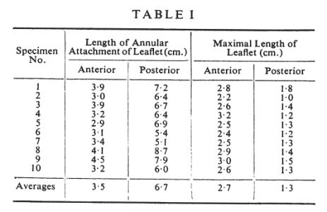
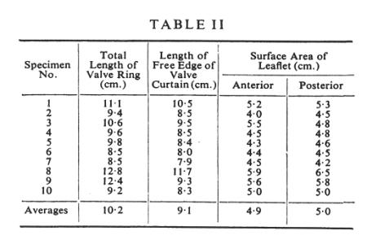
  10 normal cadaveric heart specimens
Annular attachment ~ Ant : post = 3.5 : 6.7 ( 1 : 1.9 )
** Trigone : the others = 1 : 2.1-2.3
Notes:
This is valuable old report.
In MV annulus, ant to post ratio is usually 1:1.9 and trigone to the others is 1: 2.1.
Most rings are designed according to this principle because post annulus is usually dilated in degenerative MR.

Slide 36
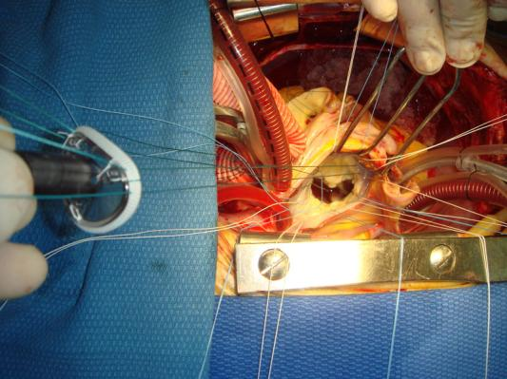
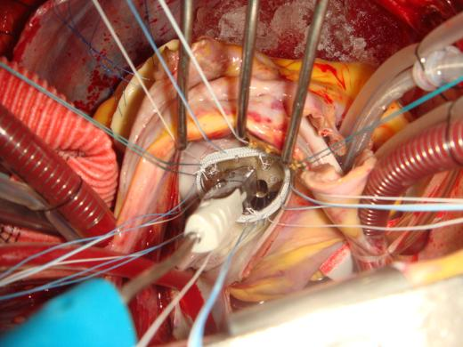
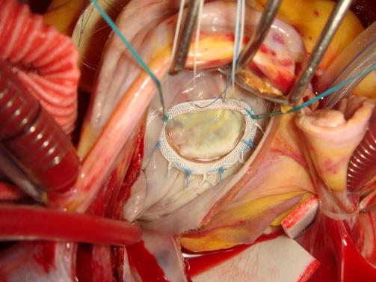
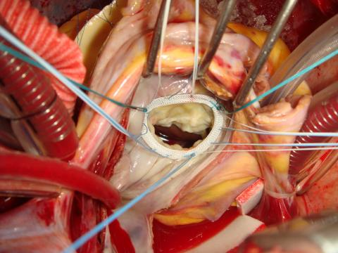

Slide 37
Ring for Ischemic MR
A ring for asymmetric MR
Notes:
Rings for ischemic MR is quite different.
In type IIIb MR, P3 portion is usually dilated, so asymmetric ring is useful for this type of lesion.

Slide 38
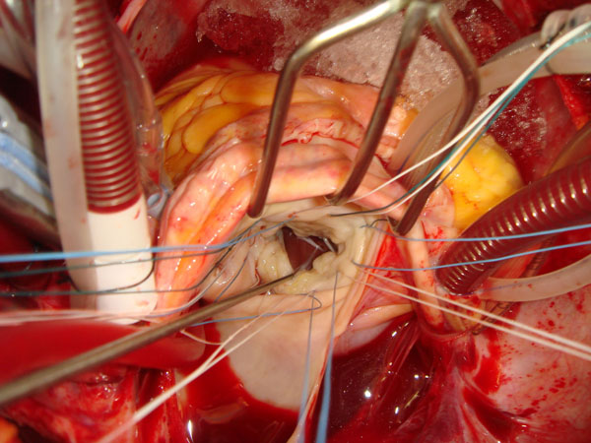
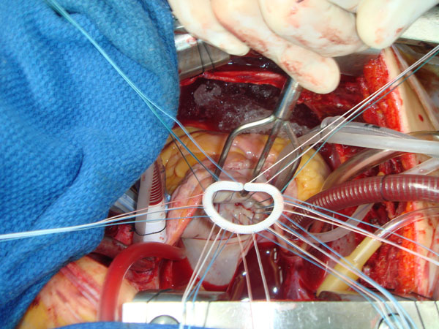
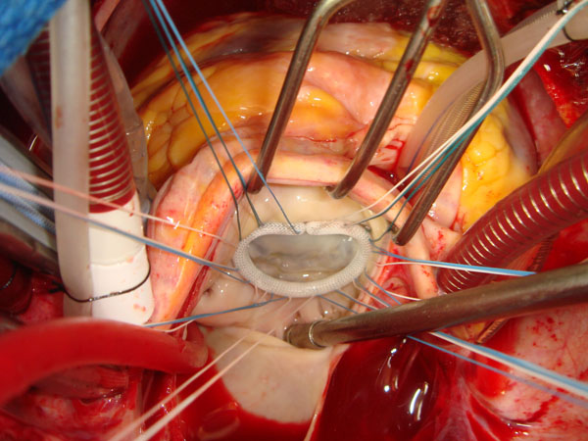
Notes:
Asymmetric ring is not availble in Korea, so
I use a downsized - classic Carpentier ring to acheive annular reduction.

Slide 39
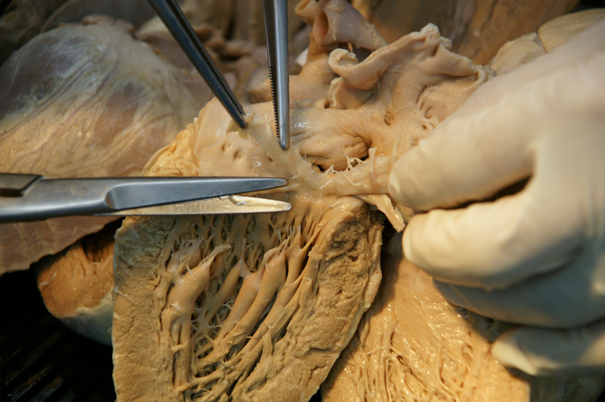
Annulus and Circumflex a

Slide 40
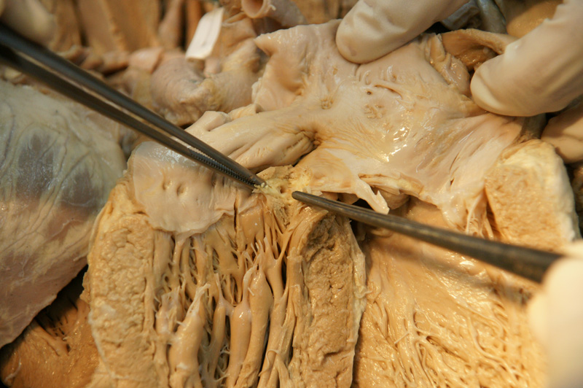
P1-P2 area

Slide 41
Paramount Importance
Requirement that the plane of the needle bite should be orthogonal to the annular plane.
If this is done, it is impossible for the stitch to impinge or distort the circumflex artery.

Slide 42
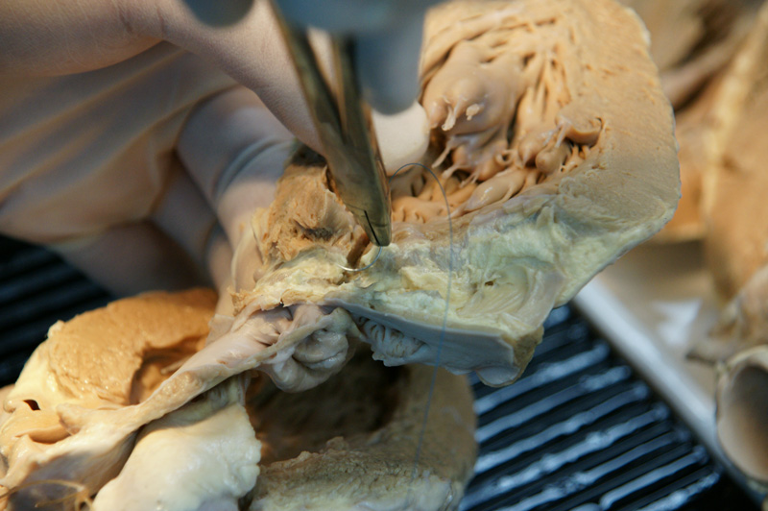
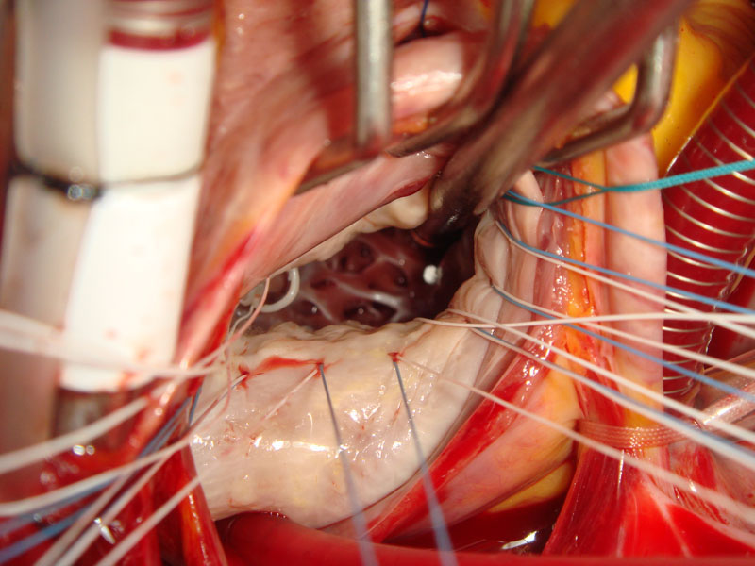

Slide 43
Annuloplasty Sutures
Sutures are placed outside(toward the atrium) of the leaflets and the repair region.
Difficult stitches(pericommissural) might be facilitated by pulling down previously placed stitches using an overhold clamp.
Lift up the suture, check it is annulus or not!

Slide 44
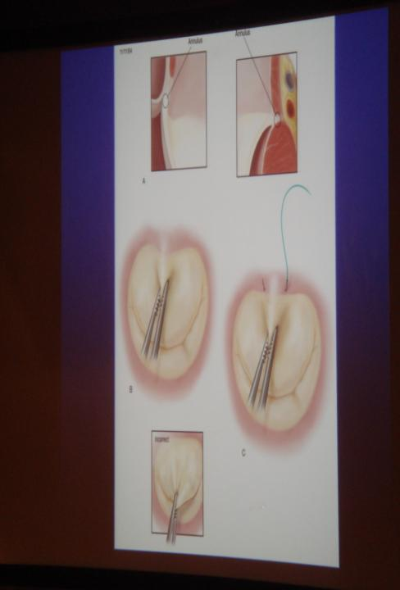
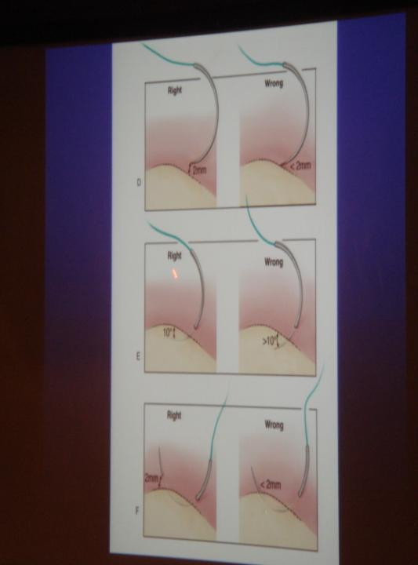

Slide 45
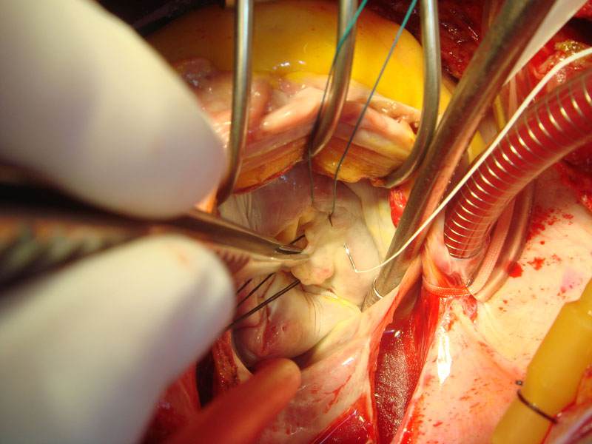

Slide 46
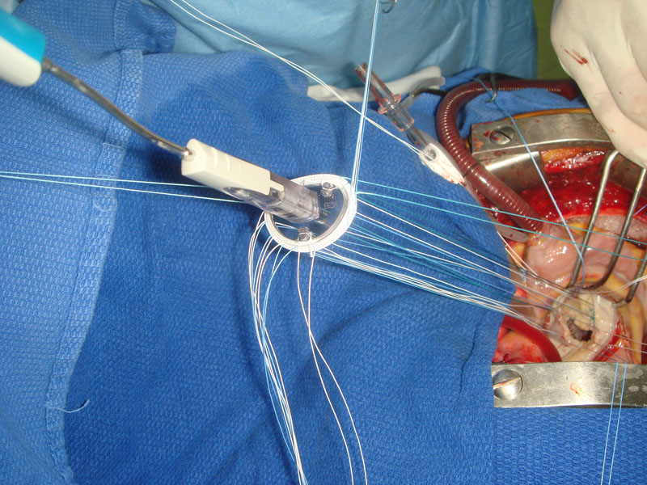
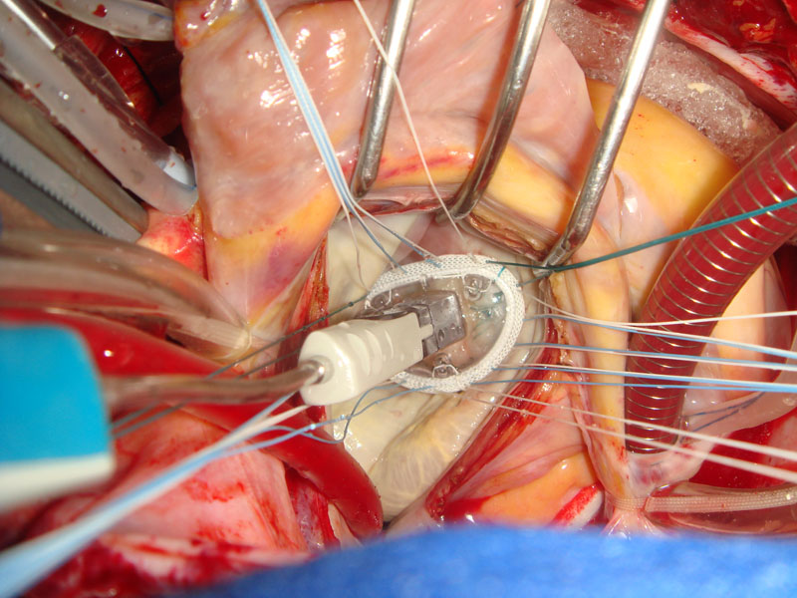
Suture & Tie order:
Both commissures
P2 area
Posterior annulus
Anterior annulus
Mirroring
MR test
6
1
2
5
4
3

Slide 47
Techniques of MV Repair
Ring annuloplasty
Quandrangular/Triangular resection and (annular plication)
Sliding annuloplasty
Chordae shortening / transposition / transfer
Artificial chordoplasty
Paracommissural obliteration / sliding
** One lesion, one technique!!
Notes:
These are techniques in MV repair.
I am going to present some cases which show each technique.
All surgeons should keep in mind the principle, “one lesion one technique.”

Slide 48
For Posterior MV Prolapse…
Quadrangular resection, annular plication
Triangular resection
American correction
Chordae transfer
Chordae shortening
Artificial chordoplasty
Notes:
For posterior MV prolapse
Q resection with annular plication is well known technique
Triangular resection and other techniques can be used.
This is Q resection with annular plication.

Slide 49
Sliding Annuloplasty Avoiding SAM
Notes:
If posterior leaflet is tall and has abundant tissue, we do sliding annuloplasty to avoid SAM.
This is quite rare in Korean, because most patients in deg MR have FED etiology.

Slide 50
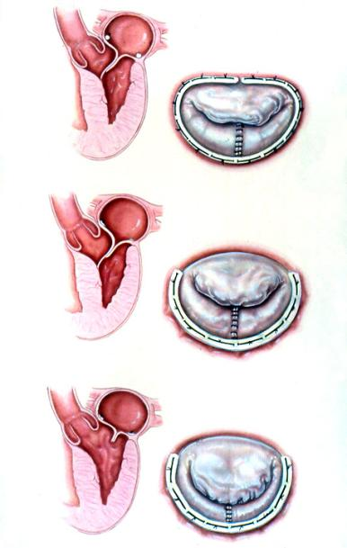
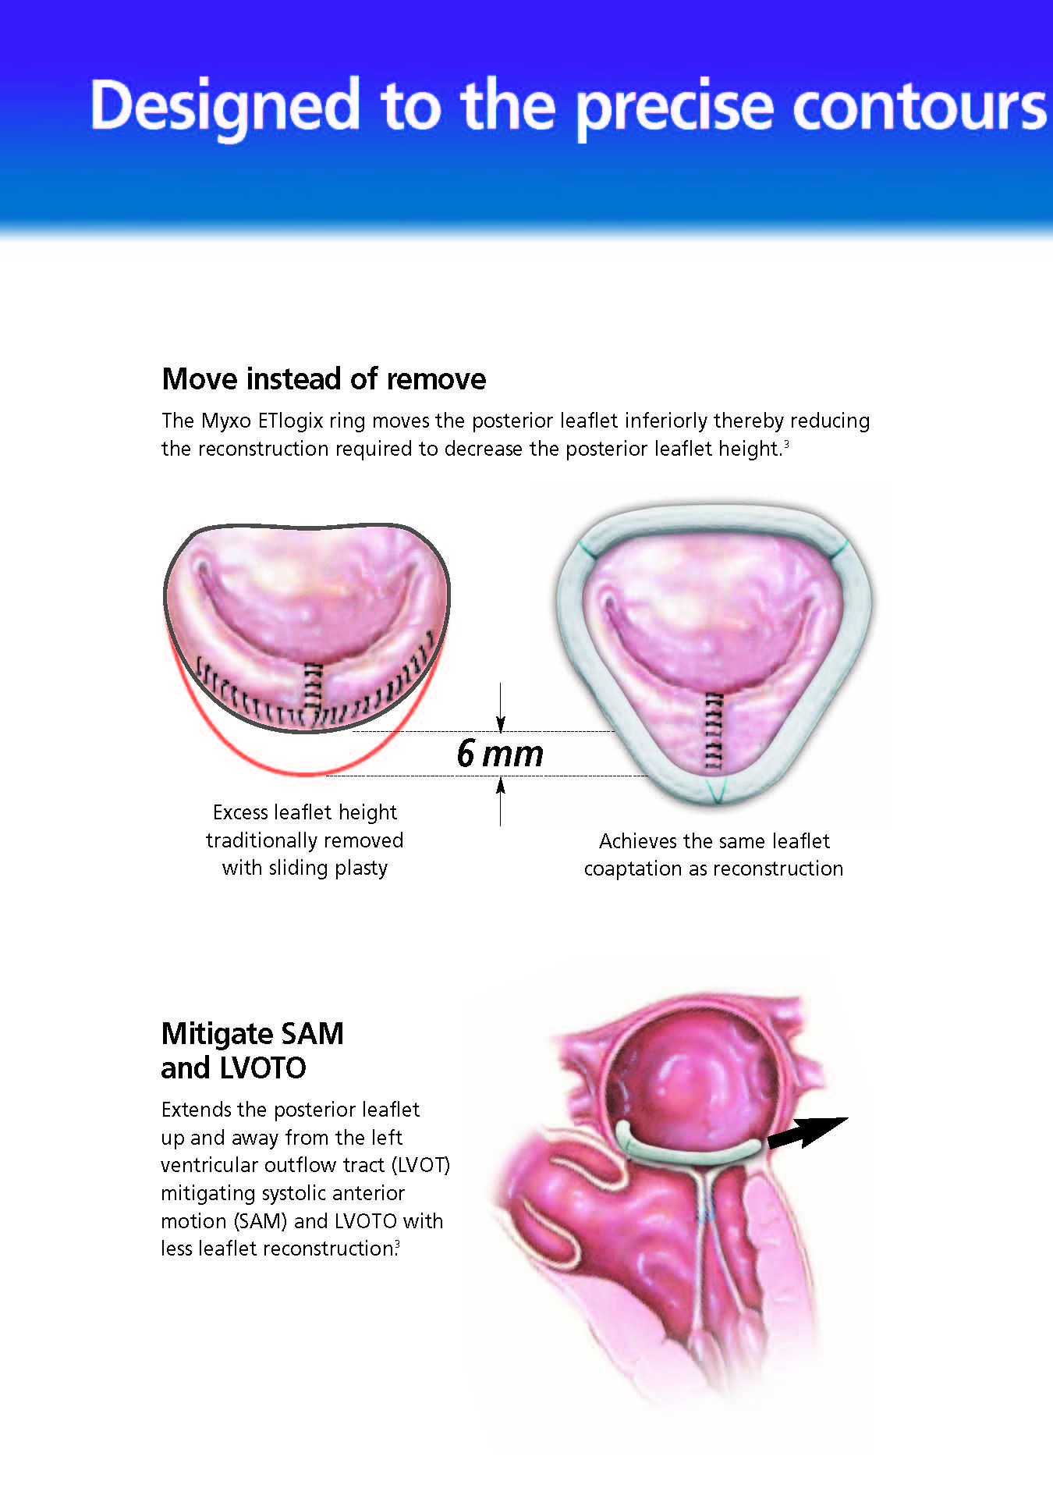
SAM(Systolic Ant Motion)
Two principal mechanisms
  Residual posterior leaflet is left too tall such that it displaces ant leaflet into LVOT → sliding annuloplasty
  Annuloplasty ring is smaller than the surface area of ant leaflet, potentially forcing excess tissue into outflow tract→ true-sized ring to ant leaflet

Slide 51
How to reduce SAM??
1. Sliding annuloplasty
2. Reduce ant leaflet
3. Avoid downsizing of ring
4. Flexible ring, Myxo ring?
….
None of this has been studied in a prospective randomized fashion.
  : Gillinov et al. ATS 2000;69:717

Slide 52
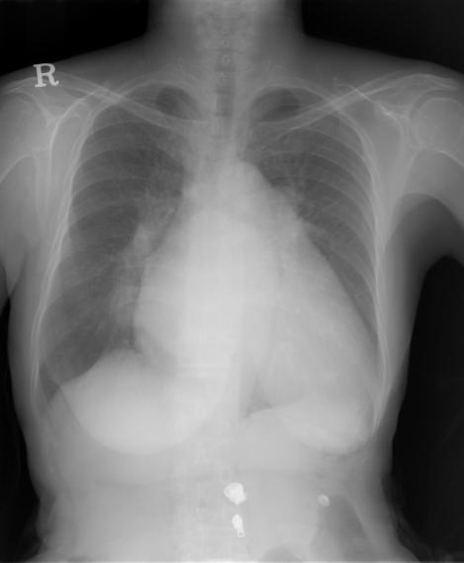
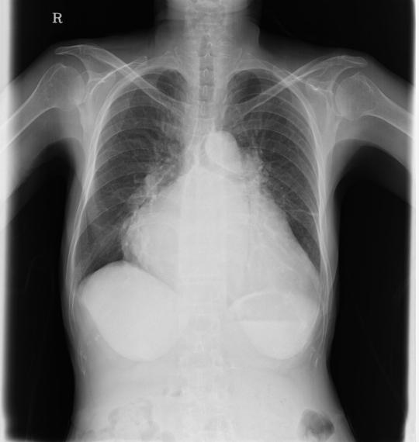
Case : F/75, Chronic MR(P2 prolapse)
Apr, 2006
Apr, 2010
Notes:
This 75 yr old female had chronic MR since 2000 with huge cardiomegaly.
She decided to have op due to Sx aggravation.
Preop echo shows severe MR.

Slide 53
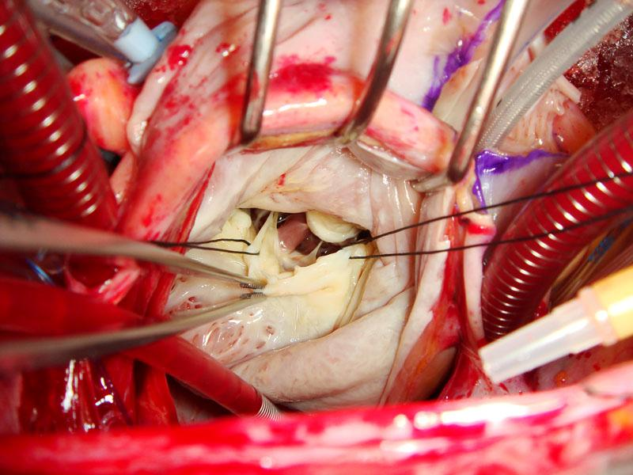
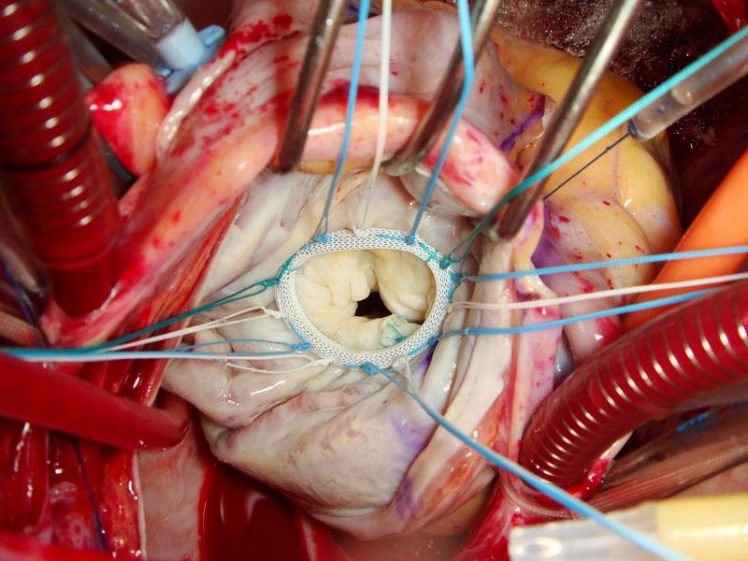
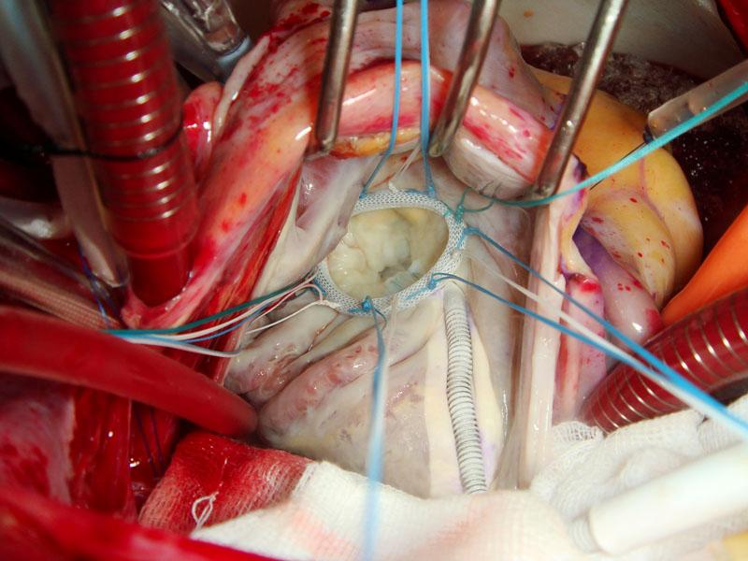
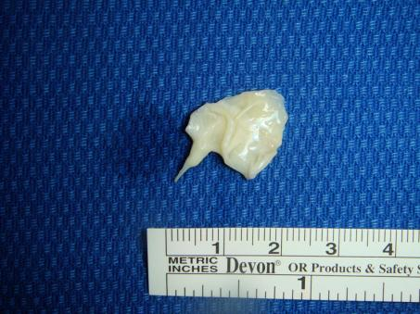
Triangular or wedge resection of post MV prolapse
Notes:
We did triangular resection.
After confirming normal chordae in both sides of P2,
We resect P2 lesion with wedge shape.
And put the ring in annulus.

Slide 54
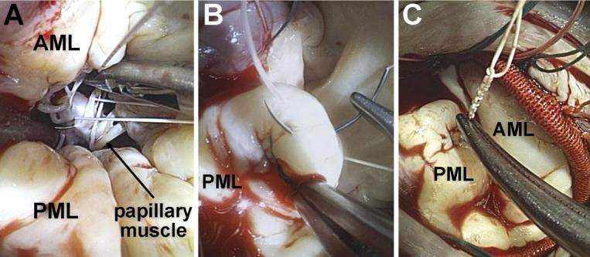
“American” Correction
Respect rather than resect in posterior MV lesion
  Chordal replacement with PTFE artificial chordae
Rather than Q resection in French Correction….
Notes:
American correction is the technique…
Respect rather than resect in posterior MV lesion
Chordal replacement with artificial chordae
Rather than Q resection in French Correction….

Slide 55
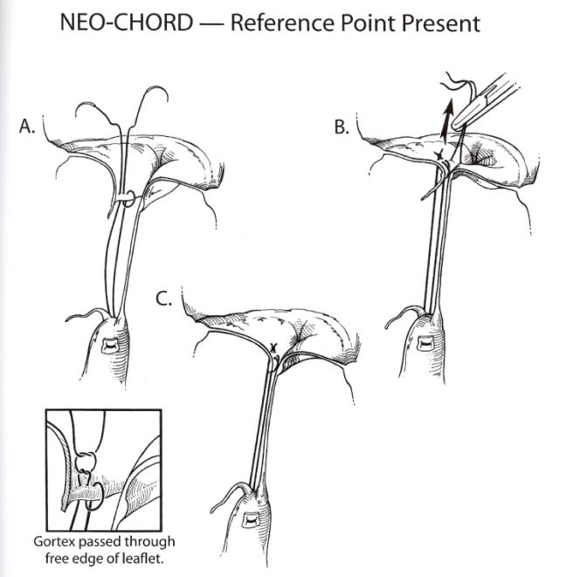
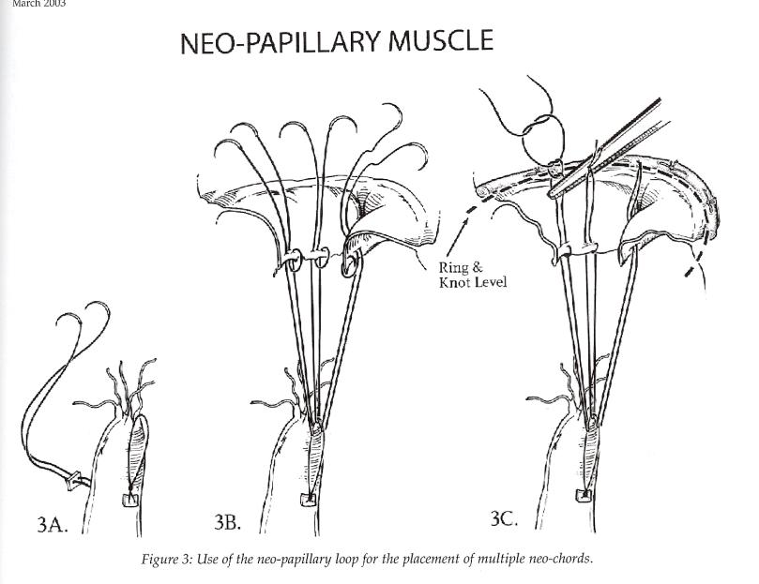
For Ant MV Prolapse
> Chorda shortening
> Papillary m shortening
> PM sliding
> PM trenching
… technically difficult, not reproducible..
No need for trying technically difficult procedure
Role of artificial chordae and papillary m!
Notes:
For ant MV prolapse,
Many difficult, non-reproducible techniques were done by expert surgeons.
However, appearance of artificial chordae and papillary m eliminated such concerns.

Slide 56

Technical Shift of AMVL Repair
Gillinov et al. ATS 2008;86:708-17
Notes:
This report is from Cleveland clinic.
You can see the increased use of artificial chordae after the year 2000.

Slide 57





RA
A2
LA
IVC
SVC
Notes:
This patient had A2 chordae rupture.
You can see the detached site of chorda in papillary m head.
After implantation of artifical chordae in A2 position,
We could get excellent valve coaptation with no residual MR.

Slide 58
Durability of MV repair for Degenerative disease
Gillinov AM et al. (J Thorac Cardiovasc Surg 1998; 116: 734–43)
1072 MVP (degenerative MR) (1985-1997, 58yrs, 65 male)
30 reoperations
Increased risk of reoperation:
Anterior leaflet prolapse
Chordal shortening
Annuloplasty alone
Leaflet resection without annuloplasty
No intraoperative echocardiogram
Best result: Q-resection of PMVL with annuloplasty

Slide 59


Outcomes of AMVL Repair
David et al. JTCS 2005;130:1242-9
1982-2001, 359 patients
Ant. (92), post. (359), bileaflet (250)
Overall Survival at 12yrs : 75% without significant difference
Notes:
Result of AMVL repair has been known to have lower surgical outcome compared to those of Posterior.
However, results of AMVL repair are more satisfactory nearly comparable to posterior.

Slide 60
Commissural Prolapse
Commissure is a leaflet, not part of annulus…
Sometimes or frequently reported as A1/P1 or A3/P3 prolapse….
Paracommissural obliteration
Notes:
Another topic is commissural chordae prolapse.
Commissure is a leaflet, not part of annulus…
It is sometimes or frequently reported as A1/P1 or A3/P3 prolapse….
We usually perform paracommissural obliteration.

Slide 61
Notes:
또한 chordae 를 main, paramedial, commissural, paracommissural 과 같이 나누는 법도 있습니다. 그리고 이 chordae 의 형태는 variation 이 매우 흔합니다. A2, P2 portion 은 따로 intermediary papillary muscle 에서 오는 chordae 에 의해 지지되기도 하고, 또는 그냥 두 papillary muscle 중 하나에서 길게 연결된 chordae 가 지지하기도 합니다. Posterior leaflet 의 indentation 에는 commissure 와 마찬가지로 부채 형태의(fanlike) chorade 가 있습니다.

Slide 62
Case : M/47, Research Dr, recent DOE
Dilated LV, EF : 60%
  LVIDd 65 mm, LVIDs 41 mm
No regional wall motion abnormality
Normal LV wall thickness
Mainly P3 prolapse with severe MR
Dilated LA cavity, Pulmonary HTN (47mmHg)
Op:
  Obliteration of posteromedical commissure near P3
  Ring annuloplasty with flexible partial ring
Notes:
This 47 yr old research Dr visited our clinic due to recent DOE.
Echo report is severe MR in P3 portion.

Slide 63






Notes:
This is prolapsed portion.,
After saline test, we could find prolapse in P3 or PC portion.
This case was detachment of commissural chordae near P3. We did obliteration of commissural leaflet not the annulus.
And this is final appearace.

Slide 64
Armamentarium for MV Repair
Quadri/Triangular resection a/o annular plication
Sliding annuloplasty
Chorda shortening, chorda transposition, chorda transfer
Artificial chordoplasty
Paracommissural obliteration/sliding
Ring annuloplasty
Can repair >90% of degenerative MR !!
Notes:
Our weapons for MV repair are as follows.
We can repair more than 90% of degenerative MR by adequate and harmonious combination of these techniques.

Slide 65


M/58, Acute MR(AC, A1, A2 chordae rupture)
CHF, Pulmonary Edema
ER visit: 4d before op
Preop #1, MICU
Complex MV Repair
Notes:
This is acute MR case.
58 yr old man visited ER due to CHF Sx.
Chest PA shows pul edema, and echo showed acute MR due to multiple chordae rupture.

Slide 66






Op finding
Complex MV Repair
Notes:
Multiple chordae rupture in AC, A1, and A2.
We did obliteration of AC and artficial chordoplasty in A1 to A2.

Slide 67


Postop. study
Notes:
Immediate postop Chest PA shows resolved pul edema and echo shows good MV status.

Slide 68
Durability of MV repair
1072 MVP (degenerative MR) (1985-1997, 58yrs, 65 male)
30 reoperations
Suggested risk factors:
  Pathology other than PMVL
  Chordae-shortening plasty
  Annuloplasty alone
  PMVL resection without annuloplasty
Best result:
  Quadrangular resection of PMVL with annuloplasty
Gillinov et al. JTCS 1998;116:734-743D
Notes:
Accordinig to major report from CCF,
PMVL lesion with Q resection showed the best results

Slide 69
Increased Risk of Reoperation
AMVL prolapse
Chordae shortening
Annuloplasty alone
Leaflet resection without annuloplasty
No Introp. check with TEE
Notes:
Increased risk of reoperation was
AMVL prolapse
Chordae shortening
Annuloplasty alone
Leaflet resection without annuloplasty
No Introp. check with TEE.

Slide 70
How to Repair MV in Rheumatic MR?
Notes:
Then, how shoud we Repair the MV in Rheumatic MR?

Slide 71
Repair in Rheumatic MR
Basic Principle:
  To increase mobility of valve
  Cut secondary chordae
  Release commissure
  Divide papillary m fusion….
  Ring annuloplasty
Consider age, sex and general characteristics
Technically Feasible, but is it durable?
Notes:
Basic principle in rheumatic ds is to increase mobility of valve, cut secondary chordae, release commissure, divide papillary m fusion, and ring annuloplasty.
Although it is technically feasible, there is some conversies for its durability.

Slide 72




Notes:
This 42 yr old female with rheumatic MR has thickend valve with retracted subvalvular apparatus with poor valve coaptation.
We cut secondary chordae to increase valve mobility and put annuloplasty ring.

Slide 73

Notes:
Chordae 는 leaflet 의 어디에 부착하는가에 따라서 세 가지 타입으로 나눕니다. Primary chordae 는 leaflet 의 margin 에 붙는 chordae 입니다. Secondary chordae 는 leftlet 의 ventricular side 에 부착합니다. Tertiary chorade 는 posterior leaflet 이나 commissural leaftlet 의 base 에 부착됩니다.

Slide 74

MV Repair for Rheumatic MR
Notes:
Repair result for rheumatic is somewhat poor compared to that of degenerative.

Slide 75

MV Repair for Rheumatic MR
Oumeiri et al. ATS 2009;87:1735-40
1996-2007 / 78 pts. / midterm results (8 yrs)
No hospital mortality / no early reoperation
Reoperation: 3 pts. (4%)
Freedom from cardiac death (8yrs) : 98±2%
Freedom from MV reoperation (8yrs) : 94±5%
Notes:
However, quite a few surgeons reported comparable result to degenerative.

Slide 76


Whether to Repair or Replace
Should repair be done in every technically reparable cases?
How about…
  Predating severe LV dysfunction?
  High risk co-morbidity?
  Risk of long CPB time?
  Risk of long myocardial arrest?
How to reduce the risk of LV rupture in MVR?
  Chordae sparing MVR : preservation of subvalvular tissue
Notes:
Should repair be done in every technically reparable cases?
How about…
Predating severe LV dysfunction?
High risk co-morbidity?
Risk of cardiopulmonary bypass re-run?
Risk of long CPB time?
How to reduce the risk of LV rupture in MVR?
Chordae sparing MVR : preservation of subvalvular tissue

Slide 77
Role of Valve Replacement in MR
How to Preserve Subvalvular Apparatus?
Case, F/65, active SBE
Multiple metastatic abscess
Spinal abscess requiring drainage
DM, Hypertension
Pneumonia
Septic shock, blurred vision
Notes:
What is the role of valve replacement in MR?

Slide 78




Notes:
She had huge vegetation in PMVL and we replaced her valve with tissue prosthesis considering co-morbidities.

Slide 79

Left Ventricular Rupture
Why?
  Lesser subvalvular apparatus
  Should maintain annulopapillary continuity
Routinely preserve chordae or artificial chorae in A1/P1, A3/P3
No LV rupture since above procedure since 2009
3 LV ruptures from 1998 to 2008
Notes:
LV rupture occurs in high profile tissue valve, lesser subvalvular apparatus, injury during op.
I experienced 3 LV ruptures during my carrer, and since 2009, I routinely preserve or make chordae in A1/P1, and A3/P3 to maintain annulopapillary continuity.
Although I do not have strong evidence to support such fact, I have had no LV rupture after this procedure since 2009.

Slide 80



Notes:
Artificial chordae in A1/P1, chordae preservation in P2-3.

Slide 81
Common Situation of MV Replacement: Mitral Stenosis
Mitral Stensis, Atrial Fibrillation, Tricuspid Regurgitation
Notes:
Then, how shoud we Repair the MV in Rheumatic MR?

Slide 82




Slide 83






Slide 84
Mitral Stenosis
Rheumatic fever, rarely congenital
  commissural fusion
  fusion & shortening of chordae
  fibrosis, stiffening, contraction & calcification of leaflet
It is an On-Going Process!!

Slide 85
Possible Events after MV Replacement
Thromboembolism
Hemorrhage
Endocarditis
Arrhythmias
Prosthesis malfunction
Late cardiac failure
LV rupture: untethered loop theory

Slide 86


Slide 87

Prosthetic Valve Failure

Slide 88


Prosthetic Valve
1990’s –present
Mechanical Valve
  St. Jude(Master, HP, Regent)
  On-X
  Carbomedics(Omnicarbon)
  Sorin
  Medtronic-Hall
  ATS

Slide 89



Prosthetic Valve
1990’s –present
Bioprosthetic Valve
  Carpentier-Edwards(perimount)
  Hancock II(Cinch valve)
  St Jude Biocor, Epic Supra
  Sorin

Slide 90
Summary
Adequate knowledge for MV is necessary.
MV repair can be performed with low mortality and morbidity.
Repair in degenerative MR can be performed in about 90% of patients.
Adequate ring annuloplasty is very important.
Artificial chordae could make valve repair simple and easy.
One lesion one technique principle should be kept.
Notes:
In conclusion,
MV repair can be performed with low mortality and morbidity.
Repair in degenerative MR can be performed in about 90% of patients.
Artificial chordae could make valve repair simple and easy.
One lesion one technique principle should be kept.

Slide 91
Summary
In rheumatic ds, the reoperation risk may be higher than in degenerative, however, repair is technically feasible.
Chordae preserving valve replacement is acceptable treatment considering co-morbidities.
Prosthetic valve replacement with chordae sparing or artificial chordae could be considered.
Notes:
In endocarditis, MV repair is a very valuable Tx option.
In rheumatic ds, the reoperation risk may be higher than in degenerative, however, repair is technically feasible.
Adequate ring annuloplasty is very important.
Chordae preserving valve replacement is another acceptable treatment considering co-morbidities.
I would like to thank the society for giving me this great opportunity.
Thanks.

