Slide 1
Aortic Valve Surgery
Ung Jin, MD, PhD
Department of Thoracic and Cardiovascular Surgery
Ulsan Hospital

Slide 2
History
Aortic commissurotomy : Tuffier (1913)
  10 years earlier than mitral commissurotomy
1950s : Aortic commissurotomy and debriment recommended → poor result
AR treatment before CPB →
bicuspidalization or circumclusion
Cusp enlargement (Ross) : 1963
Duran. Op Tech Card Thor Surg 1996;1: 15-29

Slide 3
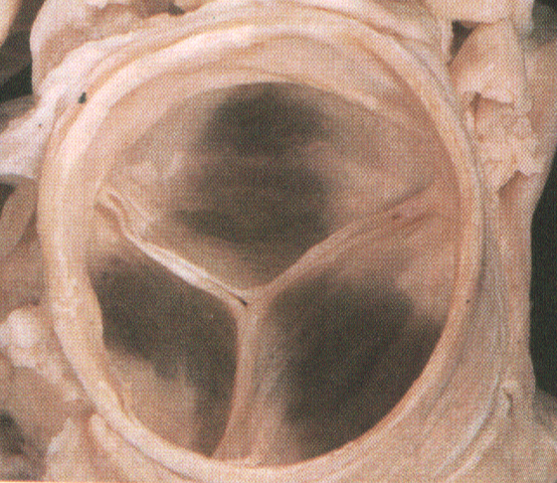
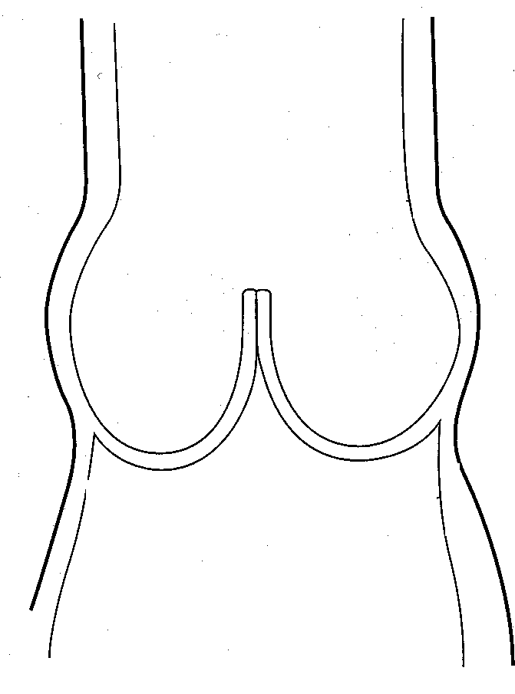
Anatomy of Aortic Root
commissures
Sinotubular
junction
coronary
orifice
sinus
cusps
aortic annulus

Slide 4
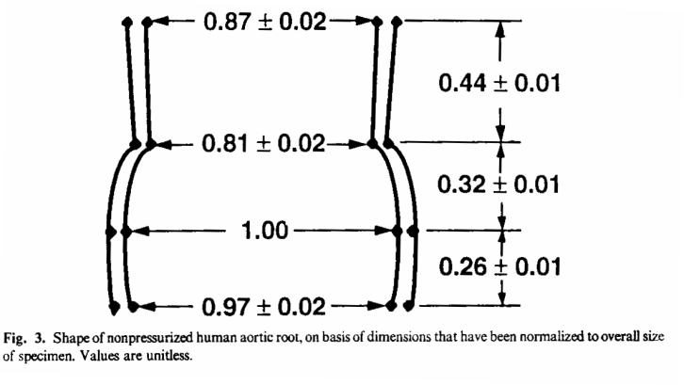
Root Dimensions
Mean diameter : 23mm, valve area : 4.5 cm²
Inlet diameter : 10~20% larger than STJ
Height : STJ 의 80%
Kunzelman KS, JTCS 1994;107:162-70

Slide 5
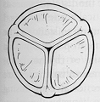
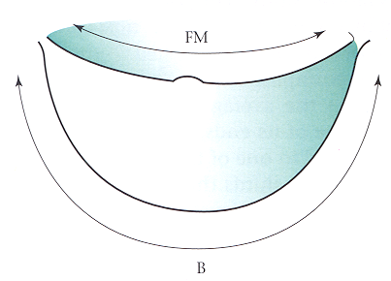
Cusp Dimension
Free margin length : 28 ~ 34 mm (average 32mm)
Cusp height : less than 1/2 of FM length : 13 ~ 15mm
Width
Extra length : loss of extra length during aneurysm → AR
FM:B=1:1.5

Slide 6
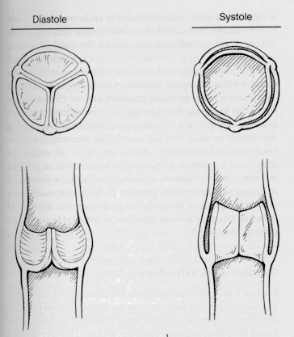
Dynamic Change of Aortic Root
16% of diameter changed
at coaptation level
During systole
- ridge diameter
: increment by increased pressure
pulling effect on commissures
→ triangular opening of AV
- inlet diameter
: decrement by muscle contraction
actually small increase
Overall change : cone --> cylindrical
- more effective flow passage
- stress sharing effect
Brewer RJ. JTCS 1976;72:413
Notes:
1513, Leonardo da Vinci : Vortex theory
1969, Bellhouse : Sinus ridge effect
1986, Thubrikar : Sinus effect of stress sharing

Slide 7
Aortic Root Volume Change
(2000, Pang & Duran, Montana)
Crystals at commissure, STJ, nadir, leflet tips
3-D digital sonomicrometry
Systolic root expansion (40% of volume increase) and 12% leaflet opening before ejection phase during isovolumic phase.

Slide 8
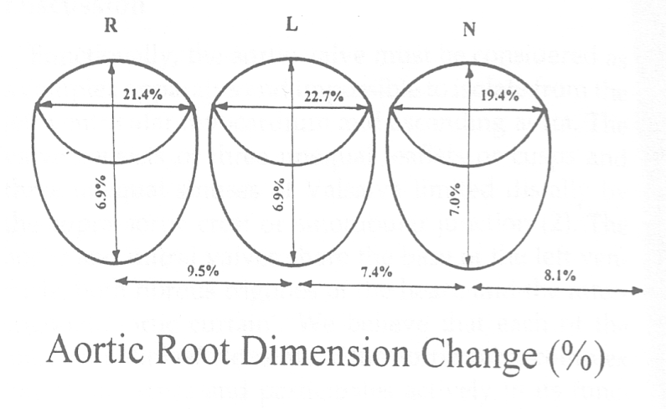

Slide 9
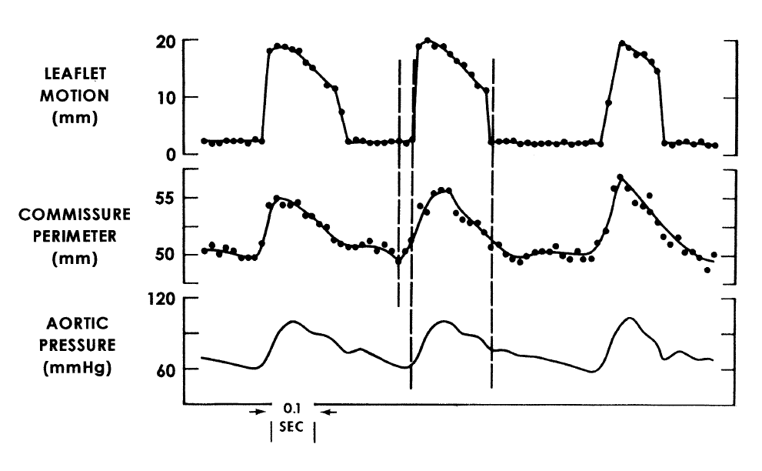
2002, Robicsek et al, Annals

Slide 10
Movements of Commissures
(Pull and Release Mechanism)
Outward displacement of commissures
  During systole : by pressure
  Tightening of leaflet : Less wrinkling
  Triangular shape of aortic opening
    Linear flexion of leaflets
    Less stress than circular flexion (in stented tissue valve)
    Ready to easier closure d/t effective Eddy’s flow
  Late systole : lessening of outward pulling (with Eddy’ flow,SCD) (?)
    Initiation of closure →less regurgitant flow
Inward displacement of commissures
  During diastole : transferred from backward pressure on leaflets
  Late diastole : loss of pressure difference across the leaflet
  → lessening of inward pulling : pre-opening before forward flow

Slide 11
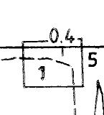
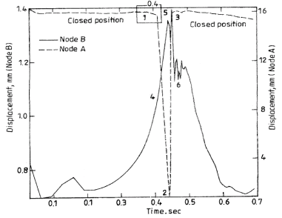
Dynamic Analysis of AV
(Gnyaneshwar, 2002, India)
Preopenning of AV before forward flow
Node A : Arantius nodule
Node B : commissure end
4 : preopen dilation of commissures
1 : presystolic valve opening
about 20 % of leaflet opening
(3mm/16mm)

Slide 12
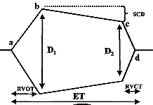
Slow Closing Displacement
(2001, Paulis et al, Italy)
Slow closure of AV in late systole period

Slide 13
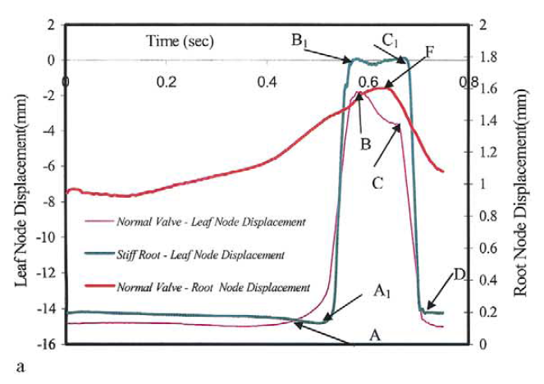
Role of Compliant Root on Leaflet Opening and Valve area (2004, Sripathi et al, India)
65% of full dilation

Slide 14
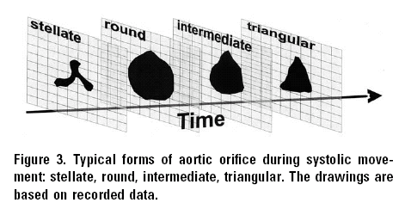
In Vivo AV Dynamics by 3D Echo
(2003, Handke et al, Germany)
3 phase of valve movement
  rapid opening, slow closing, rapid closing

Slide 15
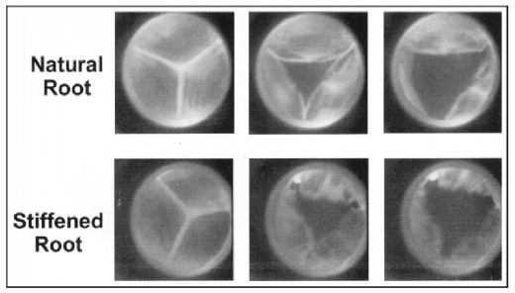
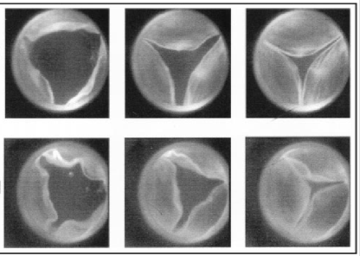
Role of Sinus Wall Compliance
(1999, Robiscek & Thubrikar, NC)
External stiffening of root with glue at 40mmHg
No flow change but leaflet motion change to asynchronous and irregular pattern
  Decreased diameter (11 % less than at 80mmHg)
  Stiffness of aortic wall

Slide 16
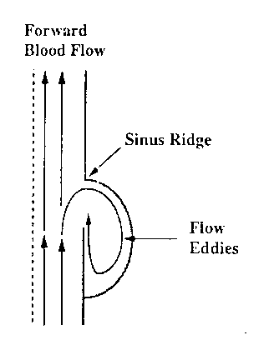
Sinus
Eddy currents
( in concert with sinotubular junction)
1. Avoid impact of leaflet to aortic wall
Leaflet stress reduction
2. Initiate valve closure
Regurgitant fraction : 23 → 4%
3. Promote coronary flow
4. Assist coaptation
5. Ensure coordinated closure
Curvilinear configuration
; Load and stress sharing between the aorta and leaflets
그림

Slide 17
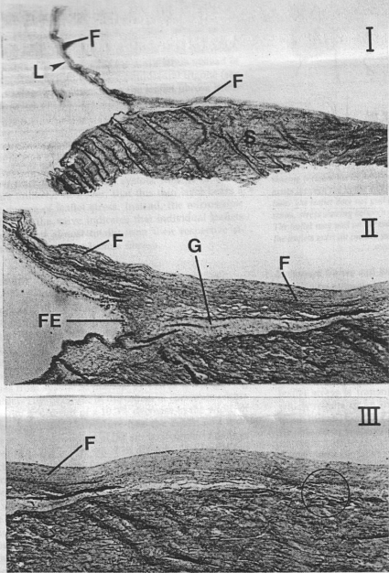
Histologic Features of leaflets & Sinus
Lamina fibrosa of leaflets extends into sinus wall (F)
  Stress transfer to sinus wall
  Fibroelastic lamina (FE) at LV side of leaflet attachment site
Triangular wedge shaped area, loose sponge tissue (G)
: between leaflet lining fibrosa & sinus wall
Array of fibrous tissue in leaflets
: parallel to free margin
→ circumferential stress 24.3g/mm²
radial stress 12.1g/mm²

Slide 18
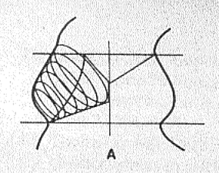
Stress Sharing between Sinus & Leaflets
Leaflet + Sinus
Symmetric Unit
Even distribution
of stress
Thubrikar MJ et al, Annals 1986;434

Slide 19
Stress of Native Leaflets

Slide 20
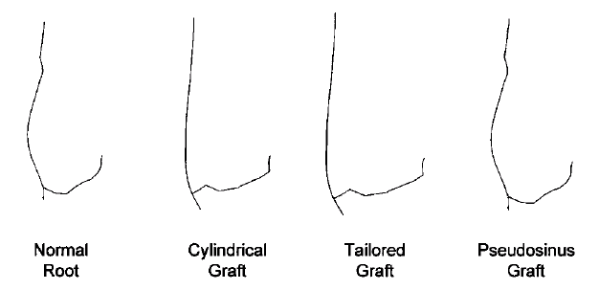
Root-Valve Relationship

Slide 21
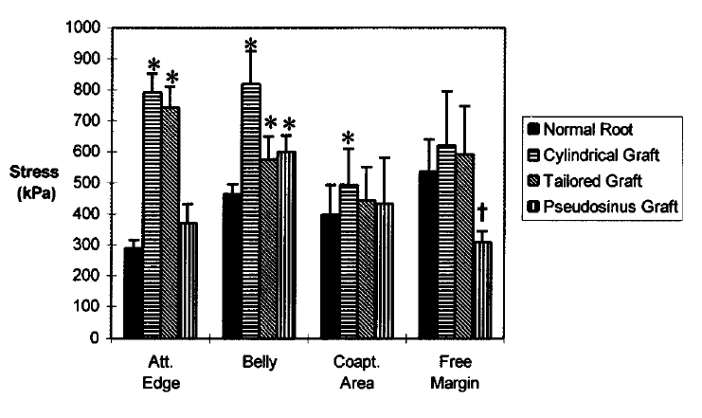

Slide 22
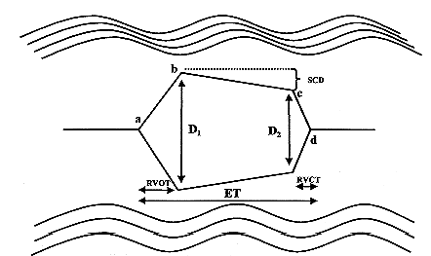
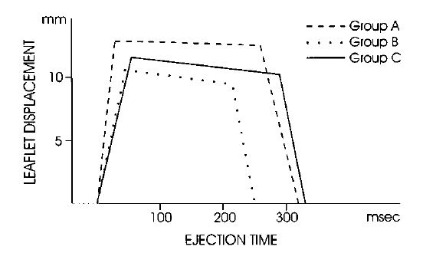
Effects of Operation Types on The Mechanism of AV
Rapid Valve openning time
23.0 << 43.0 < 57.5 (ms)
Openning speed
58.3 >> 27.1 = 20.9 (cm/s)
Maximal distance of leaflets
26.0 >> 21.1 = 23.1 (mm)
Slow closing displacement
3.8% << 10.8% = 12.5%
Rapid Valve closing time
58.5 >> 31.5 < 39.5 (ms)
D2
25.0 >> 18.9 = 20.5 (mm)
Closing speed
21.8 < 32.4 > 26.3 (cm/s)
Ejection time
319 > 254 < 329 (ms)
Reimp
Remod
Contr
** Contact of leaflet with graft in only reimplantation group
Yacoub et al, Circulation 1999;100:2153

Slide 23
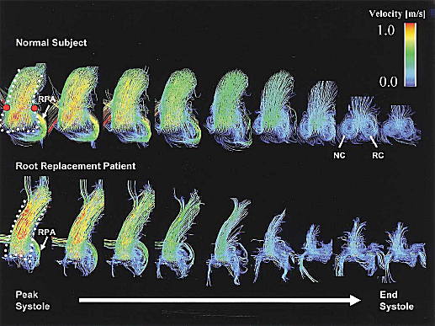
Flow Pattern In The Aortic Root
Kvitting et al, JTCS 2004;127:1602

Slide 24
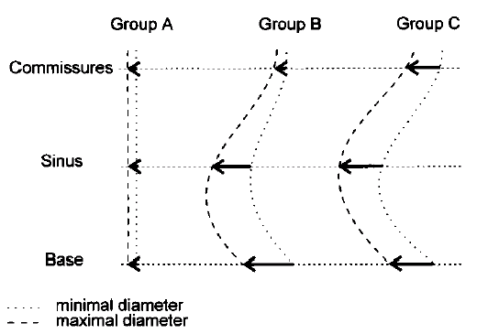
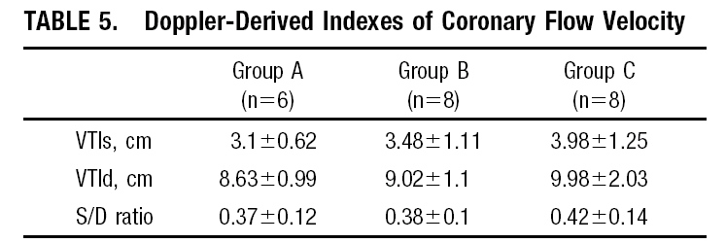
Sinus Distensibility & Coronary Flow
Group A : Reimplantation
Group B : Remodeling
Group C : Control
2.2%
2.7%
9.6%
10.1%
Yacoub et al, Circulation 1999;100:2153

Slide 25
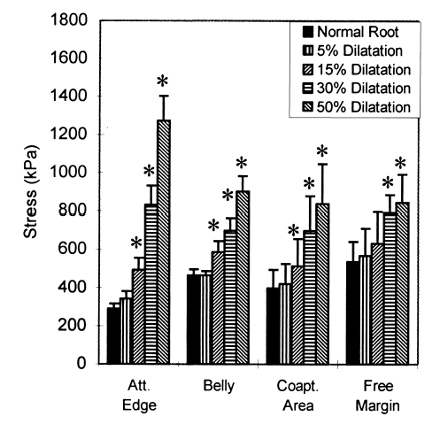
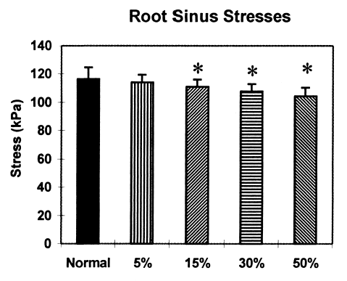
Root Dilation & Stress Sharing
Dilation more than 30% → stress sharing mechanism failure
Grande KJ et al, Annals 2000;69:1851

Slide 26
Stress Sharing & Normal AV function
Delicate Geometry
Adequate Compliance

Slide 27
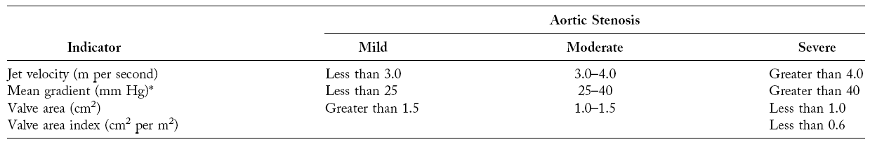
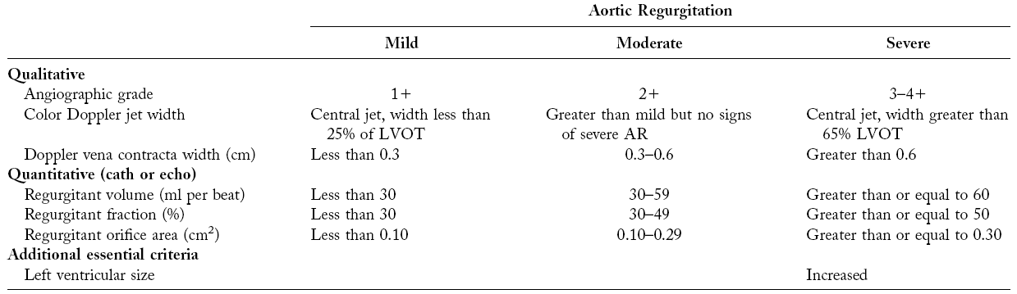
Grading of AV Disease

Slide 28
Aortic Stenosis

Slide 29
Pathophysiology of AS
Gradual obstruction usually over decades.
LV hypertrophy with afterload increment.
  Increased LV mass (concentric) : volume/mass ratio ↓
  Advantage : LV wall stress normal with normal EF
  Disadvantage : diminished compliance
  → increased LVEDP (LV diastolic failure)
  cf) atrial kicking is critical
If LV hypertrophy fail to keep up afterload increase, then low EF develops.
Low EF due to myocardial depression.
due to high afterload.

Slide 30
Ischemia and hypertrophy
Disadvantage of hypertrophied LV wall
  Reduced coronary flow / gram of muscle
  Limited coronary vasodilators reserve
  Exercise or tachycardia → maldistribution of coronary flow: subendocardial ischemia.
  Increased sensitivity to ischemia.
Excessive hypertrophy (es, elderly, woman)
  Low systolic wall stress and high EF
  High perioperative morbidity and mortality

Slide 31
Natural History
Long latent period with low morbidity and mortality
Annual progress of mod. AS
  Jet velocity : 0.3cm/sec per yr
  Mean pr gradient : 7mmHg/yr
  Valve area : 0.1cm2/yr
Definition of Rapid progression
  Velocity > 0.3cm/sec/yr,
  valve area > 0.1cm2/yr
  Pressure gradient > 7mmHg/yr

Slide 32
Natural History of AS
In severe AS without symptoms
: symptom free rate for 5 yrs <50%
If symptom develop → average survival 2~3 yrs
:sudden death without prior symptoms
  Subtle, subclinical symptom 도 중요.
Other finding of severe AS
  Plt dysfunction and decreased von Willebrand factor
  ; Epistaxis or ecchymosis in 20% of patients
  correlate with the severity of AS
  → resolve after AVR

Slide 33
Summary of Op Ix
AVR is indicated in all symptomatic patients with severe AS.
In asymptomatic patients.
  EF<50%, severe calcification, expectation of rapid progression
  Mod AS patient undergoing other OHS
  Mild AS patient with more than mod calcification of valve undergoing other OHS
Extremely severe AS even if asymptomatic

Slide 34
About Operation for AS
If symptomatic, immediate operation
Age is not a contraindication
LV function improves after AVR even there was moderate depression of contractile function.
(Release of afterload mismatch improves LV function)

Slide 35
Aortic Regurgitation

Slide 36
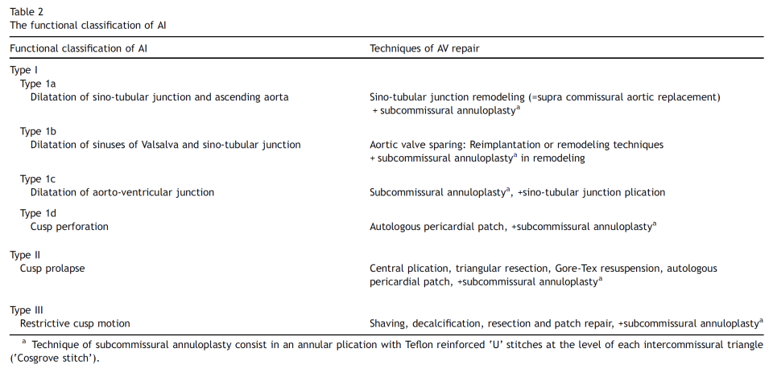
Classification of Aortic Leaflet Prolapse
Kerchove et al. EACTS 2008;34:785-91

Slide 37
Acute Aortic Regurgitation
Cause : mostly d/t dissection, infective endocarditis
Emergence operation
Pathophysiology
  Volume load → increased LVEDP
    Increased LA pressure → pulmonary edema
    Thinning of LV wall (increased LV wall stress)
    → O2 demand increase
    Decrease myocardial perfusion pressure → coronary flow ↓ More severe in non-compliant LV (eg, LV with AS)
  Decreased diastolic flow → tachycardia to keep up CO → Increased myocardial o2 demand

Slide 38
Pathophysiology of Chr. AR
Compensatory mechanism to volume load (Avoid LVEDP increase)
  Increase in end diastolic volume
  Increase in chamber compliance
Maintain normal preload at sarcomere level & large stroke volume to maintain forward stroke
Increase chamber size, increased wall stress → afterload increase → hypertrophy induced
Eccentric + Concentric hypertrophy
AR is a condition with volume and pressure overload.

Slide 39
LV dysfunction in Chr. AR
With time, LV contraction depressed.
  Early LV dysfunction : reversible phenomenon related to afterload excess → full recovery after AVR
  -----------------------------------------------
  Ventricular enlargement → spherical shape → decreased contractility induce systolic dysfunction
Op prognostic factor (high risk group)
  LV systolic function :EF < 50%
  End systolic size : ESD > 55mm, EDD > 75mm

Slide 40
Natural Course of Chr AR
Chronic AR : angina, dyspnea
  Compensation lasts for decades without symptom
  Decreased LV function, symptoms develop
  Coronary angina d/t diminished coronary flow
More than ¼ die or LV dysfunction
before onset of symptoms.

Slide 41
AR with LV dysfunction
Asmptomatic AR with LV failure
: symptoms in 2~3 years.
All symptomatic patient : Op indicated
Annual mortality in pt with symptom
  with dyspnea : mortality > 20% in a year
  with angina : mortality > 10% in a year

Slide 42
Summary of Op Ix
Development of mild symptoms is an indication for AVR
In asymptomatic patient
  If EF < 50%
  LVESD > 55mm or LVEDD > 75mm even if EF>50%
  LVESD > 50mm or LVEDD > 70mm
    With declining exercise tolerance
    WP> 25mmHg with exercise
    Small sized patient
  Moderate AR pt undergoing other OHS

Slide 43
About Operation for AR
LV function will improve after AVR even in a patient with LV dysfunction if EF > 25% and/or ESD < 60mm
After AVR, in 1 or 2 weeks, LVEDD reduced 80% of overall reduction during the long-term postoperative course : This relates EF improvement
Better than medical treatment (even in worst case)

