Slide 1
종격동 질환
(Mediastinal Disease)
대한흉부외과학회 제4차 전공의 연수교육
2011.6.3
성균관의대 흉부외과학교실
최용수

Slide 2
Mediastinum
Benign conditions
  Acute necrotizing mediastinitis
  Chronic mediastinitis
  Pericardial disease
  Surgery for myasthenia gravis
Cysts
  Mediastinal cysts and duplications
Tumors and masses
  Thymic tumors
  Germ cell tumors
  Lymphoma
  Neurogenic tumors
Surgical techniques

Slide 3
Definition of mediastinum
Mediastinal lymph node & mediastinoscopy
Anterior mediastinum
  Thymoma
  Germ cell tumors
  Lymphoma
Middle mediastinum
Posterior mediastinum
  Neurogenic tumors
Mediastinitis
Hyperhidrosis

Slide 4
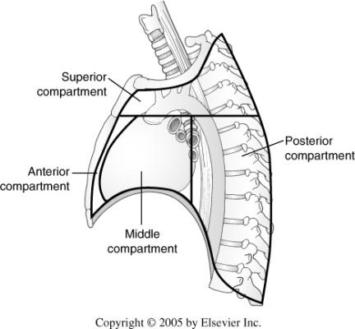
Mediastinum, definition
Mediastinum, definition
  Thoracic space bounded
  superiorly by the thoracic inlet
  inferiorly by the diaphragm
  anteriorly by the sternum
  posteriorly by the spine
  laterally by the pleural spaces
  all the thoracic viscera except the lungs
종격동 (縱隔洞)이란 흉곽 내에서
양측폐를 분리하고 있는 조직과 기관들을 말한다.

Slide 5

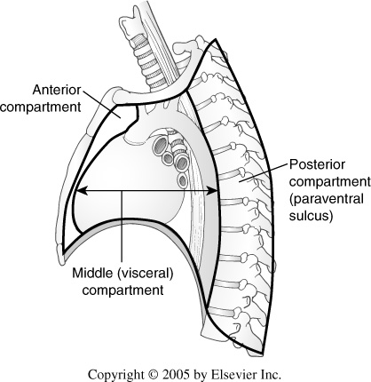
Compartment of mediastinum
Four-compartment model
Three-compartment model

Slide 6
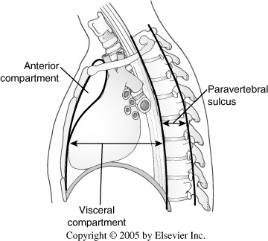
Thymus
Internal thoracic vessels
Internal thoracic LN
Prevascular LN
Fat & connective tissue
Sympathetic chain
Proximal intercostal nerve, artery, & vein
Posterior paraesophageal LN
Intercostal LN
Pericardium/Heart
Great vessels
Trachea
Proximal Rt. & Lt. mainstem bronchus
Esophagus, Phrenic N, Thoracic duct, Proximal azygos vein, Paratracheal & subcarinal LN

Slide 7
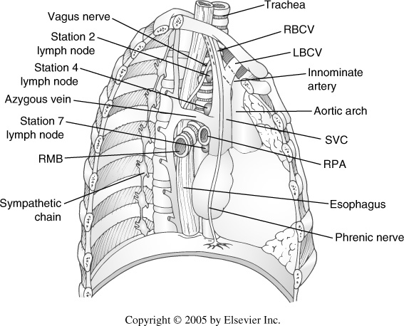
Rt. mediastinal view

Slide 8
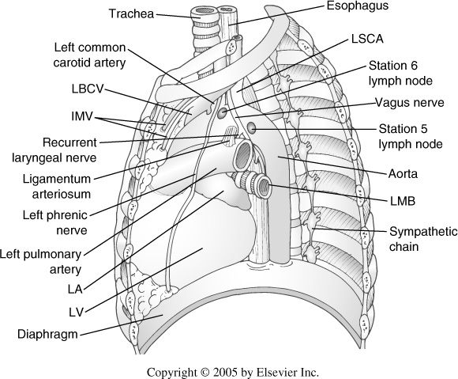
Lt. mediastinal view

Slide 9
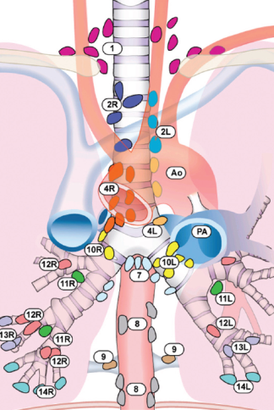
The International Association for the Study of Lung Cancer (IASLC) lymph node map

Slide 10
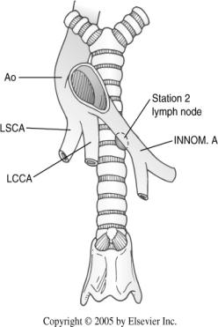
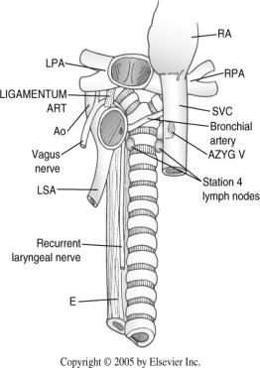
Potential spaces in the mediastinum
Pretracheal space
  Explored by standard mediastinoscopy
Subcarinal space
  Contiguous with pretracheal space
Aortopulmonary window
  Accessed by anterior mediastinotomy, extended mediastinoscopy, or thoracoscopy/thoracotomy

Slide 11
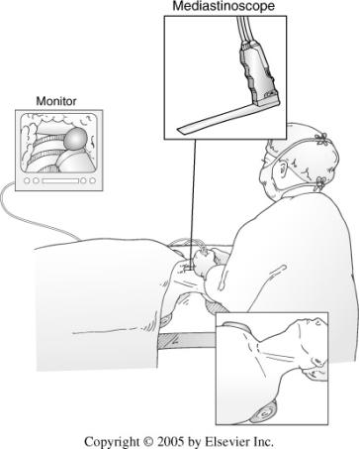
Mediastinoscopy
General anesthesia
Small anterior cervical incision
Introduction of mediastinoscope into pretracheal space
Indications
  Preop. staging for lung ca.
  Primary lymphadenopathy (lymphoma, sarcoidosis)
Standard vs. Extended mediastinoscopy

Slide 12
Complications of mediastinoscopy
Morbidity 0.6%, Mortality 0.2%
Major vessel hemorrhage
Esophageal perforation
Stroke (d/t innominate a. compression of severe atherosclerosis)
Lt. Recurrent laryngeal N. injury
Pneumothorax
Wound infection
Rare tumor seeding

Slide 13
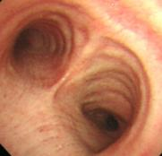
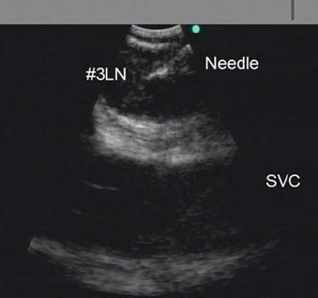
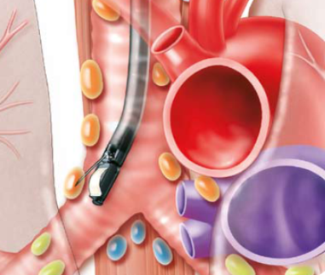
Endobronchial ultrasound-transbronchial needle aspiration (EBUS-TBNA)

Slide 14
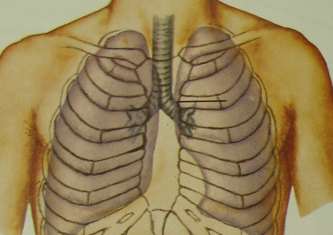
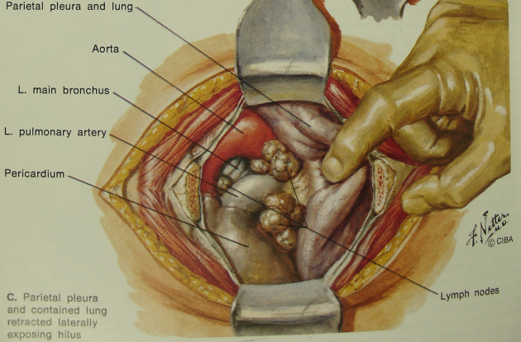
Anterior mediastinotomy
(Chamberlain procedure)

Slide 15
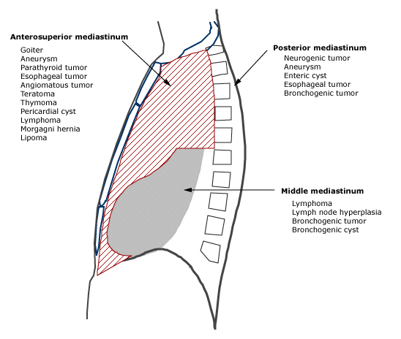
Mediastinal masses

Slide 16
Anterior mediastinal mass
Neoplastic
  Thymus
  Lymphoma, teratoma, germ cell tumors
  Thyroid, ectopic parathyroid with adenoma, etc.
Infectious
  Acute descending necrotizing mediastinitis
  Subacute mediastinitis
Vascular
  Aortic arch aneurysm

Slide 17
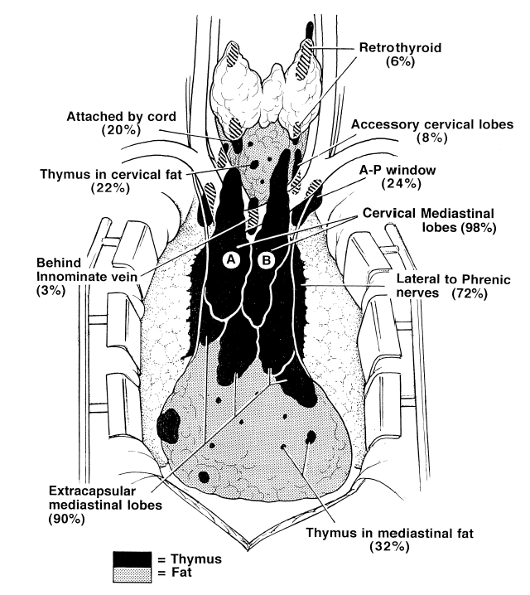
Normal thymus

Slide 18
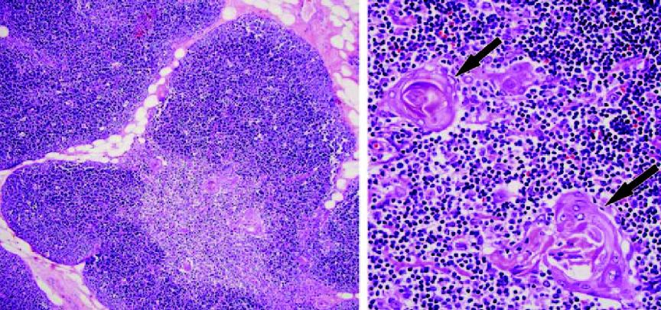
Normal thymus
cortex, mainly composed of lymphocytes (thymocytes)
Hassall corpuscles
medulla, mainly composed of epithelial cells
Notes:
(a) Photomicrograph (original magnification, 10; hematoxylin-eosin [H-E] stain) of the thymus shows
the cortex, mainly composed of lymphocytes (thymocytes), and the medulla, mainly composed of epithelial cells.
(b) Photomicrograph (original magnification, 40; H-E stain) of the medulla shows Hassall corpuscles (arrows) as
round, keratinized formations with mature epithelial cells.

Slide 19
Thymic masses
Thymic hyperplasia
Thymic cyst
Thymolipoma
Tumor of thymus
  Thymic lymphoma
  Thymic germ cell tumor
  Thymic epithelial tumor
    Thymoma
    Thymic carcinoma including thymic neuroendocrine tumors
Metastasis to thymoma
Notes:
The two main differential diagnoses of most anterior
compartment masses are lymphoma and thymoma.
In general, thymoma patients are older as compared with
patients presenting with lymphoma originating in the
anterior mediastinal compartment, who tend to be in the
late teens to young adult age groups. Constitutional
symptoms such as night sweats, fever, weight loss, and
malaise are more consistent with lymphomatous processes.
Physical examination including careful palpation
of lymph node bearing areas such as the neck, axillae,
and groin for adenopathy amenable to excisional biopsy,
which might establish a diagnosis of lymphoma, is
indicated. A small anterior mediastinal compartment
mass in a patient with a history of an associated immune
disorder has a high probability of being a thymoma
(Fig. 1). We therefore believe that wide surgical excision,
including en bloc thymectomy without biopsy, is justi-
fied for both diagnostic and likely therapeutic purposes
in these cases.

Slide 20
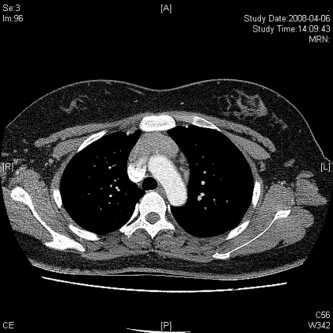
F/20
눈이 처지고 복시현상, 팔다리 힘이 빠짐, 말이 어눌해지는 증상
MG
Thymic hyperplasia
65%
Thymoma 10%
Thymoma
Thymic hyperplasia
MG 30-60 %
Notes:
Anterior mediastinum에 soft-tissue attenuation이 보이는데 thymic tissue의 shape을 conform 하고 있어서 tumorous condition 보다는 thymic hyperplasia일 가능성이 높으며, 2008/1/11 시행한 outside CT와 비교시 그 크기는 변화 없음.
양측 lungs에는 이상 소견 없음.

Slide 21
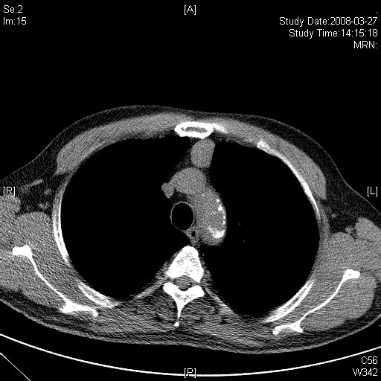
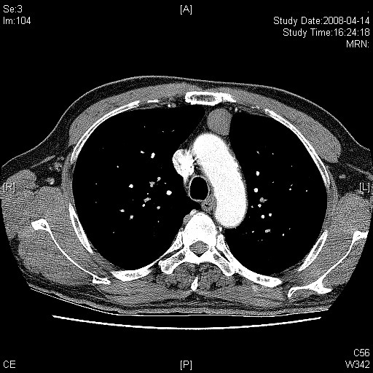
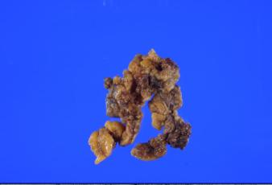
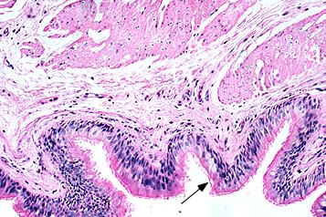
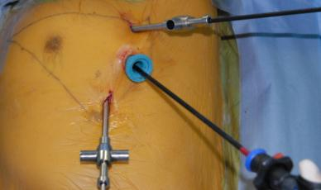
M/67
건강검진상 발견된 ant. mediastinal mass, asymptomatic
Low dose CT
Enhanced
R/O low grade thymic epithelial tumor
Bronchogenic cyst
Thymus with physiologic atrophy

Slide 22
Mediastinal cysts
20% of all mediastinal lesions
Bronchogenic cyst, Enteric cyst, Pericardial cyst, Thymic cyst
Benign, but can be compressive
Mx
  resection to obtain a diagnosis, exclude malignant potential, and prevent enlargement
  percutaneous aspiration
  conservative management of asymptomatic patients
Notes:
MEDIASTINAL CYSTS — Primary cysts of the mediastinum account for approximately 20 percent of all mediastinal lesions. This diverse group includes pericardial cysts, bronchogenic cysts, enteric cysts, thymic cysts, and thoracic duct cysts [14,25,70,71] . All of these lesions are benign, but can produce compressive symptoms.
Standard therapy for mediastinal cysts has been open or thoracoscopic resection to obtain a diagnosis, exclude malignant potential, and prevent enlargement. However, percutaneous aspiration under CT guidance can also obtain diagnostic tissue and provide definitive treatment with a minimal risk of recurrence [72-79] . Conservative management of asymptomatic patients in whom chest radiograph and CT scan strongly suggest the diagnosis of pericardial cyst also has been reported [80,81] .
Pericardial cysts — Pericardial cysts are thin-walled mesothelial cell-lined cysts arising from the pericardium, most commonly in the area of the right cardiophrenic angle [82] . These simple cysts are almost always asymptomatic, although cardiac impingement with hemodynamic compromise has been described (show radiograph 3) [83,84] .
Enterogenous cysts — Bronchogenic and enteric cysts are collectively known as enterogenous cysts. Bronchogenic cysts account for 60 percent of all mediastinal cysts; they are lined with ciliated respiratory epithelium and may contain cartilage or mucous glands in their walls (show histology 1) [14] . They can cause airway compression, resulting in cough, wheezing, dyspnea, and recurrent pulmonary infection. Infrequently, the cysts communicate with the tracheobronchial tree, and may become infected (show radiograph 4) [85] . CT scan can be highly suggestive of the diagnosis if sharply marginated mediastinal lesions with water attenuation are seen [86] .
The majority of enteric cysts are discovered in childhood. They are uncommonly seen in the mediastinum but may rarely result in tracheal or esophageal obstruction. Enteric cysts are lined by gastric, intestinal, or stratified squamous epithelium; lesions containing gastric mucosa may develop ulcerations, hemorrhage, and perforation [87,88] . Communication with the dural space is occasionally noted [89] .
Thymic cysts — True thymic cysts are congenital in origin and represent an anomaly of pharyngeal pouch formation. They are uncommon, accounting for only 1 percent of mediastinal masses. Thymic cysts are often calcified, resulting in a characteristic radiographic appearance. Thymomas can degenerate to produce pseudocysts, but these can be distinguished from true cysts by the absence of an epithelial lining [90,91] .
THYROID TISSUE — Substernal thyroid tissue may develop from the intrathoracic extension of a cervical goiter or from rests of intrathoracic thyroid tissue. Mediastinal thyroid tissue can be diagnosed without biopsy by its avid uptake of radioactive iodine. Treatment with surgery, radioactive iodine, or levothyroxine suppression is not necessary unless symptoms of airway, nerve, vessel, or esophageal compression are present (show radiograph 5). (See "Clinical manifestations and evaluation of obstructive or substernal goiter" and see "Treatment of obstructive or substernal goiter").
PARATHYROID TISSUE — Parathyroid tissue can rarely produce an anterior mediastinal mass. The approach to and treatment of parathyroid cysts, carcinomas, and adenomas are discussed separately. (See "Parathyroid carcinoma", see "Parathyroid cysts" and see "Diagnosis and differential diagnosis of primary hyperparathyroidism").

Slide 23
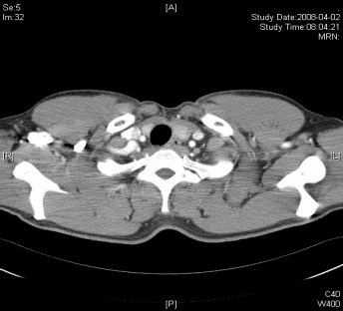
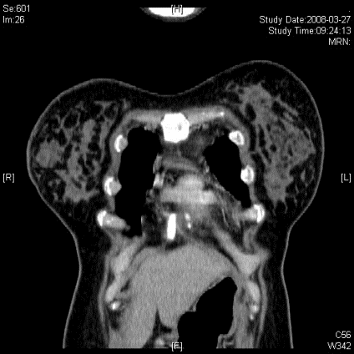
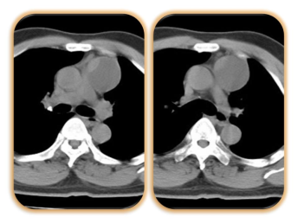
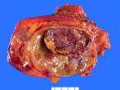
Other ant. mediastinal mass
R/O thymic cyst
R/O bronchogenic cyst
Parathyroid tissue
Substernal thyroid tissue
(intrathoracic goiter)
Cystic thymoma
d/t degeneration

Slide 24
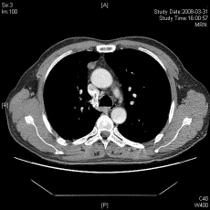
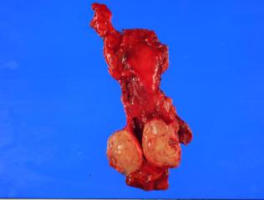
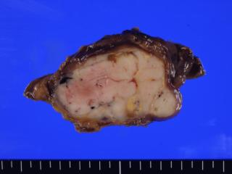
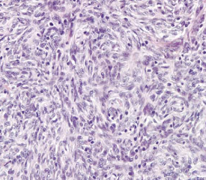
M/47
R/O thymoma?
Yes!
Tx? Thymectomy by VATS or sternotomy
VATS thymectomy WHO type A, Masaoka stage I
Plan? adjuvant therapy?
Notes:
Right lower lobe에 약 7 mm 가량의 nodule이 보임.
Anterior mediastinum에는 약 5.5 cm 가량의 well-defined mass가 보임.
Enhancement는 homogeneous한 양상이며 내부에 tiny calcification을 포함하고 있음.
Hila와 mediastinum에 의미있게 커져 있는 lymph node는 보이지 않음.
CONCLUSION:
1. A 5.5 cm well-defined enhancing anterior mediastinal mass.
--> Thymic epithelial tumor, more likely.
2. A 7 cm nodule in right lower lobe.
--> Benign nodule more likely than pulmonary metastasis.
Thymus, total thymectomy:
. Thymoma, WHO type A ;
1) tumor size: 5x3x3 cm
2) encapsulated
3) negative resection margin
4) increased cellularity and some mitotic figures
Photomicrograph (original magnification, 40; H-E stain)
demonstrates mixed histologic features, with foci of medullary and spindle cells admixed with lymphocytes.

Slide 25
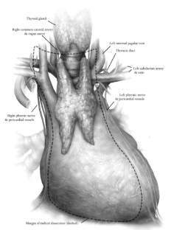
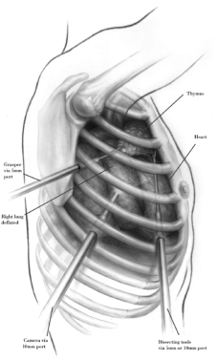
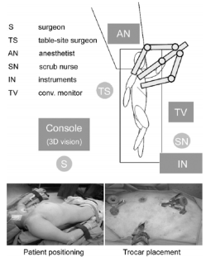
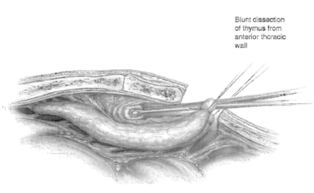
Surgical approach
Radical transsternal thymectomy
VATS thymectomy
Robotic thymectomy
Transcervical thymectomy

Slide 26
Thymic tumors
Uncommon
  0.2~1.5% of all malignancies
  incidence of 0.15 cases per 100,000 population
The most common tumor of the anterior mediastinum
  20% of mediastinal tumors
  50% of anterior mediastinal tumors
  Over 90% of all thymic tumors occur in the anterior mediastinum, the remainder in the neck or other mediastinal areas
Roughly equal among men and women
Associated with several paraneoplastic conditions
  uncommon in thymic carcinomas

Slide 27
Classiffication of thymoma
TNM classification
  No value
Masaoka staging
  Surgical staging
  Presence of invasion into adjacent structures
WHO classification
  Histological systems

Slide 28
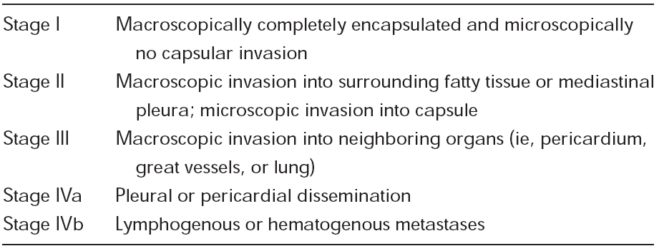
Masaoka staging (1981)
Based on invasiveness of the tumor at surgery
Correlates with 5-year survival rates

Slide 29
Before WHO classification
Bernatz (1961)
  first histological classification
  predominantly lymphocytic, predominantly epithelial, predominantly mixed, and predominantly spindle cell type
Levine and Rosai (1978)
  clinical stage and the degree of cellular atypia
  benign (noninvasive)
  malignant (invasive)
    category I (no or minimal atypia)
    category II (moderate to marked atypia)
Müller-Hermelink (1985)
  medullary, cortical

Slide 30
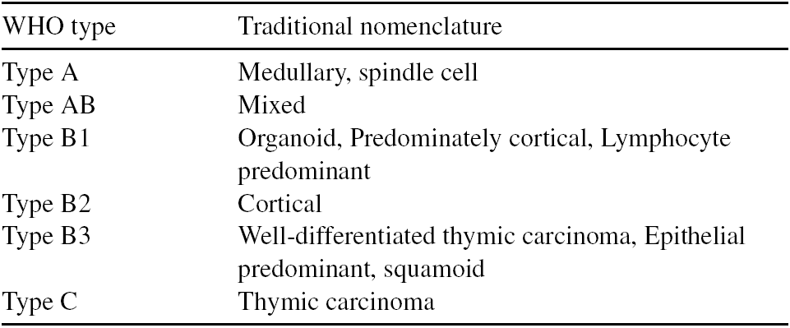
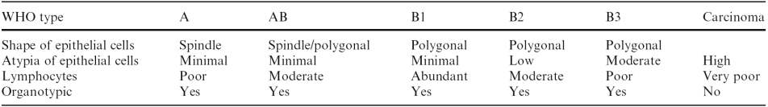
WHO classification (1999, 2004)
Histological assessment of the morphology of the neoplastic epithelial cells and the relative amount of a non-neoplastic lymphocytic component

Slide 31

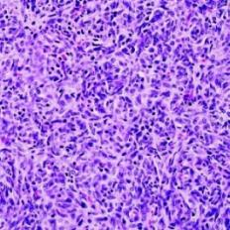
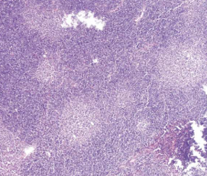
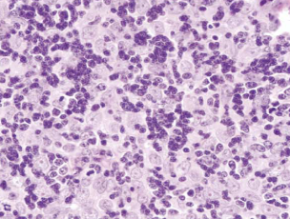
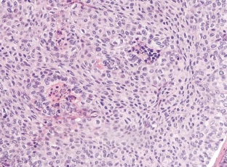
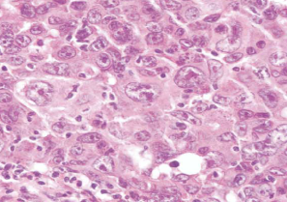
Type A
: spindle tumor cells with sparse lymphocytes
Type AB
: medullary and spindle cells with lymphocytes
Type B1
: predominant lymphocytes with few neoplastic epithelial cells
Type B2
: pale epithelial cells among the small, dark blue lymphocytes
Type B3
: the most abundant epithelial cells with atypical morphology
Combined type
B2 + B3
B3 + thymic sq. cell ca.
Thymic ca.
: frank malignant, not organotypic
Notes:
Thymomas
with neoplastic spindle-shaped epithelial cells are
defi ned as type A, and the lymphoid component is relatively
poor in these tumors. Thymomas with neoplastic
epithelial cells with a polygonal shape are defi ned as type
B, and they are further divided into three subtypes (B1,
B2, B3) according to the abundance of the lymphocyte
component. A type B1 thymoma resembles the cortex of
a normal thymus and has a large number of lymphocytes;
type B2 has less infi ltration of lymphocytes than
type B1; and type B3 is predominantly composed of
polygonal epithelial cells with slight atypia and a minor
component of lymphocytes. Atypia of neoplastic epithelial
cells increases in the order of type B1, B2, and B3.
Thymomas with both type A and type B components are
defi ned as type AB.

Slide 32
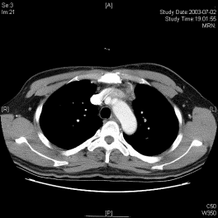
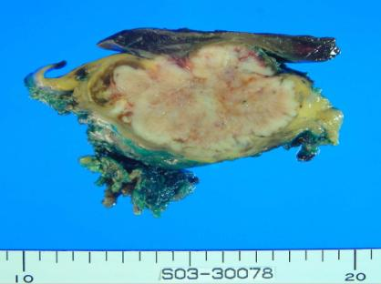
M/45
Radiologic Dx.
1) R/O thymic ca
2) R/O thymoma B2 or B3
2003
Transsternal thymectomy
thymic squamous ca.
Masaoka stage III
Adjuvant RT
Notes:
Left anterior mediastinum에 5.5 cm size의 infiltrative growth를 보이는 soft-tissue mass가 관찰되며 lobulating contour를 보임.
병변의 주위로 lymph node로 생각되는 oval small nodule이 약 11 mm 로 measure됨.
Pleura에 nodularity의 evidence 없음.
양측 lung에 metastatic nodule의 evidence 없음.
결 론 :
About 55-mm-sized mass in the left anterior mediastinum accompanying lymph node enlargement.
DDx. 1) Thymic epithelial tumor of type C (thymic carcinoma), most likely.
2) R/O Rather benign thymic epithelial tumor, such as B2 or B3 tumor
Thymus and lung, left upper lobe, excision:
. Keratinizing squamous cell carcinoma, WHO type C;
1) tumor size: 6.1x5.8x4.5 cm
2) capsular penetration
3) invasion into lung
4) no lymphovascular invasion
5) extension to resection margin of the tumor

Slide 33
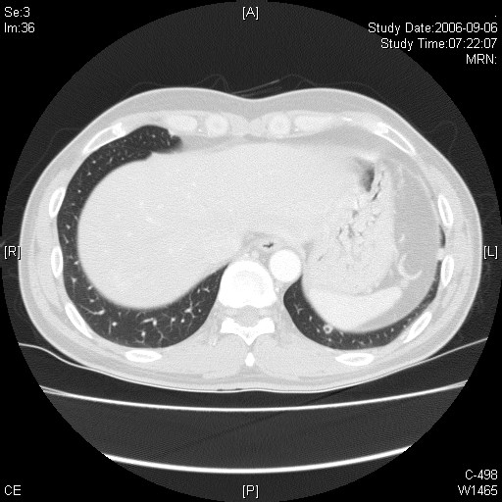
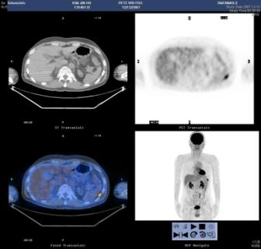
M/45
Thymic ca.
III
Op.+RT
2004-2006
Slowly growing lung nodules
VATS wedge resection
Metastatic thymic squamous ca
2007
PET uptake at pleura
Pleural mass excision
Metastatic thymic squamous ca
RT
Notes:
Spleen 뒤쪽의 아마도 left lower pleura로 생각되는 부위에 강한 FDG 섭취증가
(p-SUV = 6.3)가 관찰되는데 pleural seeding 등의 malignant lesion의 가능성이
높음.
PET (2007/12/12): Lt lower pleura (spleen 뒷쪽) increased FDG uptake
→ Malignant lesion more likely
→ Post-op Change (?) d/t prev LLL VATS wegde resection
수술전 CT부터 serial 하게 봤을 때 2004년부터 서서히 커지는 양상으로 보임.
■ 진료계획
Bx confirm 하는 것이 좋겠습니다.
[검사]
FNABC & C.B(임상시술)
US GUIDED ASPIRATION(PLEURA)
최용수 선생님과 통화하여 입원하기로 함. 환자 원하여 바로 절제하기로 함.

Slide 34
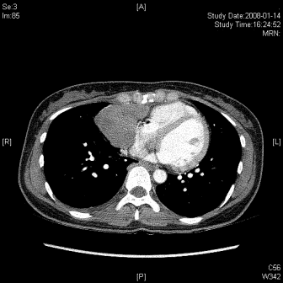
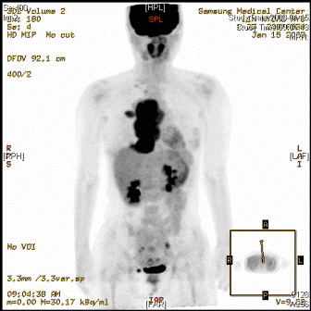
F/33
Dyspnea
Chest pain
Radiologic Dx: R/O Thymic carcinoma with pleural seeding
Core needle Bx: thymoma B2
Neoadjuvant chemotherapy (3 cycles of docetaxel, cisplatin)
Notes:
처음 CT 판독
< Right anterior mediastinum에 약 9 cm 크기의 mass가 보임.
Right pleral space에 multiple nodule들과 소량의 pleural effusion이 보임.
CONCLUSION :
A 9 cm anterior mediastinal mass with multiple pleural nodules in right hemithorax.
-- Thymic carcinoma with pleural seeding, most likely.>
PET 판독결과는
1. A huge hypermetabolic mass in the right anterior mediastinum,
malignancy is more likely.
2. Hypermetabolic masses and nodules along the right major fissure and right
pleura with ipsilateral pleural effusion, c/w pleural seeding.

Slide 35
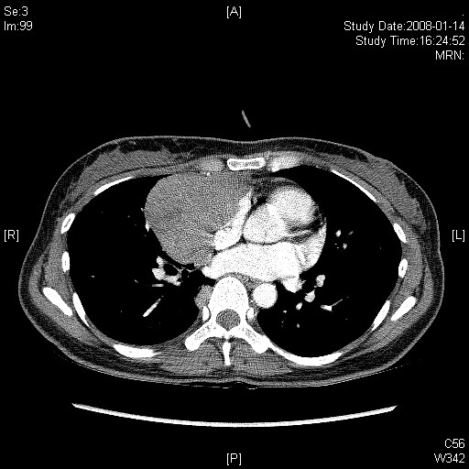



F/33
Thymoma
B2
IVA
Neoadjuvant
chemotherapy

Slide 36





F/33
Thymoma
B2
IVA
droplet metastases
Notes:
presence of parietal pleural deposits or so
called ‘‘droplet metastases’’ most frequently found in the
posterior basilar pleural space and diaphragm. As this
tendency to metastasize in the posterior basilar pleural
space is rather unique to thymomas, the radiographic
presence of both an anterior compartment mass and
‘‘droplet’’ metastases is highly suggestive of the diagnosis.

Slide 37
Treatment of thymoma
  Surgery
  Adjuvant therapies
    Postop. Radiotherapy for Masaoka stage III (controversial for stage II)
    Neoadjuvant chemotherapy for aggressive thymomas

Slide 38
Systemic diseases associated with thymoma
MG
Cytopenias (red cell hypoplasia)
Nonthymic malignancies
Hypogammaglobulinemia
SLE
Polymyositis
RA
Thyroiditis
Sjogren’s syndrome
Ulcerative colitis

Slide 39




Survival of thymoma

Slide 40


Role of MRI in mediastinal mass
Thymic cyst
WHO type B3, Masaoka stage III
detecting an intraspinal component of neurogenic tumor
questionable vascular invasion
cystic lesions
Notes:
61-year-old woman with thymic cyst. (A) Non-contrast-enhanced CT scan (5mm collimation) obtained at the level of the aortic arch shows a homogeneous
anterior mediastinal mass with smooth contours and oval shape. The mass is isodense relative to chestwall muscle. (B) Contrast-enhanced CT scan (5mmcollimation)
at the level of the aortic arch shows a soft tissue density mass in the anterior mediastinum. Note little or no enhancement of the mass, which demonstrates no evidence
of invasion to the adjacent structures. (C) Transverse T1-weighted fast spine-echo MR image (TR = 950 ms, TE = 15 ms) at the level of the left pulmonary artery
shows a slightly heterogeneous anterior mediastinum mass with round shape. The mass shows iso- to slightly high signal intensity relative to the chest wall muscle.
(D) Transverse T2-weighted fast spine-echo MR image (TR = 5200 ms, TE = 120 ms) at the level of the left pulmonary artery shows an anterior mediastinum mass
with markedly high signal intensity. Note difference in shape of the same mass demonstrated on CT and MRI.
High-risk (type B3) thymoma with invasion of the anterior segment of the right upper lobe and the great vessels (Masaoka stage III) in a 72-year-old man.
(A) Contrast-enhanced CT scan at level of tracheal carina shows anterior mediastinal mass with irregular contours and homogeneous enhancement. (B) Transverse
T2-weighted fast spin-echoMRimage (4500/100) shows lobulated mass with heterogeneous intensity and reticular septa as low-intensity lines (arrow). (C) Transverse
gadopentetate dimeglumin-enhanced-T1-weighted spin-echoMRimage (720/15) shows mass with heterogeneous enhancement. Note small hyperintense signal areas
on T2-weighted image (B) and corresponding to small hypointense signals on enhanced T1-weighted image (C) suggesting necrotic or cystic component and right
pleural effusion.

Slide 41
Germ cell tumors
Extragonadal germ cell tumors
15-20% of ant. mediastinal mass
Benign mediastinal teratoma
  Complete excision
Malignant germ cell tumor
  Seminoma : chemotherapy, RT, surgery
  NSGCT : chemotherapy, surgery
Benign GCT | Epidermoid cyst
 | Dermoid cyst
 | Mature teratoma
Seminoma
NSGCT | Choriocarcinoma
 | Yolk sac carcinoma
 | Embryonal carcinoma
 | Teratocarcinoma
 | Malignant teratoma

Slide 42


Mediastinal teratoma in a 21-year-old male

Slide 43
Malignant germ cell tumor
Testicular examination
Tumor markers
  AFP : embryonal ca., yolk sac tumor
  * Pure seminoma : normal AFP
  ß-hCG : chorioca., embryonal ca., seminoma
  Placental ALP : seminoma, yolk sac tumor, embryonal ca.
  LDH : malignant GCT

Slide 44
Lymphoma
Hodgkin’s disease
Non-Hodgkin’s lymphoma
Diagnosis on clinical history and CT
Surgical biopsy over needle biopsy when lymphoma is suspected
Chemotherapy and/or radiotherapy

Slide 45
Approach for ant. mediastinal mass
Imaging
Serum studies : AFP, hCG, ALP, LDH
MG evaluation
Biopsy
  fine needle aspiration or core needle biopsy, Ant. mediastinotomy (Chamberlain procedure), VATS
  immunohistochemistry, flow cytometry
  frozen section or permanent sections

Slide 46
Resection without biopsy for ant. mediastinal mass
CT or MRI shows features consistent with teratoma
Over 40 years of age without clinical signs of lymphoma, with normal AFP and ß-hCG
Mass associated with MG

Slide 47
Middle mediastinum

Slide 48
Middle mediastinum
Lymphadenopathy
  Metastasis from lung or other thoracic malignancy
  Lymphoma
  Inflammation : sarcoidosis, TB, pneumonia, etc.
Tracheal ds.
Esophageal ds.
Cysts : bronchogenic, esophageal, pericardial
Mediastinal infections
  Esophageal perforation
  Postop. sternal infections after sternotomy
  Descending necrotizing mediastinitis
Chronic fibrosing mediastinitis : fungal infection

Slide 49
Benign mediastinal lymphadenopathy
Caseating granuloma : TB
Noncaseating granuloma : Sarcoidosis
Follicular reactive hyperplasia
Anthracosis

Slide 50


Subcarinal lymphadenopathy
: sarcoidosis
Bronchogenic cysts
in the subcarinal area

Slide 51
Descending necrotizing mediastinitis
Progression of infection from oropharyngeal abscess
Via pretracheal or retrovisceral spaces or along the carotid sheaths
Diagnosis
  often delayed
  Mediastinal air on CT
Treatment
  Systemic antibiotics
  Surgical drainage of neck and mediastinum

Slide 52



Descending necrotizing mediastinitis

Slide 53
Posterior mediastinum

Slide 54
Posterior mediastinum
Neurogenic tumors
Esophageal mass
  Neoplasm, esophageal cysts, hiatal hernia
Cysts
  Bronchogenic cysts
  Gastroenteric cysts, neuroenteric cysts
Other masses
  Primary or metastatic spine tumors
  Lymphoma, TB, aortic aneurysm
Infections
  Descending necrotizing mediastinitis
  Esophageal perforation

Slide 55


Neurogenic tumors
Young adults and children
Benign or malignant
50% are malignant in children
Neurilemmoma (schwannoma) is the most common
Dumbbell tumors
MRI
Surgery is the standard of care

Slide 56
Origin of neurogenic tumors
Intercostal N.
Neurofibroma
Neurilemmoma
Neurofibrosarcoma
Neurosarcoma
Sympathetic ganglia
Ganglioma
Ganglioblatoma
Neuroblastoma
Paraganglia cell
Pheochromocytoma

Slide 57


Slide 58


Slide 59


Hyperhidrosis
sympathectomy, sympathicotomy

Slide 60
Thank you for your attention !
Definition of mediastinum
Mediastinal LN & mediastinoscopy
Anterior mediastinal mass
  Thymoma
  Germ cell tumors
  Lymphoma
Middle mediastinum
Posterior mediastinum
  Neurogenic tumors
Mediastinitis
Hyperhidrosis
Thymoma classification
Direct resection for anterior mediastinal mass
Serum study for mediastinal germ cell tumors

