Slide 1
단순 흉부영상의 판독
울산의대 강릉 아산병원 영상의학과
류대식

Slide 2
Contents
Characteristic and Technique.
Anatomy and basic interpretation.
Mediastinal interface.
Line and tube in ICU films.

Slide 3
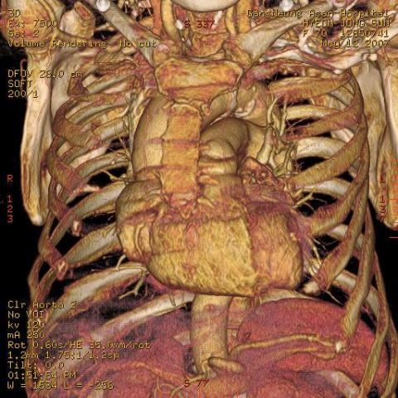
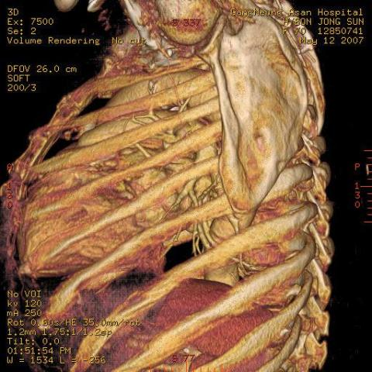

Slide 4
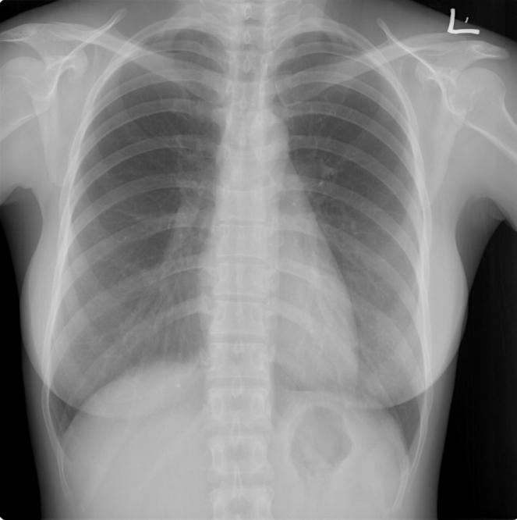

Slide 5
Advantage of chest film
Air structure.
General outline
Cheap
Easy follow up

Slide 6
Perception of the contrast
Air
Fat
Water
Bone

Slide 7
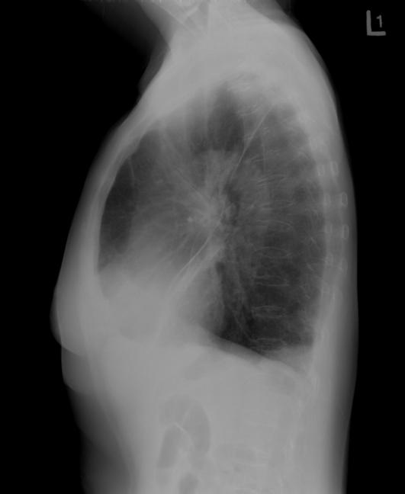

Slide 8
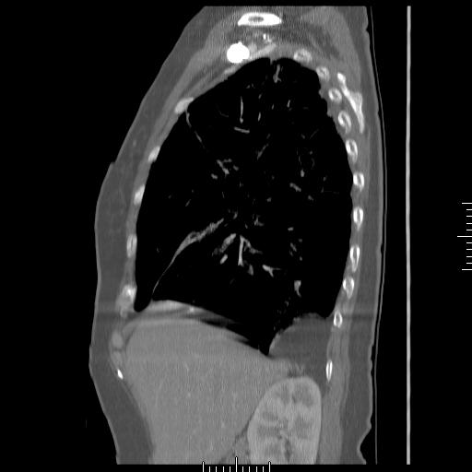

Slide 9
Summation effect
An object replacing medium less dense than itself increases the radiographic density.

Slide 10
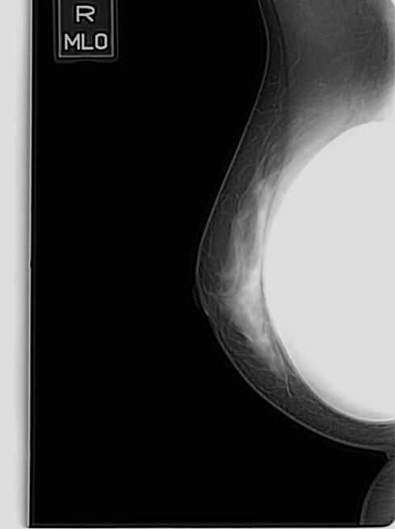
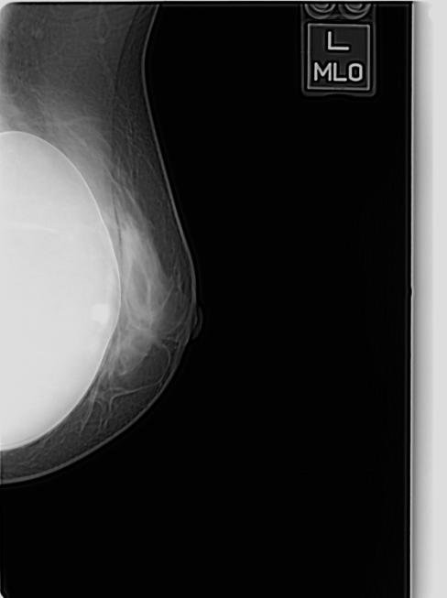

Slide 12
High kVp technique
Low contrast.
Large exposure latitude.

Slide 13
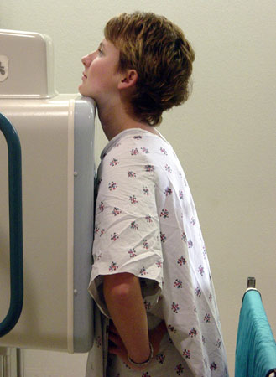
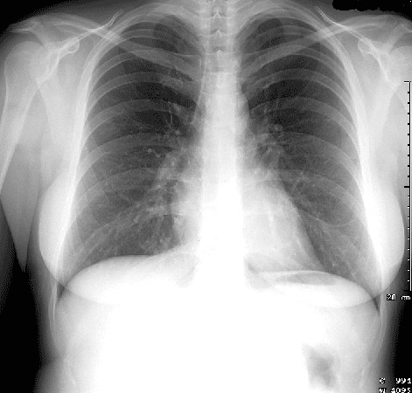
Positioning

Slide 14
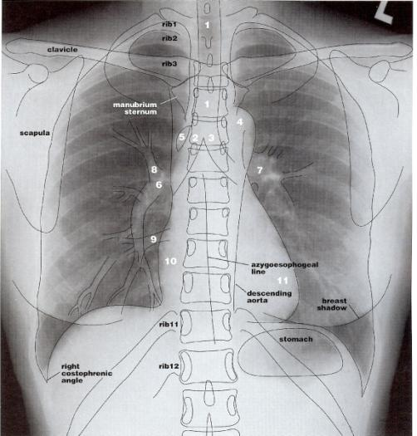
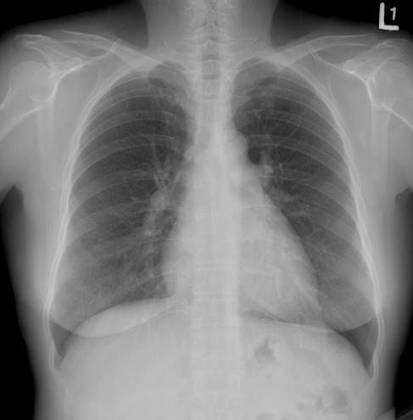

Slide 15
Interpretation of the chest radiograph
Always look at both views- PA and lateral.
Right heart border is formed by the right atrium, RML lesion(silhouette sign+).
Left heart border is formed by the left ventricle, lingular segment(silhouette sign+).
Right diaphragm is 1.5-2cm higher than the left.
Diaphragm is obscured by lower lobe process.

Slide 16
Interpretation of the chest radiograph
Major fissure are seen on the lateral view from anterior diaphragm to level of aortic arch.
Minor fissure is on right, seen on PA and lateral views.
Hilar opacities are predominantly due to pulmonary arteries and should be symmetric in size and density.
Aortic arch or knob is above the left hilum.

Slide 17
Interpretation of the chest radiograph
Trachea is midline but may be deviated by to the right or forward from a tortuous aorta.
The costophrenic angles should be sharp, except severe emphysema.
With good inspiration, caridothoracic ratio less than 50%.
RML and left lingular segment are projected over the heart on the lateral view.

Slide 18
Interpretation of the chest radiograph
To inflate the lungs to the level of the 10th rib posteriorly or 6th rib anteriorly.
Normal right and left lung opacification should be symmetric
Stomach bubble is under the left hemidiaphragm.
Don’t forget to look at the bone and soft tissue.

Slide 19
Size
Hilar height: left hilum 2cm higher than right.
Arteriobronchial: artery and bronchus shoud be the same size.
Right lower lobe artery to trachea: the width of the right lower lobe artery should not be wider than width of trachea

Slide 20
Size
Tracheobronchial wall to lumen: the wall of the trachea or bronchus should not be thicker than one eighth of the diameter of the lumen.
Azygotracheal: azygs vein should be no wider than one half the width of the treachea.

Slide 21
Density
Cardiohepatic: the heart should be about half as dense as the middle of the liver.
Intracardiac: the heart should be the same density on each side of the spine.
Intrahepatic : the top of the liver should be about half as dense as the middle.
Hila should be the same density.

Slide 23
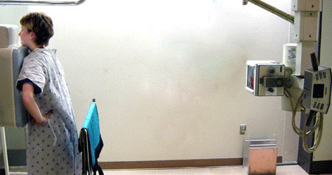
Positioning

Slide 24
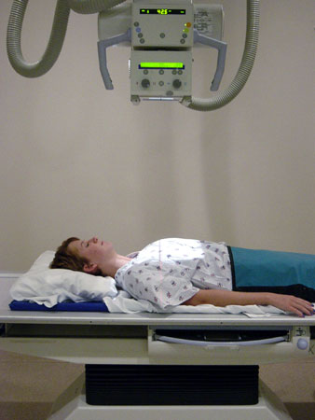
Positioning

Slide 25
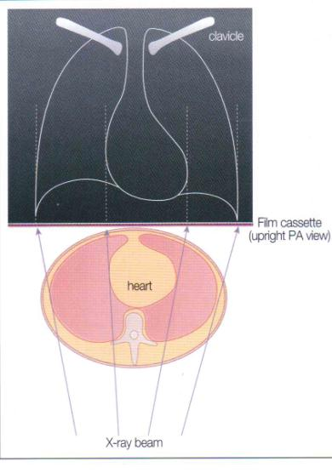
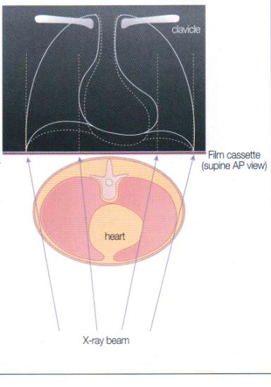

Slide 26
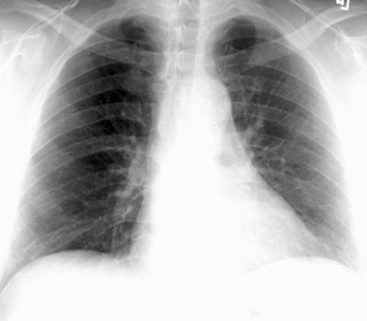
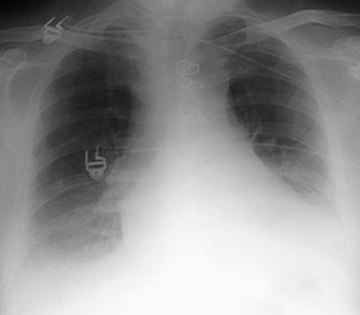

Slide 27
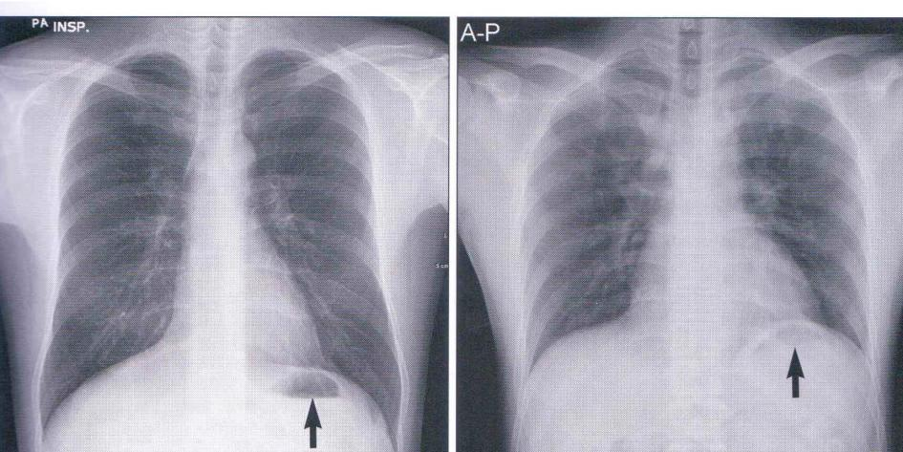

Slide 28
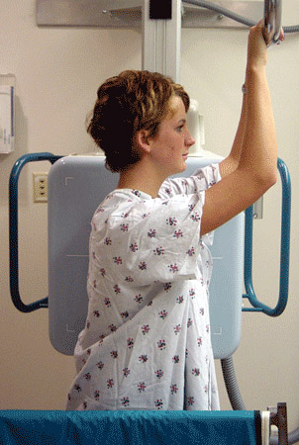
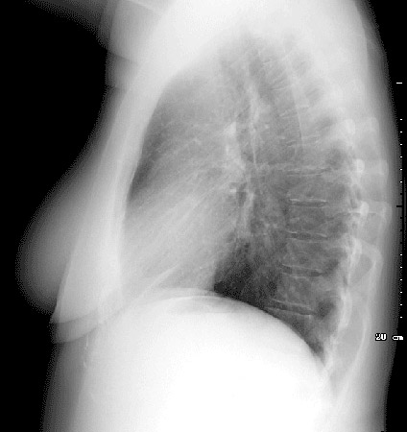
Positioning

Slide 29
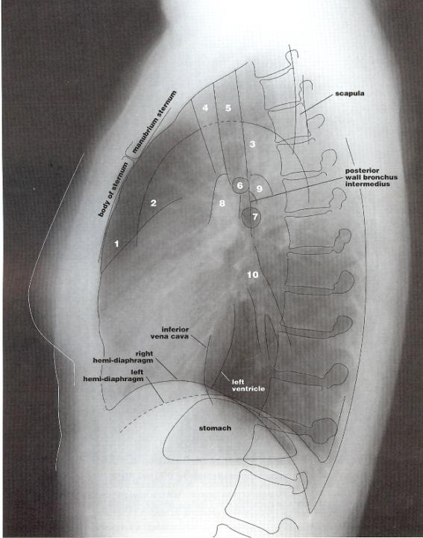

Slide 30
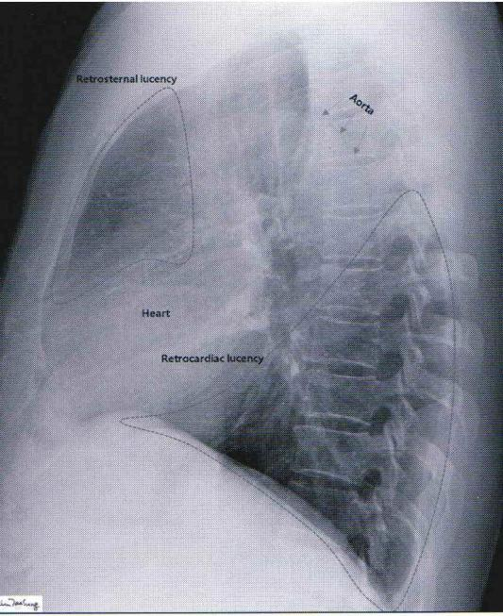

Slide 31
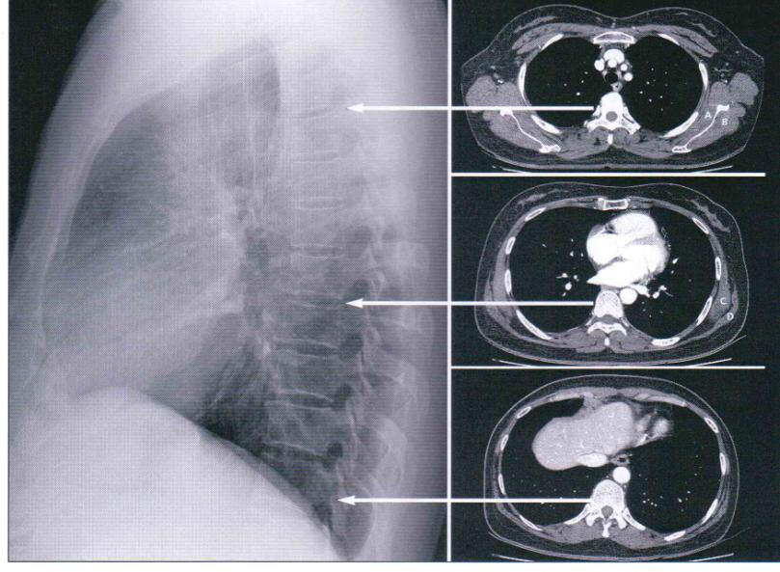

Slide 32
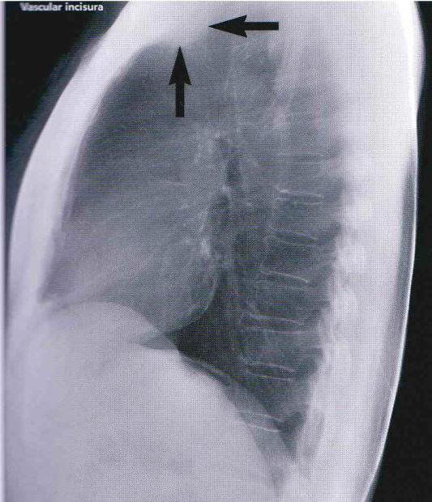

Slide 33
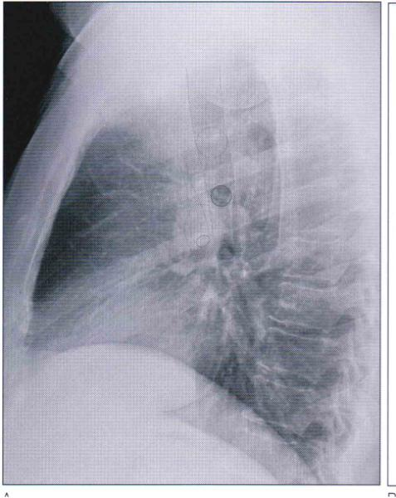
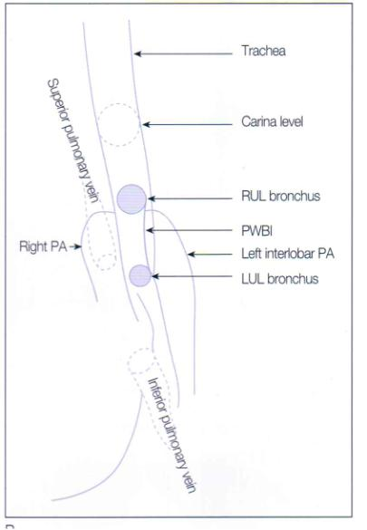

Slide 34
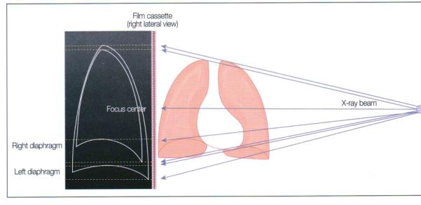
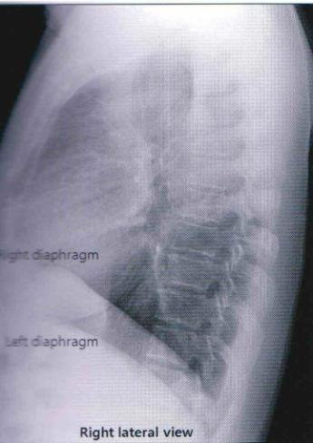

Slide 35
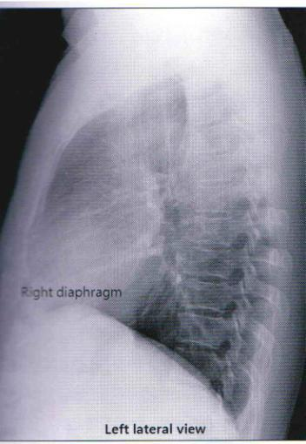
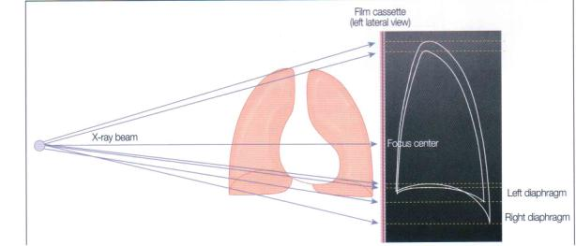

Slide 36
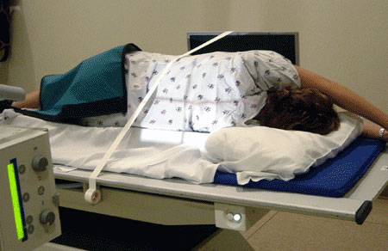
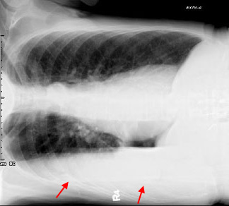
Positioning

Slide 37
Technique
정확한 tube의 중심정렬 및 피폭자의 자세
1) X-ray tube의 중심과 필름 중심의 일치
2) X-ray beam 은 평행하게 진행
3) 양측 견갑골은 폐야의 밖으로 위치
4) 최대 흡기 시 촬영
5) 상의는 모두 탈의 후 촬영 가운을 착용
Notes:
수기에 대하여

Slide 38
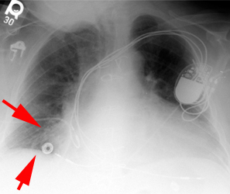
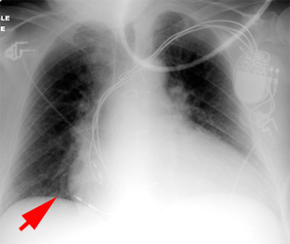
Technically adequate

Slide 39
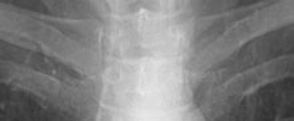
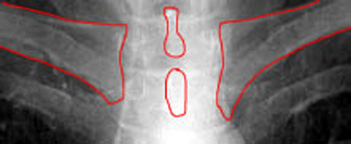
Rotation

Slide 40
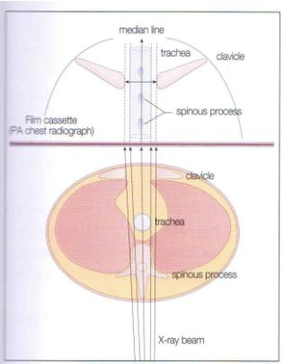
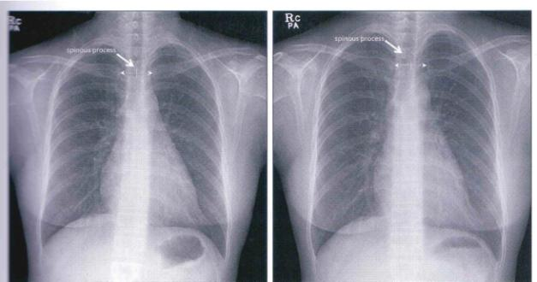

Slide 41
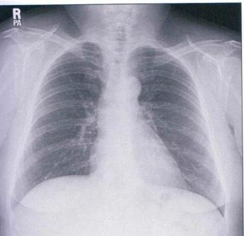
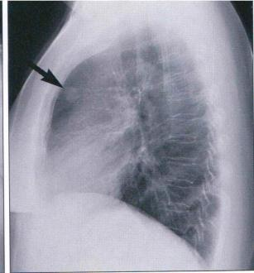
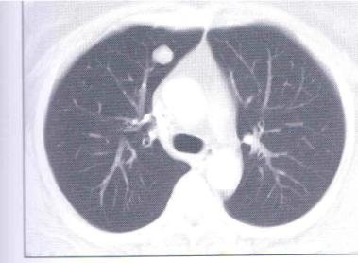

Slide 42
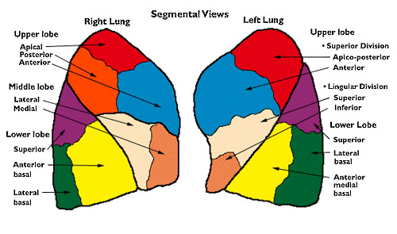
Lung anatomy

Slide 43
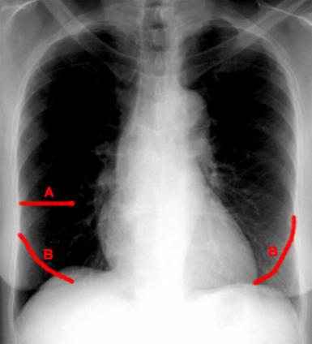
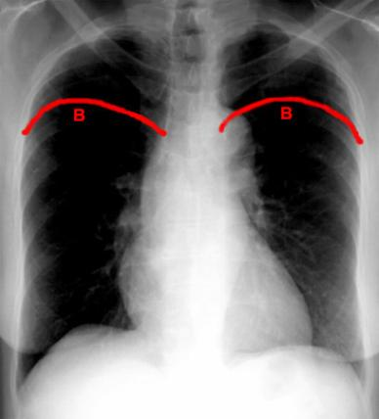
Lobe and Fissure

Slide 44
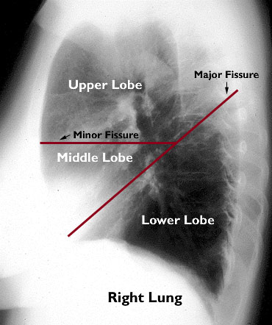
Lung anatomy

Slide 45
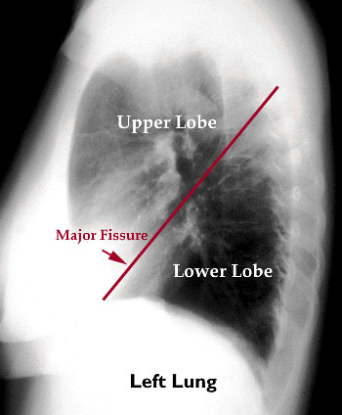
Lung anatomy

Slide 46
Laws of tangent
The length of the tangent along the path of the X ray beam is a major determinant of the line or edge.

Slide 47
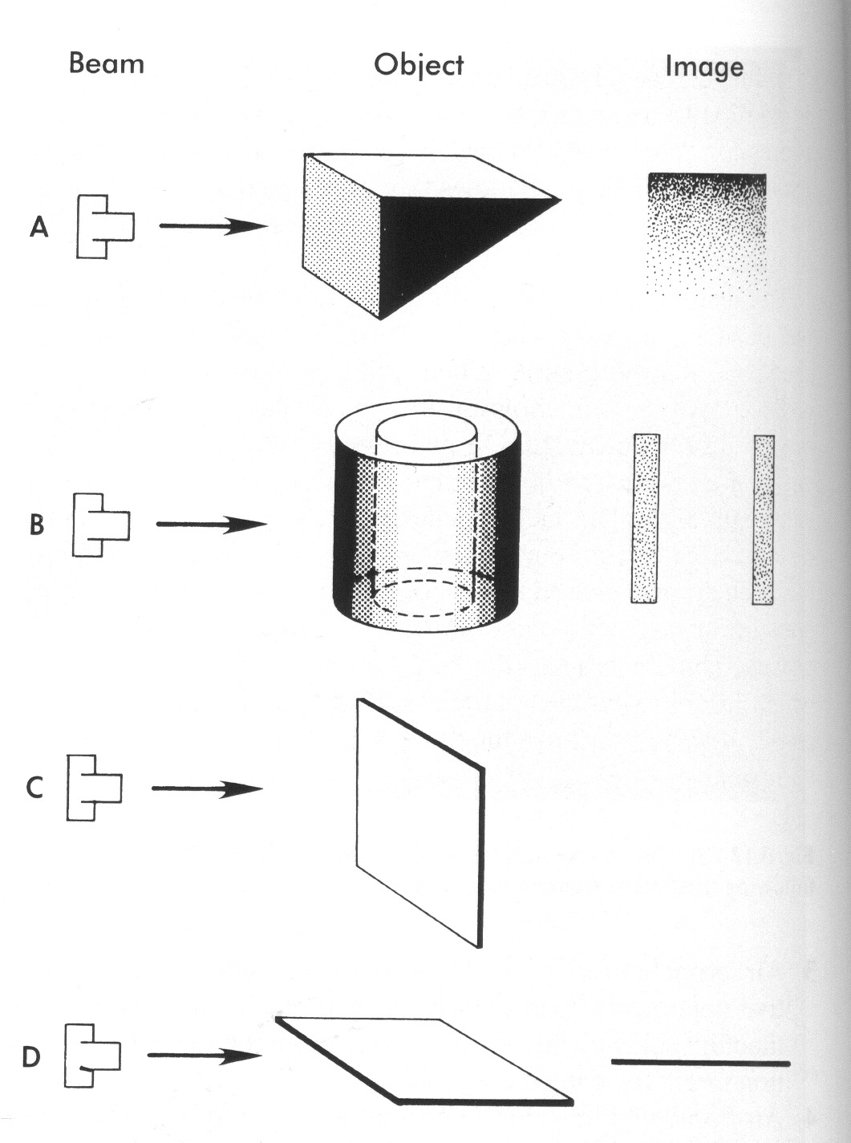

Slide 48


Slide 49
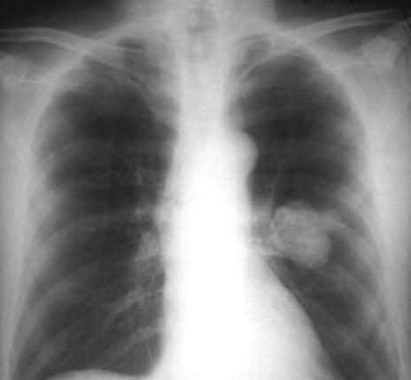
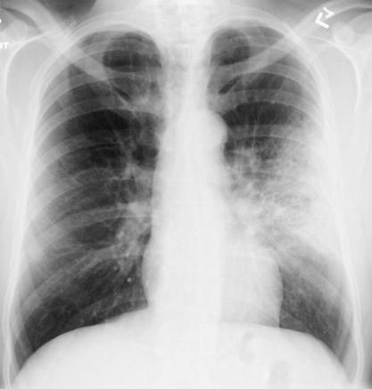
Opacity

Slide 50
무기폐
직접징후: 엽사위틈새의 전위 ,폐엽의 음영증가 , 기관지혈관의 집속
간접 징후: , 폐문의 이동, 동측 가로막의 상승 , 기관 또는 종격의 동측전위 , 보상성 과팽창 , 동측 흉곽크기의 감소 와 늑간의 협소화, 가로막근접정

Slide 51
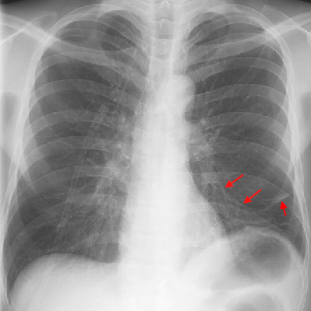
LLL Atelectasis

Slide 52

LLL Atelectasis

Slide 53


Lung and mediastinum

Slide 54

Lines and interface

Slide 55
Line and interface
Lines: less than 1mm in wide, thin intervening tissue.
Stripes: thicker lines formed by air outlining thicker intervening soft tissue( both paratracheal stripe, posterior tracheal stripe)
Interfaces: formed when structures of different densitis come in contact with one another ( paraspinal lines and azygoesophageal recess)

Slide 56
Anterior junctional line
Superior and inferior recess of anterior junctional reflection(V-shaped, and inverted V shape)
24.5-57%
Anterior mediastinal mass(thyroid,LN,neoplasm thymic mass, lipomatosis) or volume loss

Slide 57


Anterior junctional line

Slide 58

Anterior junctional line

Slide 59


Anterior junctional line

Slide 60


Posterior junctional line

Slide 61
Posterior junctional line
Superior and inferior recess
32%
Abnormal bulging or convexity; Posterior mass, esophageal mass,LN, aortic disease, neurogenic tumor

Slide 62

Posterior junctional line

Slide 63


Right paratracheal stripe

Slide 64
Right paratracheal stripe
RUL and right lateral border of the trachea
4mm
97% most commonly seen
Paratracheal LN, thyroid, parathyroid neoplasm, tracheal Ca or stenosis, pleural disease(effusion and thickening)

Slide 65

Right paratracheal stripe

Slide 66


Right paratracheal stripe

Slide 67


Left paratracheal stripe

Slide 68
Left paratracheal stripe
Left upper lobe and left tracheal wall
21-31%
Left pleural effusion. Paratracheal LN, neoplasm, hematoma

Slide 69


Left paratracheal stripe

Slide 70


Aortic-pulmonary stripe

Slide 71
Aortic-pulmonary stripe
Pleura of the anterior left lung coming in contact with and tagengetially reflecting over the mediastinal fat antrolateral to the left pulmonary artery and aortic arch.
Thyorid, thymic mass , prevascular LN

Slide 72

Aortic-pulmonary stripe

Slide 73


Aortic-pulmonary stripe

Slide 74


Aortopulmonary window

Slide 75
Aortopulmonary window
Posterior to the aortic-pulmonary stripe.
Left lung extends into the space connecting the aortic arch and the left pulmonary artery, thereby forming the normal concave reflections.

Slide 76
Aortopulmonary window
Inferior wall of aortic arch, superior wall of the left pulmonary artery, the posterior wall of the ascending aorta, anterior wall of the descending aorta
Left recurrent laryngeal nerve, left vagus nerve, ligamentum arteriosum, mediastinal fat, LN, left bronchial arteries, aorta.

Slide 77


Aortopulmonary window

Slide 78



Right paraspinal line

Slide 79
Right paraspinal line
Right lung and the posterior mediastinal fat and soft tissue.
8-12th T spine
23%
Osteophyte, mediastinal fat.
Posterior mediastinal mass, hematoma, extramedullary hematopoiesis

Slide 80


Right paraspinal line

Slide 81


Left paraspinal line

Slide 82
Left paraspinal line
Positive Mach band
41%
어두운 음영과 그에 접한 밝은 음영의 경계부위가 강조되어 보이는 시각적 착각현상.
Esophageal varieces

Slide 83


Left paraspinal line

Slide 84



Azygoesophageal recess

Slide 85
Azygoesophageal recess
Posteromedial right lower lobe of the lung
Air filled esophagus and intervening pleura come in contact with RLL
Mild leftward convexity
LN,hiatal hernia, bronchogenic cyst, esophageal CA, LA enlargement

Slide 86


Azygoesophageal recess

Slide 87


Posterior wall of bronchus intermedius

Slide 88


Posterior wall of bronchus intermedius

Slide 89
Posterior wall of bronchus intermedius
3-4cm in length
When lung within the azygoesophagel recess outlines the posterior wall.
90-95% of lateral chest film
Stripe projects through the radiolucent area created by the LUL bronchus

Slide 90
Posterior wall of bronchus intermedius
0.5-3 mm
Pulmonary edema, neoplasm,LN, Tbc , sarcoidosis

Slide 91



Slide 92

Inferior hilar window

Slide 93


Inferior hilar window

Slide 94



Slide 95


PWBI and IHW

Slide 96
Others interface
SVC interface
Azygos vein
Left subclavian artery interface
Preaortic interface
Descending aorta interface
Oblique interface in the right cardiophrenic angle

Slide 98

Endotracheal Tubes

Slide 99
Line and tube
Endotracheal tube:carina: 4-5cm
Tracheostomy tube: T3
Chest tube: 흉강의 전상부(기흉), 후하부(흉막삼출액)
Pericardial catheter: 심장음영내
Central venous catheter: 상대정맥내, 제 1늑골 내측

Slide 100
Line and tube
Swan-Gantz catheter: 근위부 폐동맥내
Cardiac pacemaker: 우심실 음연의 전하방, 심장윤곽의 최소한 3mm내
Nasogastric tube: 위식도 경계부에서 10cm 이상의 위장음영내
Intra-aoric counter-pulsation balloon: 죄쇄골하동맥 기시부 직후

