Slide 1
Pulmonary function test focusing to CS surgeon
Division of Pulmonary & Critical Care Medicine, Gangneung Asan Hospital. University of College of Medicine
Jae min Lim, M.D.

Slide 2
Pulmonary Function Tests
Evaluates 1 or more major aspects of the respiratory system
  Lung volumes
  Airway function
  Gas exchange

Slide 3
Use and Interpretation of PFTs
Types of pulmonary function testing
Indications for pulmonary function testing
Spirometry
  Volumes and Capacities
  Interpretation: Values and Curves
  Patterns of disease

Slide 4
Indications
Detect disease
Evaluate extent and monitor course of disease
Evaluate treatment
Measure effects of exposures
Assess risk for surgical procedures

Slide 5
Tests of Pulmonary Function
Spirometry (PFTs):
  forced exhalation
Plethysmography
  lung volumes
Diffusion Testing (DLCO)
Exercise testing (using spirometry)
Ventilation-Perfusion Scans (VQ)

Slide 6
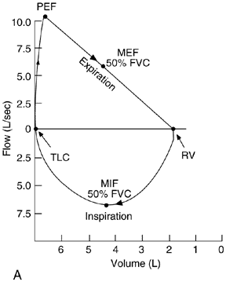
Flow-Volume Loop
Represents flow in both large and small airways
Measured directly on the volume axis after 1 second from the start of expiration
FEV1
Calculated ratio used to diagnose obstructive airway disease
Forced expiratory flow at 50% of the FVC
Analogous to the FEF₂₅₋₇₅ that was measured on the volume-time plot
Forced inspiratory flow at 50% of the inspiratory vital capacity

Slide 7
INTERPRETATION
General rule: When flow is ↓→ lesion is obstructive.
When volume is↓→ lesion is restrictive.

Slide 8
Response to Bronchodilators
>12% increase in FEV₁ or FVC
  AND
>200cc increase in FEV₁ or FVC
기관지의 가역성 → 수술 후 기관지의 가역적 폐쇄의 가능성 있음
Post bronchodilator response까지 검사를 할 것

Slide 9
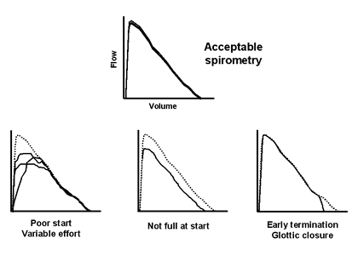
Cooperation
Poor cooperation: post operative에서 full inspiration을 시행하기 힘든것을 암시할 수도 있다.

Slide 10
Guide to Interpreting Pulmonary Function Tests
Eur Respir J 2005; 26: 948-968

Slide 11
PFTs- Aging
Loss of elastic tissue causes decreased Pl
See increased RV… air trapping
TLC constant
Therefore VC decreases, RV/TLC increases
FEV1 decreases, FEV1/VC decreases to about 70% in1 normal geriatric populations
Cohort effect! Survivors!

Slide 12
Loss of Function Over time
FEV1 4.0 L at age 30, 3.5L at age 60. 500 ml / 30 years = loss of 16 ml / year
Smokers have accelerated loss of function
Pulmonary disease have even more accelerated loss of function… do serial testing!

Slide 13
수술전 위험평가

Slide 14
PULMONARY RISK INDEXES
Cardiopulmonary Risk Index
Epstein SK. Chest 1993;104:694
Lawrence Risk Index
Lawrence WA. Chest 1996; 110: 744
Brooks – Brunn Risk Index
Brooks-Brunn JA. Chest 1997;111: 564
Multifactorial Risk Index
Arozullah AM. Ann Surg 2000; 232: 242

Slide 15
PULMONARY RISK INDEX
Variant | Score
BMI > 27 kg/m2 | 1
Cigarette (last 8 weeks) | 1
Productive coughing (last 5 days) | 1
Wheezing (last 5 days) | 1
FEV1/FVC < % 70 (predicted) | 1
PaCO2 > 45 mmHg | 1
Total | 6
> 4: Pulmonary risk 73.4 %
< 4: Pulmonary risk 11%
Pulmonary risk index: Factors that increase postoperative pulmonary complications

Slide 16
CARDIOPULMONARY RISK SCORE
Cardiac risk index score : 1 - 4
Pulmonary risk index score : 0 – 6
Cardiopulmonary risk index score = 1-10
Cardiac ( 1- 4 ) + Pulmonary ( 0 - 6 )
Index > 4 : Complication risk 22 times higher
Index < 2 : No Complication
Epstein et al. Chest 1993.

Slide 17
Postoperative
Pneumonia Risk Index
Type of Surgery
  AAA 15
  Thoracic 14
  Upper Abdominal 10
  Neck 8
  Neurosurgery 8
  Vascular 3
Age
  > 80 yrs 17
  70-79 yrs 13
  60-69 yrs 9
  50-59 yrs 4
Functional Status
  Totally dependent 10
  Partially dependent 6
Weight loss > 10% in 6 mo 7
Hx COPD 5
Gen Anesth 4
Impaired Sensorium 4
Hx CVA 4
BUN
  < 8mg/dL 4
  22-30 mg/dL 2
  > 30 mg/dL 3
Transfusion > 4 units 3
Emergency Surgery 3
Chronic Steroid use 3
Current smoker within 1 yr 3
Alcohol > 2 drinks in 2 wks 2
Arozullah et al, Ann Intern Med 2001

Slide 18
Postoperative Pneumonia Risk Index Scores in Two Cohorts
Risk Class | Cohort | Postop Pneumonia Developmental Cohort Rate | Postop Pneumonia Validated Cohort Rate
0 – 15 Points | 69,333 (43%) | 0.24% | 0.24%
16 – 25 Points | 55,757 (35%) | 1.19% | 1.18%
26 – 40 Points | 32,103 (20%) | 4% | 4.6%
41 – 55 Points | 3517 (2%) | 9.4% | 10.8%
> 55 Points | 95 (0.1%) | 15.8% | 15.9%
흉부외과 수술에서 기본적으로 가지고 있는 점수 + 가능한 점수
14(thoracic surgery) + 4(전신마취)+ 4(BUN)=22
추가적, Age (4-17) + COPD(5) + smoking within 1 yr (3) = 3~25
Arozullah et al, Ann Intern Med 2001

Slide 19
PFT in pre-op
수술을 절대적으로 금지하는 PFT의 하한치는 없음
PFT가 정상이라고 폐합병증이 없는 수술이 보장되지 않으며, 수술전후 필요한 폐관리를 소홀히 하는 이유가 되어서도 안됨
흉부외과의 수술은 기본적으로 호흡기 합병증이 높게 측정됨

Slide 20
RESECTION SURGERY
General Evaluation
Respiratory Function
  Spirometry – FEV₁
  Diffusion Capacity
  Postoperative FEV₁ (FVC, DLCO, VO₂ max)
ABG
Exercise Capacity

Slide 21
SPIROMETRY
FEV1 is primary parameter
  Pneumonectomy: Preoperative FEV1 > 2 L
  Lobectomy : Preoperative FEV1 > 1 L
  Wedge and segmental resection = 0.6 L

Slide 22
PULMONARY RISK EVALUATION
BEFORE MAJOR LUNG RESECTION
TEST Border values for low risk
FEV1 (for pneumonectomy ) > 2000 mL
FEV1 (for lobectomy ) > 1000 - 1500 mL
% FEV1* ( Preop.) before Bronchodil. > % 60
% DLCO ( Preop.) after Bronchodil. > % 60
FEV1 ( poc ) ** > 800 mL or
% FEV1 (poc ) > % 40
% DLCO (poc ) > % 40
Exercise VO2 max > 15 mL / kg / min
* Percentage of normal predicted value
** poc : Post operative calculated

Slide 23
Lung surgery risk at PFT
Predicted postoperative FEV1 and DLco | Risk | Recommendation
> 40% predicted | Average | No further test
<40% predicted | High | 16-60% mortality Consider less extensive resection Consider SRS
Any other combination | Intermediate | Exercise PFT (VO2max) >15-20mL/Kg : no increased risk of death <10mL/Kg: 50% mortality

Slide 24
What is predicted postoperative (ppo) value?
preoperative value X [1-(S-N)/(19-N)]
  S : the numbers of resected segments (10 for the right and 9 for the left lung)
  N : the numbers of nonfunctional or obstructed segments.

Slide 25
Predicted FEV1
Total number of lung segment (N=19)
LLL lobectomy
Preop FEV1=1.3L
Postoperative FEV1
=1.3L X (19-4)/19=1.0L
lesion | N | lesion | N
RUL | 3 | LUL-upper | 3
RML | 2 | LUL-lingular | 2
RLL | 5 | LLL | 4

Slide 26
그런데 꼭 이 공식이 맞을까? (1)
F/67
15YA LUL lobectomy d/t fungal ball
Slow growing mass at RML
 | meausred | %
FVC | 2.06 | 68
FEV1 | 1.50 | 63
FEV1/FVC | 73
DLco | 9.7mL/mmHg/min | 54

Slide 27
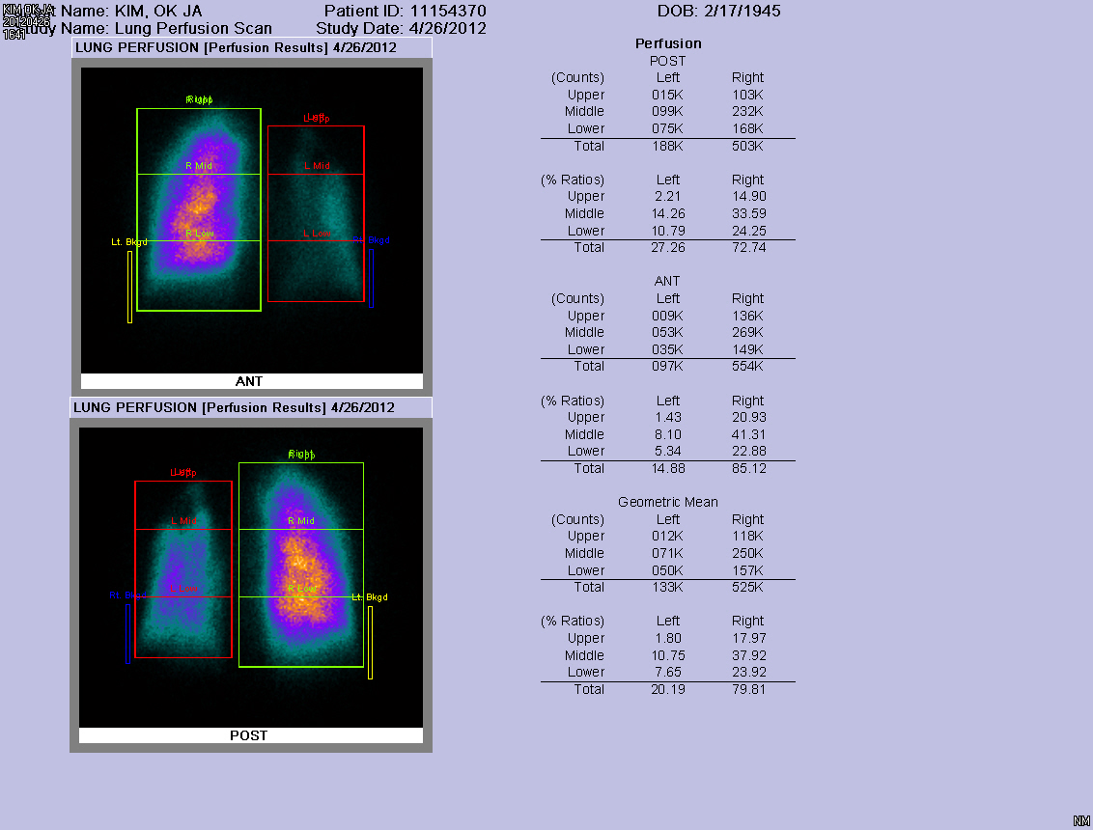
그런데 꼭 이 공식이 맞을까? (1)
 | Right | Left
perfusion | 72% | 28%
Geometric | 79% | 21%

Slide 28
그런데 꼭 이 공식이 맞을까? (1)
Limitation
  overestimation of functional loss
  possibly the denial of surgery to patients with borderline PFT
250 mL after lobectomy
500 mL after pneumonectomy.
Zeiher et al, Chest1995

Slide 29
그런데 꼭 이 공식이 맞을까? (1)
Lung volume이 균일하지 않은 환자의 경우 단순 공식을 사용하는 것은 정확한 예측에서 벗어날 수 있다.
Perfusion scan을 이용하는 것이 정확한 예측에 도움이 된다.
  FEV1 preoperative X (1 - fractional contribution of resected lung segments)

Slide 30
그런데 꼭 이 공식이 맞을까? (2)
lung cancer로 lobectomy를 해야 하는 환자에서 postoperative DLco가 계산 공식상에서 40% 안되면 어떻게 할 것인가?

Slide 31
그런데 꼭 이 공식이 맞을까? (2)
Lobectomy leads to very little permanent functional deficit.
  Bolliger CT et al. Eur Respir J 1998 (review)

Slide 32
그런데 꼭 이 공식이 맞을까? (2)
공식에 대한 고려는 lobectomy보다 pneumonectomy에 대하여 더 고려해야 하며
Lobectomy는 큰 영향을 주지 않을 수 있다.

Slide 33
DIFFUSION CAPACITY
DLCO < % 50 major resection is contrandicated
Cander L. A J Cardiol 1963
DLCO < % 60 mortality risk % 24
ppoDLCO < % 40 mortality risk % 33
Markos J et al. Am Rev Respir Dis 1989

Slide 34
ARTERIAL BLOOD GASES
Hipoxia is not a predictor alone
  Improvement of endobronchial obstruction after surgery ! ( V/ Q)
Is PaCO2 > 45mmHg significiant risk factor? Not proven!
There are reports which show no difference
Kearny DJ. Chest 1994
Marshall MC. Clin Chest Med 1993

Slide 35
CARDIOPULMONARY EXERCISE TESTS
Important in lung resection surgery
Recommendation of BTS and ACCP
  VO₂max > 15 ml/kg/d Operable
  VO₂max < 15 ml/kg/d High risk
Notes:
BTS Guidelines: Guidelines on the selection of patients with lung cancer surgery. Thorax 2001; 56:89-108
Beckles MA, Spiro SG, Colice GL et al. The physiologic evaluation of patients with lung cancer being considered for resectional surgery. Chest 2003; 123: 105S-114S

Slide 36
PFT가 borderline한 상황에서 exercise cardiopulmonary test를 시행할 수
없는 병원에서는 어떠한 방법을 쓸 수 있는가?
6MWT (6 minute walking test)
Stair climbing test
"Shuttle walk"

Slide 37
PERFORMANCE EXERCISE TESTS
Stair climbing test
6 - 12 minute walking test: Submaximal test
(Correlation with VO2max r= 0.4 – 0.6 )
10 meters “Shuttle walk” test. Progressive maximal test (Correlation with VO2max r=0.98 )

Slide 38
British Thoracic Society Thorax 2001;56: 89-108
SPIROMETRY
LOBECTOMY
PNEUMONECTOMY
FEV₁>1500 ml
FEV₁>2000 ml
No
Yes
No
Surgery
FURTHER EXAMINATION
Quantitative scintigraphy
D_{L}CO
ABG
Exercise tests (selected cases)
Post-op FEV₁ > % 40
Post-op D_{L}CO > % 40
SaO₂ > % 90
Post-op FEV₁ < % 40
Post-op D_{L}CO < % 40
Acceptable risk
High risk

