Slide 1
Inflammatory lung disease
부산대학교병원
조정수

Slide 2
contents
Bacterial infections of the lungs and Bronchial compressive disorder
Pulmonary tuberculosis and other Mycobacterial disease of the lung
Surgery for the management of Mycobacterium tuberculosis and Nontuberculous Mycobacterial infections of the lung
Mycotic and Actinomycotic infections of the lung
Pleuropulmonary Amebiasis
Hydatid disease of the lung
Pulmonary paragonimiasis and its surgical complications

Slide 3
Bacterial infections of the lungs and Bronchial compressive disorder
Surgical spectrum of bacterial infection of the lung and bronchial compressive disease
Spectrum of surgical infectious disease
Bronchiectasis
Lung abscess
Organizing pneumonia
Pulmonary infection in granulomatous disease of childhood
Tuberculosis and fungal disease
Thoracic empyema
Bronchial compressive pulmonary disorders
Right middle lobe syndrome
Broncholithiasis
Inflammatory lymphadenopathy
Congenital processes
Sclerosing mediastinitis
Cardiovascular disease

Slide 4
Bacterial infections of the lungs and Bronchial compressive disorder
Bronchiectasis
  Abnormal permanent dilatation of subsegmental airways
  Etiology
    Congenital - Congenital cystic bronchiectasis, Selective immunoglobulin A deﬁciency, Primary hypogammaglobulinemia, Cystic ﬁbrosis, α1-antitrypsin deﬁciency, Kartagener’s syndrome, Congenital deﬁciency of bronchial cartilage, Bronchopulmonary sequestration
    Acquired – Infection, Bronchial obstruction(Intrinsic: tumor, foreign body Extrinsic: enlarged lymph nodes), Middle lobe syndrome, Scarring secondary to tuberculosis, acquired hypogamma globulinemia

Slide 5
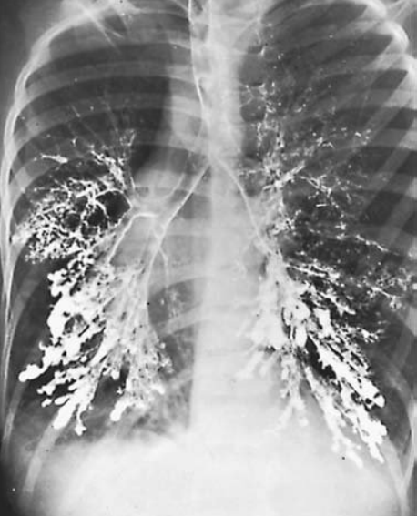
Bacterial infections of the lungs and Bronchial compressive disorder
Classification of Bronchiectasis
    Saccular bronchiectasis
    Cylindrical bronchiectasis
    Pseudobronchiectasis
    Post-tuberculosis bronchiectasis
    Genetic-related bronchiectasis
Bilateral saccular bronchiectasis,
Characteristic of the preantibiotic era,
involving the lower lobes, lingula, and RML.

Slide 6
Bacterial infections of the lungs and Bronchial compressive disorder
Anatomic Distribution of Bronchiectasis in Order of Frequency
    Left lung more often than right lung(9:7)
    Left lower lobe, most frequently involved
    Right middle lobe and lingula, next most frequently involved
    Total left bronchiectasis, fourth most commonly involved
    Right lower and total right are less often involved
    Right upper lobe is involved more often than left upper lobe(4:1)

Slide 7
Bacterial infections of the lungs and Bronchial compressive disorder
Treatment of Bronchiectasis
  Medical
    Prevention and control
    Antibiotics
    Postural drainage
  Surgical
    Unilateral, segmental, or lobar distribution
    Persistent, recurrent symptoms when medication is discontinued
    Recurrent infection and hemoptysis
  Transplantation

Slide 8
Bacterial infections of the lungs and Bronchial compressive disorder
Results of Surgical Resection for Bronchiectasis
Author | Patients | Mortality(%) | Morbidity(%)
Sealy,etal.(1966) | 140 | 1.4 | 3
Sanderson,etal.(1974) | 242 | 0.4 | 33
Annest,etal.(1982) | 24 | 8.3 | 13
Dogan(1989) | 487 | 3.5 | 11

Slide 9
Bacterial infections of the lungs and Bronchial compressive disorder
Lung abscess
  Sub acute pulmonary infection in which the chest radiograph shows a cavity within the pulmonary parenchyma
Classification of Lung abscess
Primary lung abscess (acute or chronic)
Related to anaerobic aspiration
Related to speciﬁc pneumonia
Secondary lung abscess
With existing lung disease
Metastatic from extrathoracic source
Obstructing bronchial carcinoma
Bronchoesophageal ﬁstula
Foreign body inhalation
Pulmonary infarction
Bullous emphysema

Slide 10
Bacterial infections of the lungs and Bronchial compressive disorder
Contributing Factors to Lung Abscess
Dental and periodontal disease
Anesthesia
Alcohol abuse
Seizure disorders
Immunosuppression
Neuromuscular disorders with bulbar dysfunction
Esophageal motor disorders
Bronchial obstruction

Slide 11
Bacterial infections of the lungs and Bronchial compressive disorder
Bacteriology of Lung Abscess
Anaerobic
Bacteroides fragilis
Fusobacterium bacilli
Streptococcus, β-hemolytic streptococcus
Aerobic
Klebsiella pneumoniae
Pseudomonas aeruginosa
Staphylococcus aureus
Streptococcus pneumoniae
Haemophilus inﬂuenzae

Slide 12
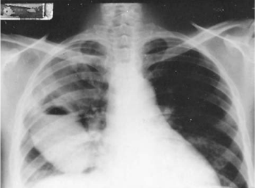
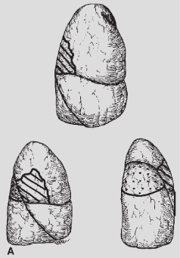
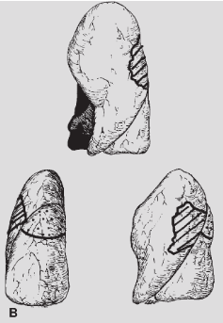
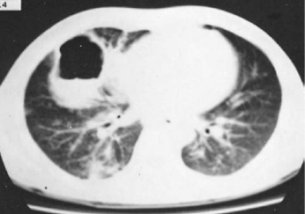
Lung abscess
Axillary sub-segment of the posterior segment at the upper lobe and superior segment of the lower lobe.
A: Right lung. B: Left lung.
A: AP view of a patient with a large
aspiration abscess of the RML
B: CT examination

Slide 13
Differential diagnosis of cavitary lung lesions
Cavitating carcinoma, generally squamous cell
Tuberculous or other fungal diseases
Pyogenic lung abscess
Empyema with bronchopleural ﬁstula.
  Patient’s history is important.
  Absence of fever, lack of purulent sputum, and anormal white blood cell count should raise strong suspicion of an underlying neoplasm.

Slide 14
Bacterial infections of the lungs and Bronchial compressive disorder
Principles of Therapy for Lung Abscess
Identiﬁcation of etiologic organism
Prolonged antimicrobial therapy
Adequate drainage in acute stage
Chest physiotherapy
Bronchoscopy
Percutaneous catheter drainage
Emergency surgical treatment
Speciﬁc indication
External drainage (only in emergent situation)

Slide 15
Bacterial infections of the lungs and Bronchial compressive disorder
Indications for Surgery in Lung Abscess
Acute stage (emergency)
Complications
- Bronchopleural ﬁstula
- Empyema
- Bleeding
Chronic stage (deﬁnitive)
Persistent symptoms and signs
Recurrent complications (empyema, bronchopleural ﬁstula)
Suspicion of carcinoma
Persistence of lung abscess larger than 6cm after 8weeks of treatment
Surgical intervention is now required in only about 10% of patients with lung abscess.

Slide 16
Bacterial infections of the lungs and Bronchial compressive disorder
Organizing pneumonia
  An occasional patient with pneumonitis, even with appropriate antibiotic therapy, does not follow the usual predictable course and develops an organized pneumonic process.
  This also is seen in some patients who receive little or no therapy.
  The course varies considerably, but the infectious process resolves into a protracted chronic course, and little or no resolution is seen on chest radiography.
  Regardless of its cause, the area of organized pneumonia should be resected.
  Outcome is satisfactory.

Slide 17
Pulmonary tuberculosis and other Mycobacterial disease of the lung
Diagnosis of infection
  Targeted tuberculin skin testing(TST)
  Whole blood interferon-gamma release assays(IGRA)
Diagnosis of active tuberculosis
  Epidemiologic risk for infection
  Clinical and radiographic presentation
  Results of tuberculin skin testing
  Results of microbiologic evaluation

Slide 18
Pulmonary tuberculosis and other Mycobacterial disease of the lung
Principles of therapy for active pulmonary tuberculosis
  Use multiple drugs to which the organism is susceptible
  Choice of initial therapy should be guided by local resistance patterns and modiﬁed by in vitro drug susceptibility tests when available
  Drug therapy should be for a sufficiently long period of time (in most cases at least 6months) to provide durable cure of disease
  Always add more than one drug to which the organism is believed sensitive to a potentially failing regimen
  Use directly observed therapy whenever possible to reduce the chances for nonadherence
  Promptly report each case to the local public health department

Slide 19
Pulmonary tuberculosis and other Mycobacterial disease of the lung
Recommended regimens (1st line agents)
Regimen | Drugs | Initiation phase(doses) | Drugs | Continuation phase(doses)
1 | I,R,P,E | 8(I₇P₇E₇R₇) | I,R | 18(I₇R₇)
 |  | 8(I₅P₅E₅R₅) |  | 18(I₅R₅)
 |  |  |  | 18(I₃R₃)
2 | I,R,P,E | 2(I₇R₇P₇E₇) then 6(I₂R₂P₂E₂) | I,R | 18(I₂R₂P₂E₂)
3 | I,R,P,E | 8(I₃P₃R₃E₃) | I,R | 18(I₃R₃)
4 | I,R,E | 8(I₇R₇E₇) | I,R | 28(I₇R₇)
 |  | 8(I₅R₅E₅) |  | 28(I₅R₅)
2HERZ/4HER(or 7HER)

Slide 20
Pulmonary tuberculosis and other Mycobacterial disease of the lung
Definition of multidrug-resistant(MDR) TB
  Resistance to at least isoniazid and rifampin
  Recommended regimens for MDR (2nd line agents)
    p-Aminosalicylicacid (8–12g)
    Ethionamide (15–20mg/kg)
    Cycloserine (10–15mg/kg)
    Ofloxacin, levofloxacin (400mg), Moxiﬂoxacin (400mg)
    Capreomycin (15–20mL/kg), Streptomycin, Kanamycin (15–30mg/kg)
    Thiacetazone (150mg)
Definition of extensively drug resistant(XDR) TB
  MDR strains resistant to any ﬂuoroquinolone and to at least one second-line injectable drug(amikacin, capreomycin, or kanamycin)

Slide 21
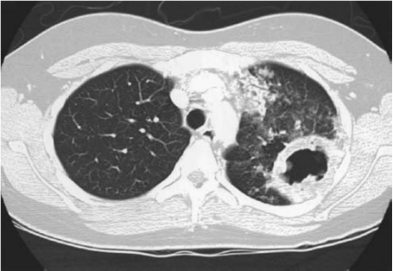
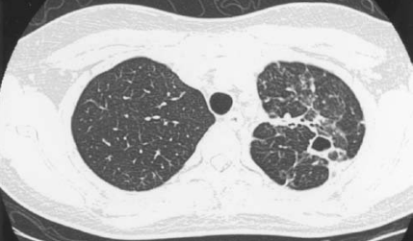
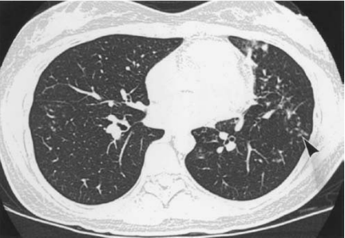
Pulmonary tuberculosis and other Mycobacterial disease of the lung
Radiographic imaging
After 7 months of multiple-drug chemotherapy

Slide 22
Surgical role in the treatment of patients with TB
Another treatment option for MDR or XDR TB that is anatomically localized, particularly in the face of limited medical therapy options, is resectional surgery
  However, no randomized studies looking at the role of surgery in MDR TB.
  Retrospective cohort studies have demonstrated success, both within developed and resource-poor countries.
  If surgery is considered for a patient with MDR TB, it should ideally be performed only after several months of chemotherapy and should be followed by up to 18 months of chemotherapy

Slide 23
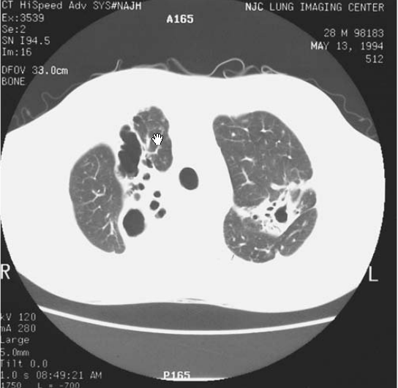
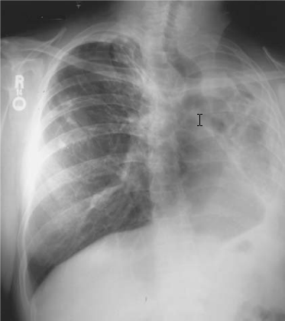
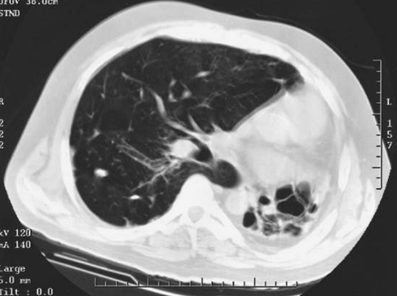
Surgical role in the treatment of patients with TB
Surgery plays a role in the treatment of patients with TB.
  Patients with lungs destroyed by MDR(XDR) TB or cavitary disease with or without positive sputum smears.

Slide 24
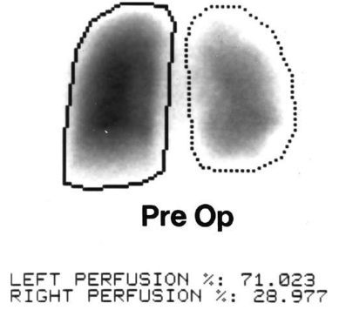
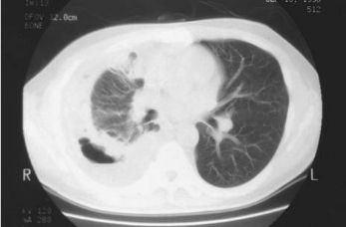
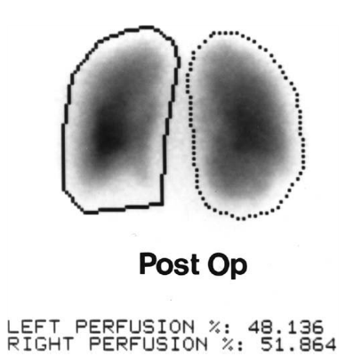
Surgical role in the treatment of patients with TB
  Decortication alone for management of a trapped lung is sometimes indicated.

Slide 25
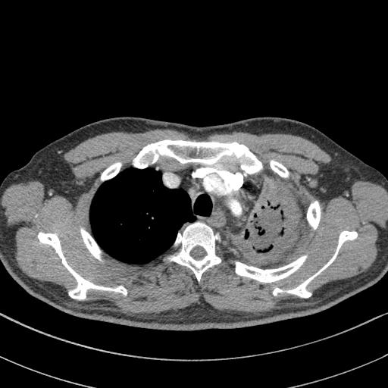
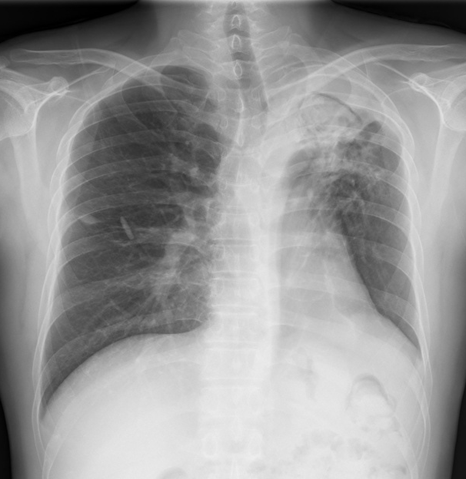
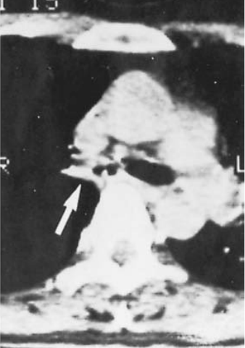
Surgical role in the treatment of patients with TB
  Mycotic infection and life-threatening hemoptysis in patients with tuberculosis
  Tuberculous bronchial stricture
cough and
exertional dyspnea
Bronchial stricture due to endobronchial tuberculosis

Slide 26
Environmental Mycobacterial infection (Nontuberculous Mycobacteria, NTM) of the lung
Environmental mycobacteria (EM) are found free in water and soil.
EM infections seem to be increasing in absolute numbers as well as in recognition as a major cause of pulmonary disease.
Most frequently, EM infects patients with previously diseased lungs, and the infection has a more indolent course than in patients infected with M. tuberculosis.
Lung damage due to previous TB, bronchiectasis, and chest irradiation is found in many patients with EM infections..
EM infections, unlike TB, are not transmitted from person to person

Slide 27
Environmental Mycobacterial infection (Nontuberculous Mycobacteria, NTM) of the lung
The most common EM infection is caused by the M. avium complex(MAC, M. avium and M. intracellulare).
MAC is widespread and infection usually advances slowly
Slow growing EM infections are caused by M. kansasii, M. xenopi, M. malmoense, and M. simiae.
Rapid growing EM producing signiﬁcant lung pathology includes M. abscessus and M.chelonae
Patients infected with rapid growers are more difﬁcult to treat because of poor bacteriocidal antibiotic effectiveness against these organisms.

Slide 28
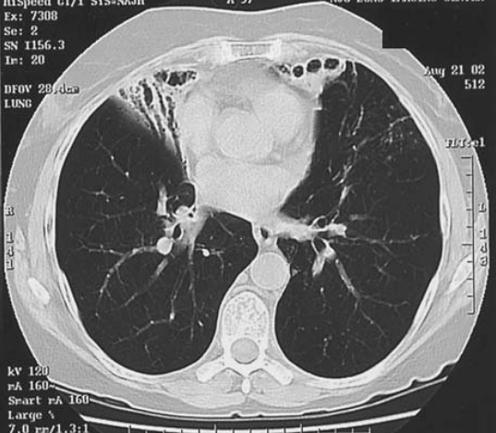
Environmental Mycobacterial infection (Nontuberculous Mycobacteria, NTM) of the lung
The medical treatment of EM infections, as with TB, is a multi-drug regimen based on speciﬁc culture data. Resistance and intolerance to antimycobacterial drugs are high.
EM infections to involve the lingula, middle lobe, or both of slender older women.

Slide 29
Environmental Mycobacterial infection (Nontuberculous Mycobacteria, NTM) of the lung
Surgical intervention for patients with EM infections is similar to that for patients with MDR TB.
After appropriate antibiotic therapy, resection should be performed if there is a destroyed lung, extensive cavitary disease, or severe involvement of the right middle lobe or lingula.
Muscle ﬂaps are used for the same indications as in patients with MDR TB; however, they are not used following resection of the middle lobe or lingula or in most cases following the resection of a lower lobe.

Slide 30
Mycotic and Actinomycotic infections of the lung
Mycotic infection
  Fungal infections of the lungs have traditionally represented a very small component of the practice of most thoracic surgeons.
  Most fungal pathogens are opportunistic, causing clinically signiﬁcant infection only in the presence of impaired host defenses.
    Histoplasmosis, Blastomycosis, Coccidioidomycosis, Aspergillosis, aspergilloma,
    Zycomycosis, Cryptococcosis, Candidiasis
Actinomycotic infection
  Actinomycosis is caused by the facultative an aerobic bacterium Actinomyces.
  The pulmonary form is rare, making up 15% of reported disease and usually occurring as a secondary infection of a previously existing cavity or bronchiectasis.

Slide 31
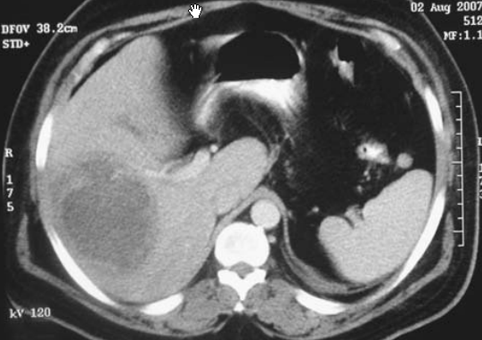
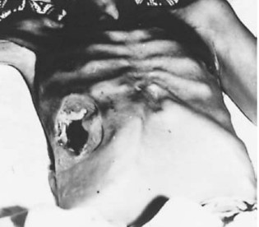
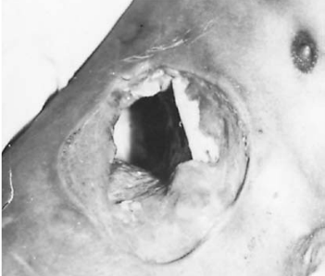
Pleuropulmonary Amebiasis
Pleuropulmonary amebiasis is almost invariably the result of perforation of an amebic liver abscess through the diaphragm.
It accounts for 10% of all deaths from amebiasis.
To understand its management, the nature of amebiasis and of the liver abscess it produces must be understood.

Slide 32
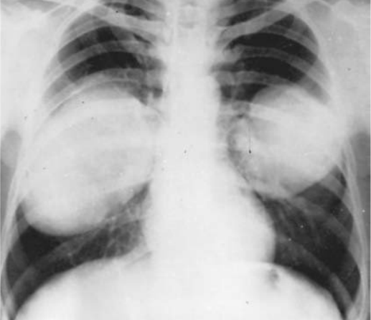
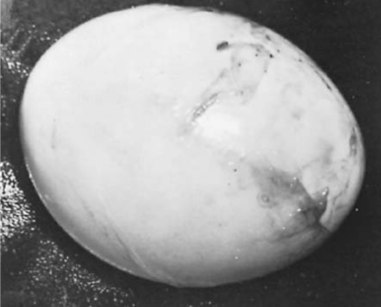
Hydatid disease of the lung
Hydatid disease is caused by the Echinococcus granulosus tapeworm and is known as echinococcosis or hydatidosis.
Echinococcosis remains a signiﬁcant health problem in endemic areas.

Slide 33
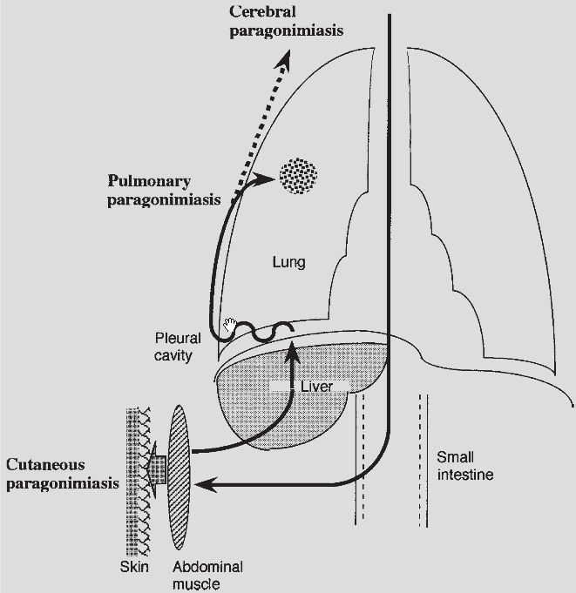
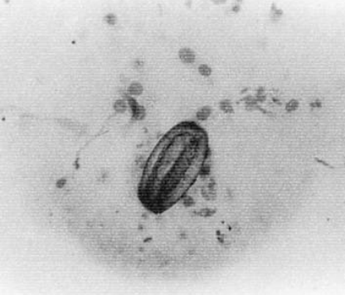
Pulmonary paragonimiasis
Paragonimiasis is a subacute to chronic inﬂammatory disease of the lung caused by lung ﬂukes of the genus Paragonimus
Migration route of Paragonimus in humans.
Paragonimiasis patients express various symptoms depending on the location of the worms.
Paragonimus Westermani egg isolated
by bronchial brushing

