Slide 1

ECMO : Current Challenges and Future Directions
제 5차 전공의 연수교육
In Seok Jeong M.D.
Department of Thoracic and Cardiovascular Surgery
Chonnam National University Hospital

Slide 2
My favorite fields
In our hospital
  Congenital Heart Disease (including adult)
  ECMO (Adult, Pediatrics and Neonates)
  Trauma
Who am I ?

Slide 3
Who are you? or
What will you do in the future?
Cardiac surgeon ?
Thoracic surgeon ?
Vascular surgeon ?
？
＋

Slide 4

Take a different route

Slide 5
Who are you? or
What will you do in the future?
Trauma surgeon
Intensivist
Cosmetic surgeon
Primary physician
Military doctor
Health care manager
Businessman …..
Cardiac surgeon
Thoracic surgeon
Vascular surgeon
＋

Slide 6
Intensivist
Critical care specialist

Slide 7
ICU Organization
Closed ICU
Open ICU
Semi-closed / Transitional ICU

Slide 8
Open ICU
Any physician with privileges to admit patients to the hospital may admit and care for patients in the ICU.

Slide 9
Closed ICU
All patients entering the ICU are transferred to the care of an intensivist (critical care specialist) for the duration of the ICU stay.

Slide 10
Semi-closed / Transitional ICU
Patients are referred for ICU admission to an intensivist, who reviews all admissions for appropriateness (gate-keeping).
  Intensivist
    Admission and discharge decision (triage function)
    More often emergency response: hemodynamic, respiratory, fluid, nutrition
  Attending surgeon: wound care

Slide 11
Need for intensivist
Decrease the mortality
Shorten the ICU stay
Save the hospital cost
Protect the patient’ safety and personality

Slide 12
Trend: open closed
Intensivist !!

Slide 13
Sub-specialist for critical care in Korea
대한중환자학회 세부 전문의 제도 인증: 2008년
8개 유관 학회:
  내과, 외과, 소아과, 신경과, 흉부외과, 신경외과, 마취과, 응급의학과
2011년 현재: 1191명
2012년: 147명 시험응시

Slide 14
중환자의학 세부전문의 전문과 별 분포
2011년 1191명
27.5%
21%
10.6%

Slide 15
Critical care medicine
Procedure: Air way management…
Monitoring: bedside US….
Nutrition
Cardiovascular problem: shock, arrhythmia..
Respiratory problem: ARDS..
Renal problem: ARF..
Infection control
Hematologic and Oncologic problem
…….
….
..
Mechanical circulatory / respiratory support: ECMO

Slide 16
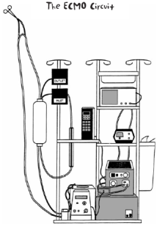
ECMO

Slide 17
Abbreviation & Definition
ECMO : Extracorporeal Membrane Oxygenation
인공 폐와 혈액 펌프를 이용한 심폐기능 보조
ECLS : Extracorporeal Life Support
지속적으로 심폐기능을 보조하는 포괄적인 개념
VAD : Ventricular Assist Device
인공 폐 없이 혈액 펌프를 이용한 심실 기능 보조
PCPS : Percutaneous Cardiopulmonary Support
경피적 접근을 통한 심폐기능 보조
ECPR : Extracorporeal Cardiopulmonary Resuscitation
ECLS 보조 하에 이뤄진 CPR

Slide 18
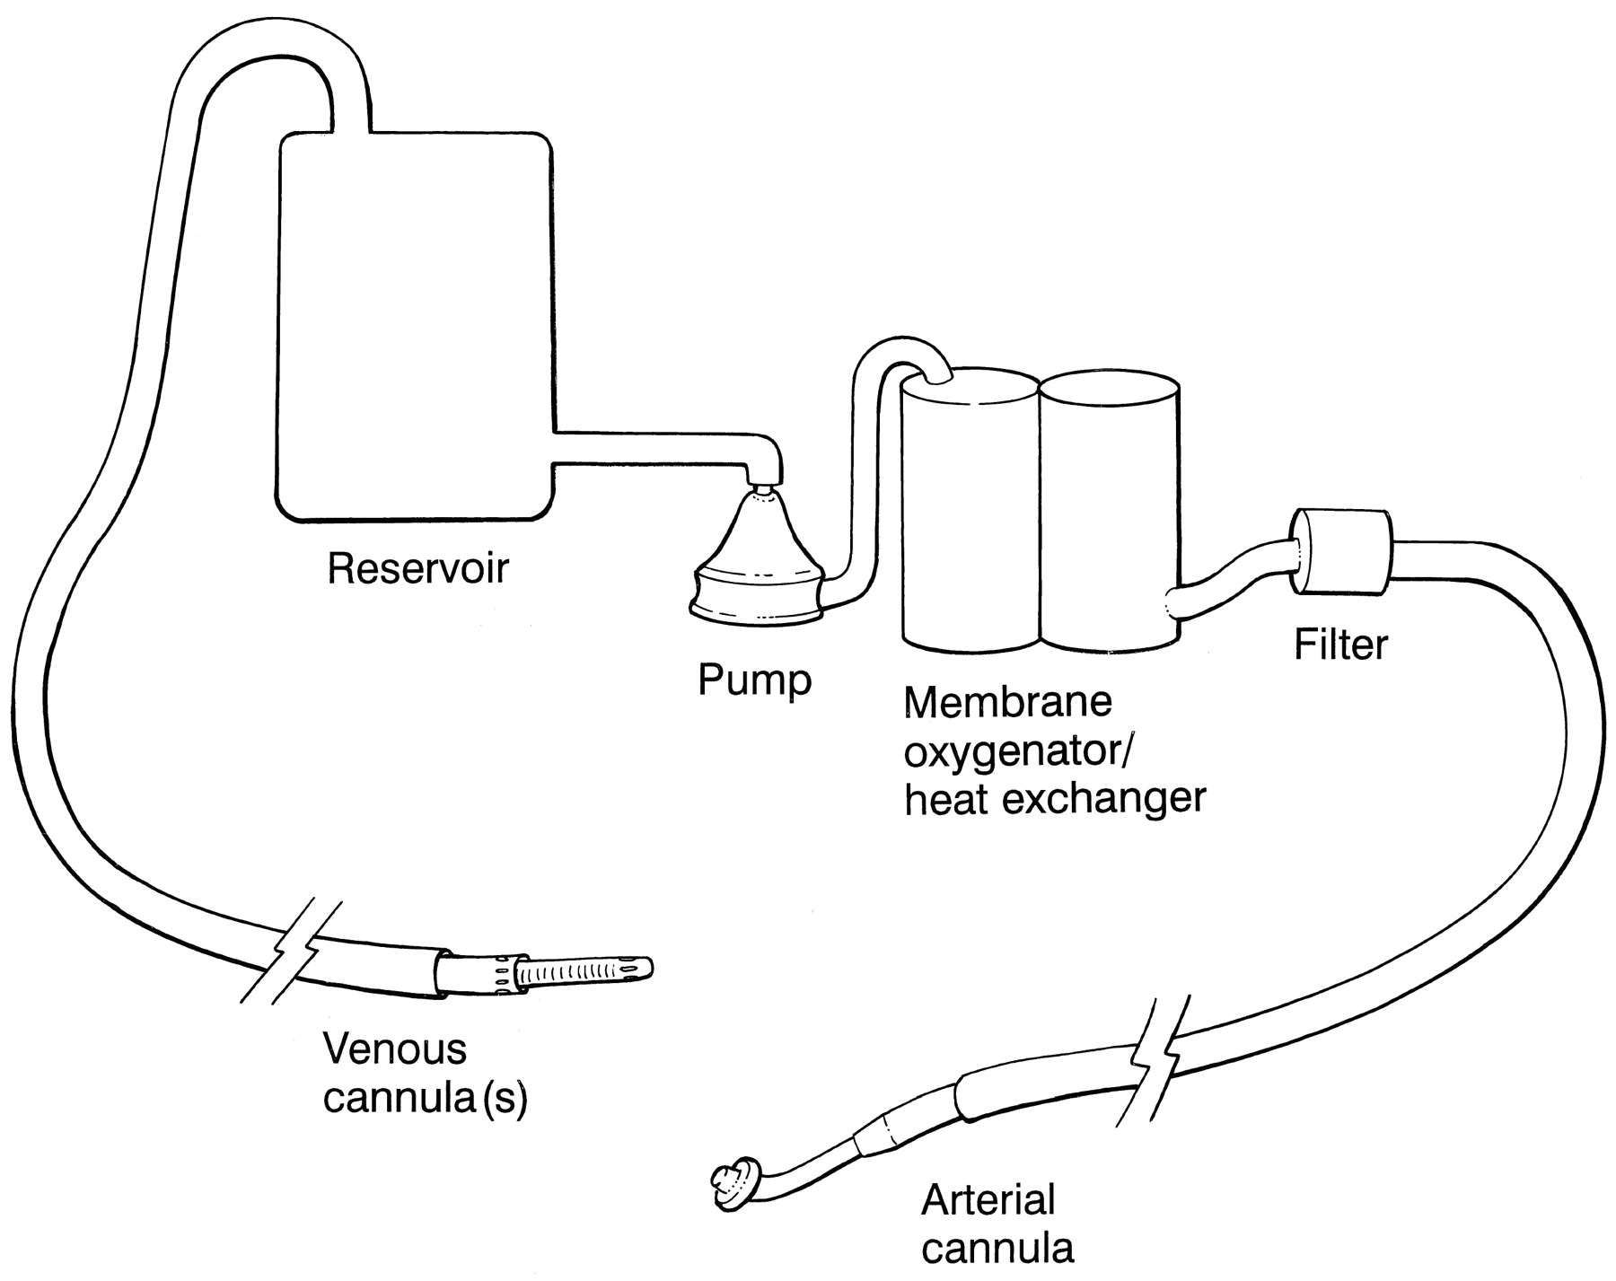
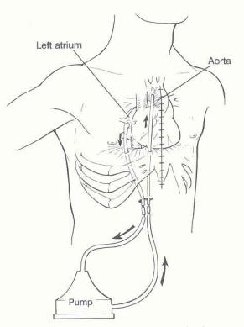
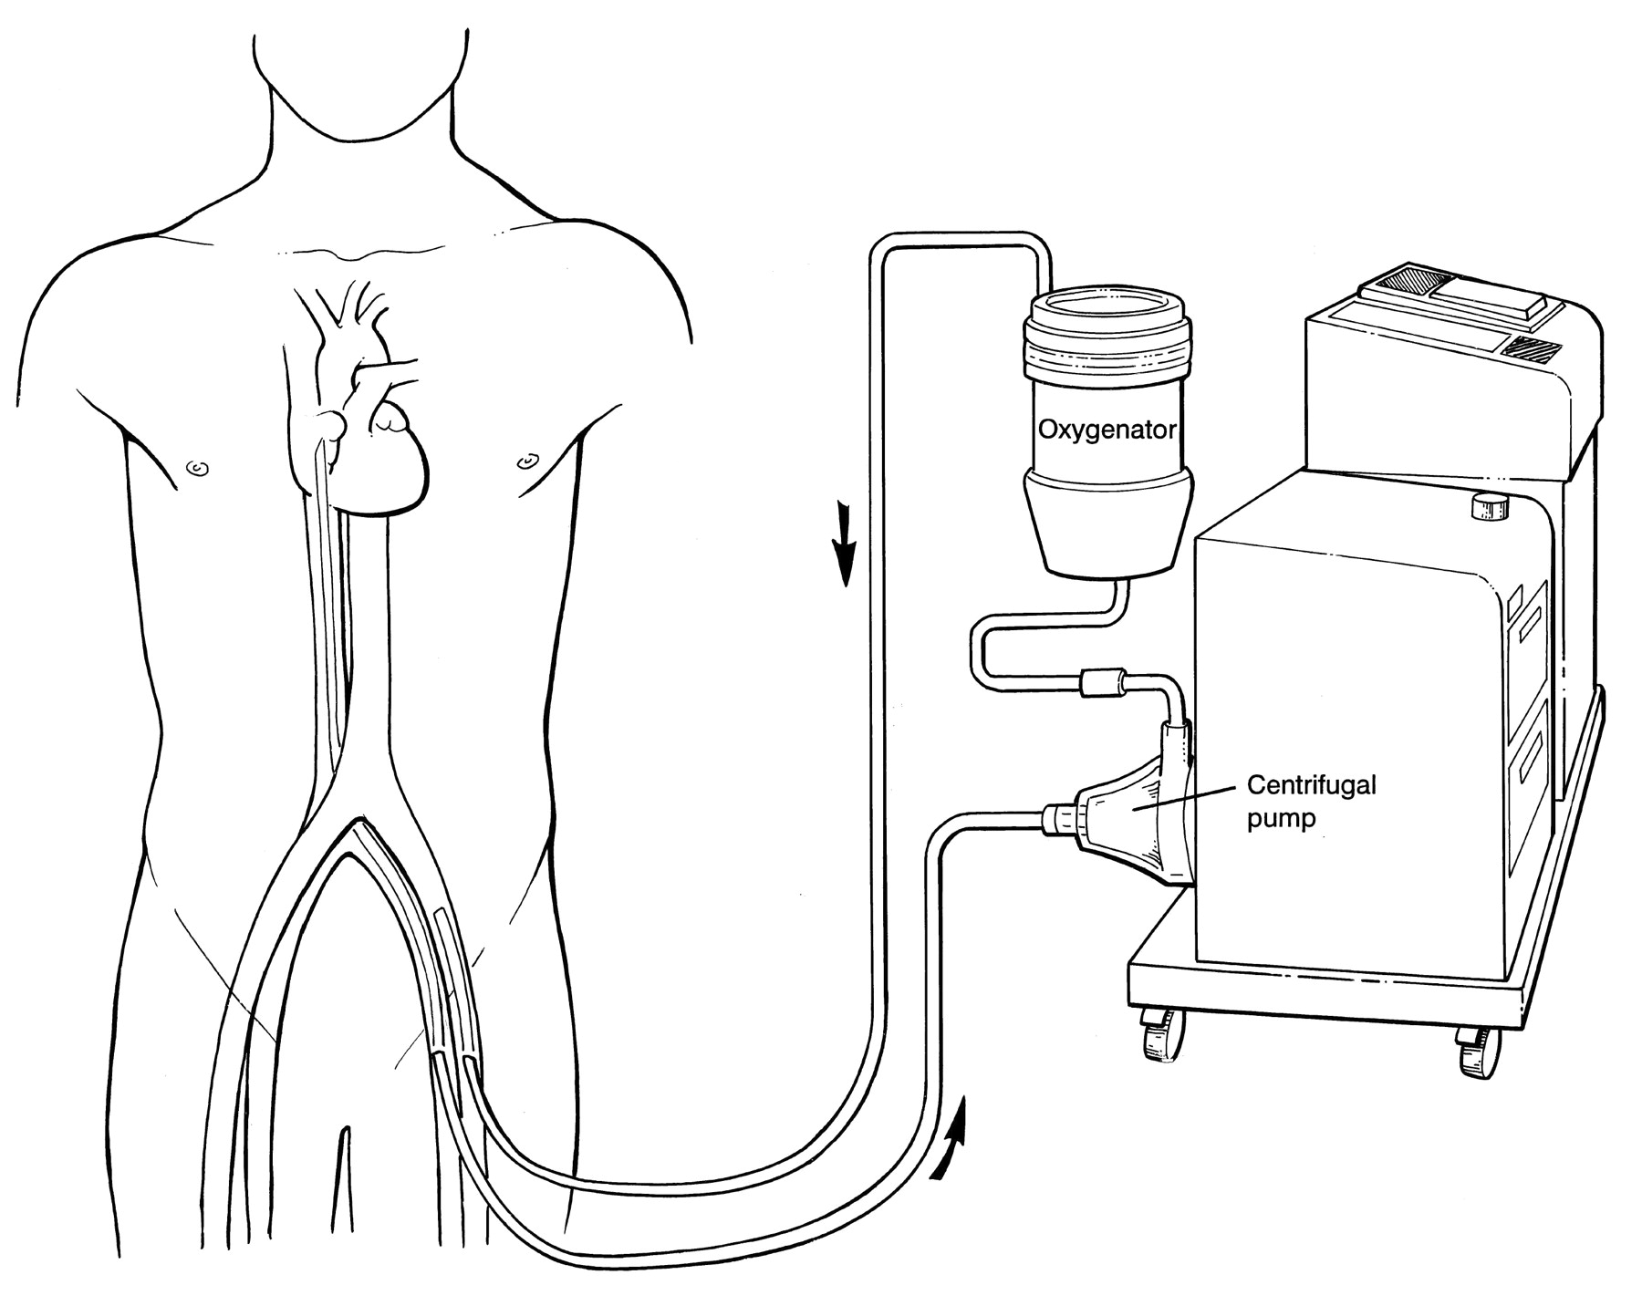
CPB , ECMO, VAD
VAD
CPB
ECMO

Slide 19
Classification
Veno-arterial perfusion
- Biventricular support
- Both circulatory and respiratoy support
Veno-veno perfusion
- Only respiratory support

Slide 20
Cannulation Site
Cervical approach
Femoral approach
Trans-thoracic approach

Slide 21
ECMO in Yesterday

Slide 22
1st successful ECLS in 1971

Slide 23
ECMO was a salvage and rescue procedure. And Physician did not recommend ECMO in 1970’s ~ early 1990’s.

Slide 24
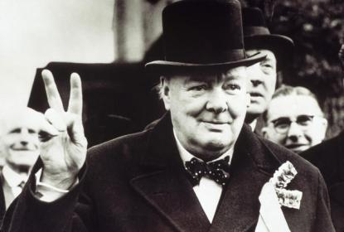
“The future is unknowable, but the past should give us hope”
Sir Winston Churchill

Slide 25
New Era of ECMO

Slide 26


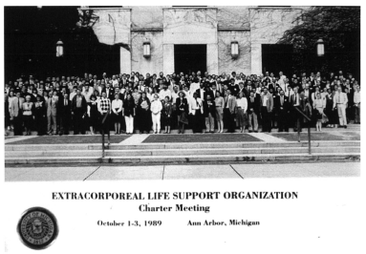
ELSO
1989, Michigan, Ann Arbor
Worldwide organization

Slide 27

1st ELSO Meeting in 1989

Slide 28
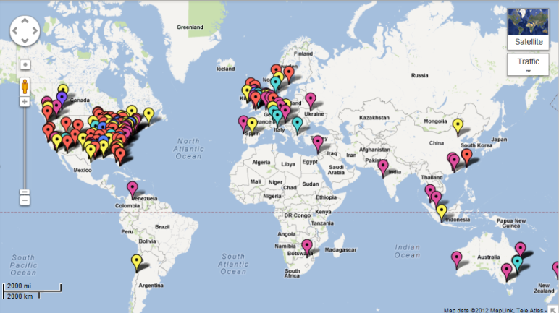
ELSO center in 2012

Slide 29
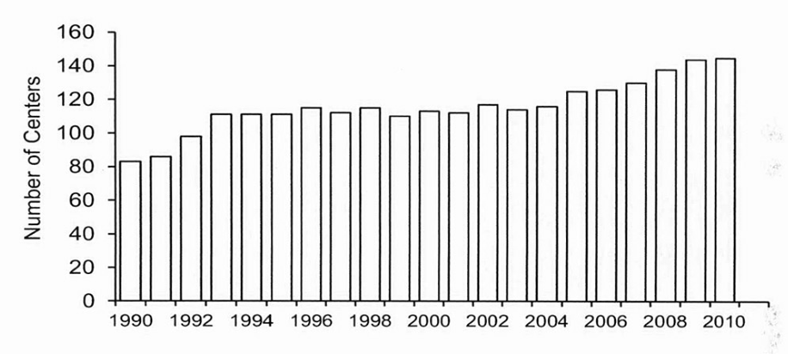
Active Centers in the ELSO Registry

Slide 30
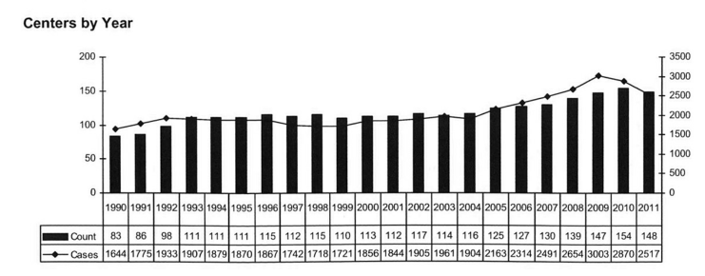
ELSO Registry statistics to 2011

Slide 31
How about ECMO in KOREA ?

Slide 32
Disclosure:
No Financial Conflict

Slide 33

Cumulative ECMO cases in Korea
EBS circuit : about 1300 sets
PLS circuit : about 200 sets

Slide 34
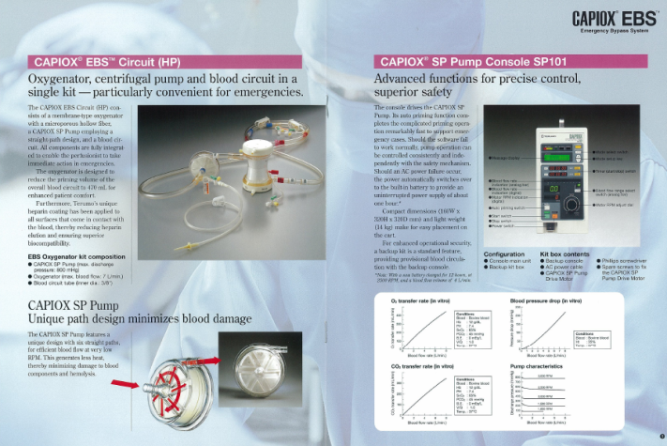
EBS (Emergency Bypass System)

Slide 35
EBS Auto-priming
Gas in
Priming
solution
Blood in
Blood out
Gas out
Air
Oxygenator
Notes:
The most important merit of EBS system is auto-priming function.
It only takes less than 5 minutes to be primed.
It is very simple to be primed, so we do not need any specially trained person to be ready to use.
So, it is very helpful in emergency situation and many hospitals use this system.

Slide 36
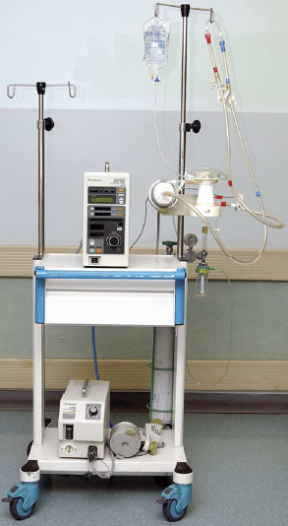
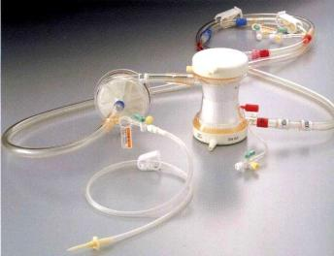
Quick
Compact
Simple
Safe
Notes:
Among them, EBS is most popular in Korea.
It is composed with preassembled heparin coated circuit and portable main console.

Slide 37
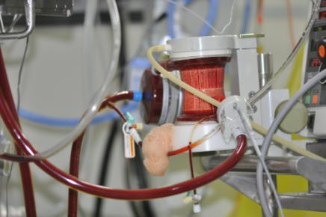
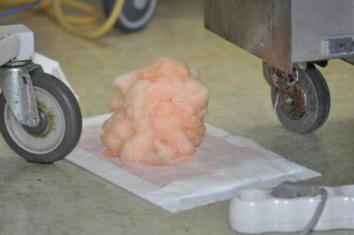
Problems – Plasma Leakage
Notes:
The most weak point of EBS system is that it can cause plasma leakage because of oxygenator material.
So, we have to change it in two or three days usually.

Slide 38
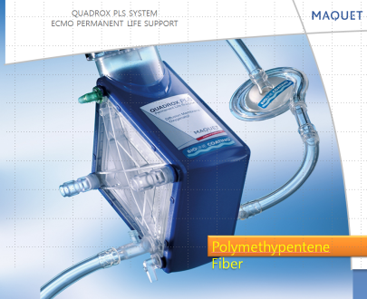
QUADROX Prolonged Life Support (PLS)
Low Prime Volume
Diffusion type oxygenator: less leak
Low hemolysis
CE Approved for 14 day use

Slide 39
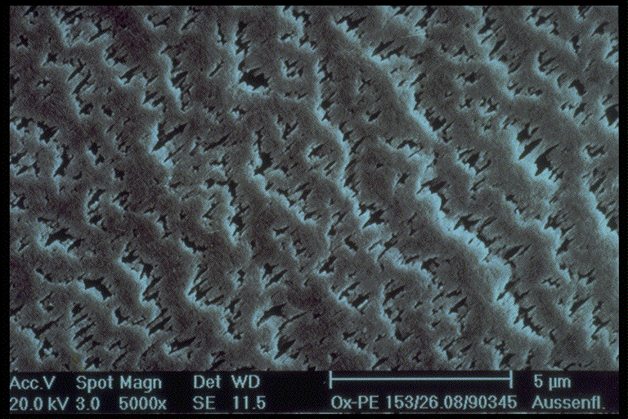
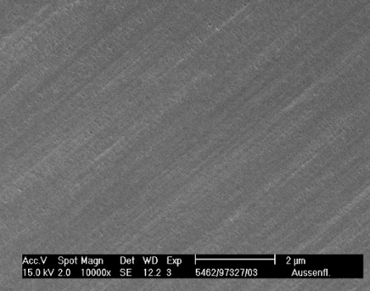
Oxygenator
Microporous Membrane Diffusion Membrane
No Plasma Leakage !!!
Notes:
14/09/2012
39

Slide 40
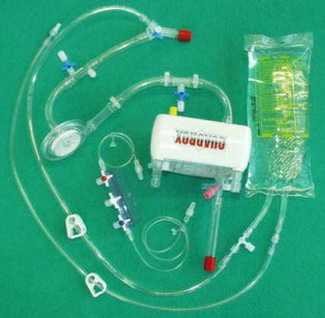
Problems
Complex circuit
No Auto-priming
More expensive
Notes:
However, PLS does not have auto priming function.
The circuit is a little bit complex.
So, some specially trained person should be necessary to be ready to use it.

Slide 41
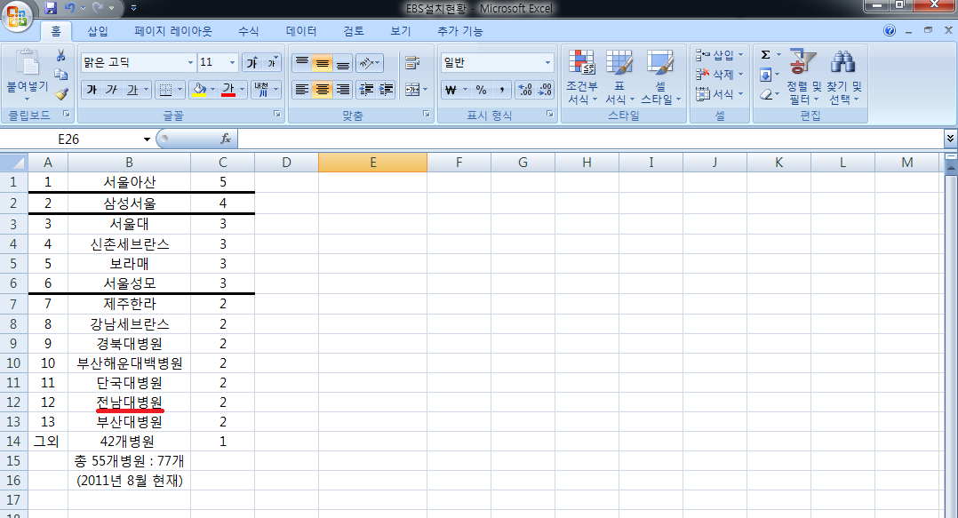
EBS in Korea
Aug. 2011
No. EBS: 77 / 55 hospitals
> 20 cases/year: 23 hospitals
> 1 case/year: 56 hospitals

Slide 42
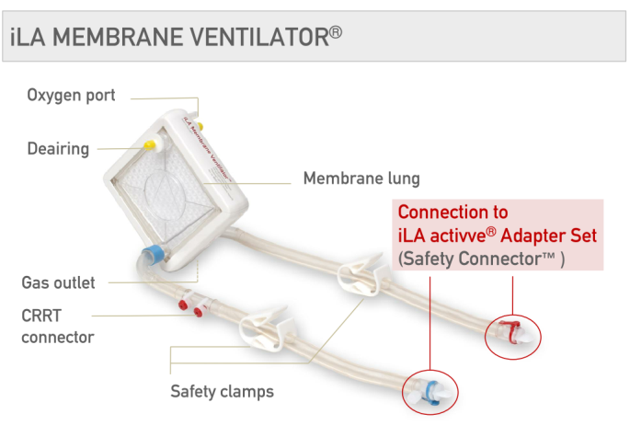
Nova Lung

Slide 43
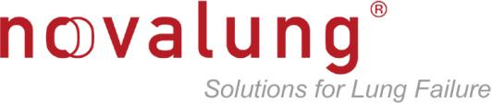
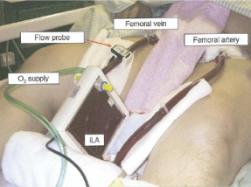
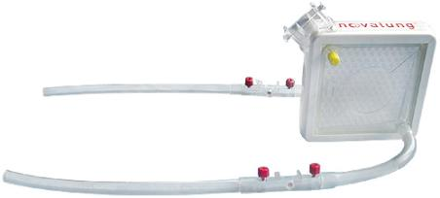
No pump
Interventional Lung Assist (iLA)

Slide 44
ECMO is no more than salvage or rescue tool.

Slide 45
Choice of Treatment
Conventional Treatment
ECMO
vs.

Slide 46
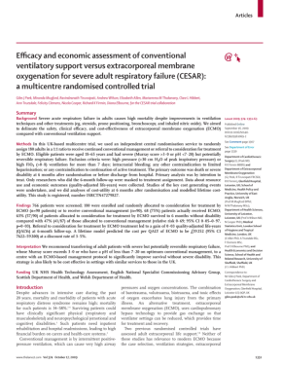
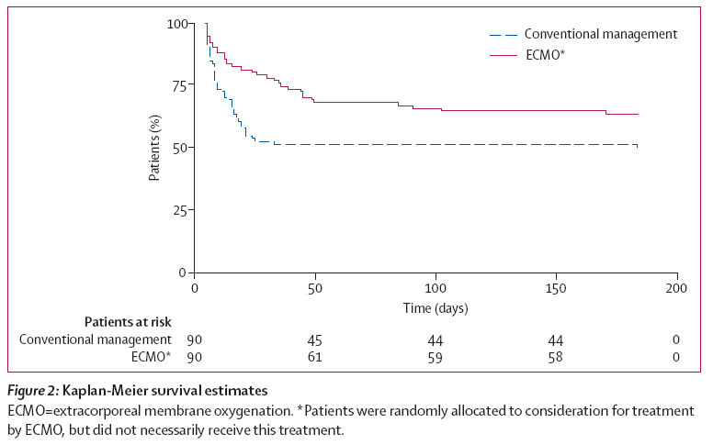
Conventional ventilatory support versus extracorporeal membrane oxygenation for severe adult respiratory failure (CESAR) trial

Slide 47
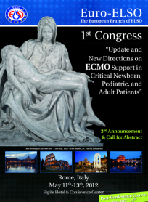
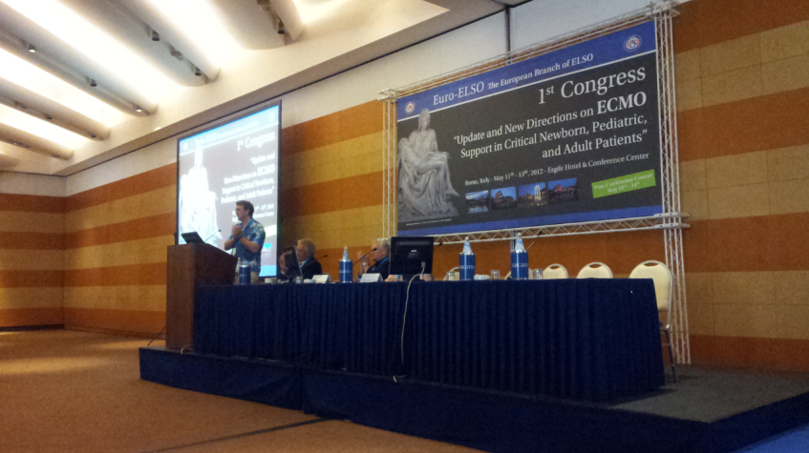

Slide 48
Current challenge of ECMO

Slide 49
Circulatory and/or Respiratory failure
Adult ECMO
Pediatric ECMO
Neonate ECMO

Slide 50
Post-cardiac surgery myocardial dysfunction
Myocarditis
Medically intractable arrhythmia
Respiratory failure and ARDS
Transplantation related condition
  Bridge to transplantation / bridge / recovery
  Post-transplantation failure
Neonatal respiratory failure
  MAS, RDS, PPHN, CDH …
Extracorporeal CPR(ECPR)
Procedure related condition
  Tracheal surgery
  Coronary intervention
Shock and Respiratory failure associated with various causes
  Sepsis
  Drug intoxication
  Malignancy

Slide 51
Standard contraindication ?
Unwitnessed cardiac arrest
Cardiac arrest > 30min
Recent CVA or head trauma
Severe aortic regurgitation
Aortic dissection

Slide 52
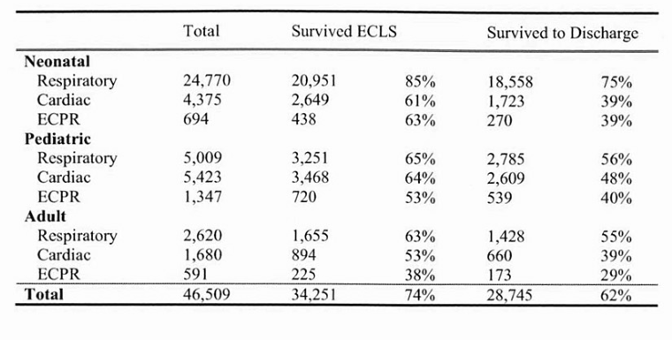
Cumulative Summary
ELSO Registry July 2011

Slide 53
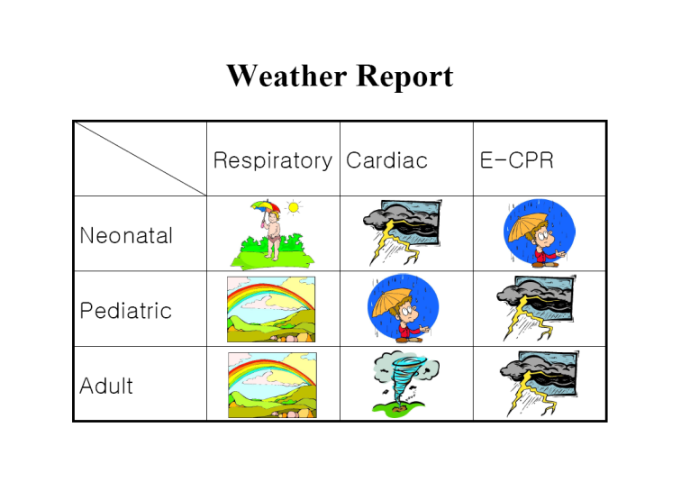

Slide 54
ECMO protocol in CNUH

Slide 55
ECMO experience in CNUH
 | 2010 | 2011 | 2012 | Total
CS | 6 | 22 | 14 | 42
EM | 5 | 15 | 5 | 25
Total | 11 | 37 | 19 | 67

Slide 56
CNUH Protocol (1)
Sedation and NM blockade
Mechanical ventilation with Lung resting setting
If possible, Minimal or No inotropics in VA-ECMO
Adjustment of preload and afterload
Anticoagulation
  Initial heparin loading: 25-50IU/Kg IV
  Maintenance: Nafamostat mesylate(Futhan®)
  Monitoring with ACT: 150-200 sec
  Check: Platelet, AT-Ⅲ, fibrogen,

Slide 57
CNUH Protocol (2)
Daily echocardiography, if necessary TEE
Central cannulation
  : mediastinal irrigation 2days
Post-ECMO Wound care
  : Negative Pressure Wound Therapy(NPWT)

Slide 58
CNUH Protocol (3)
Bedside EEG-monitoring in all pediatric patients during ECMO support
  : Consultation to pediatric neurologist
Abnormal findings in EEG monitoring
  : Infusion of anti-epileptic drug and mannitol.
Brain CT in all pediatric ECMO patients after ECMO weaning
  : Consultation to pediatric neurologist / neuro-surgeon

Slide 59
Future Direction

Slide 60
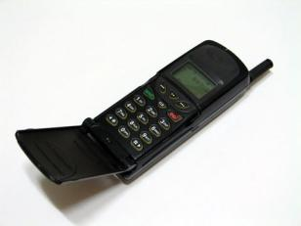
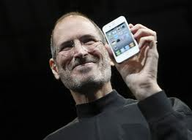
ECMO will not be a rescue tool, any more.
ECMO in Future will be the ‘iPhone’ !!!

Slide 61
New developing technology and application in ECMO
Awaken, mobile ECMO
Simple automated portable devices
Circuit without systemic anticoagulation
Implantable artificial lung
DCD abdominal organs preservation
Artificial placenta

Slide 62
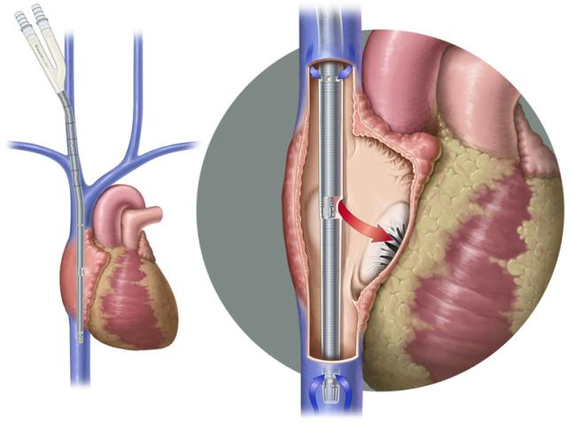
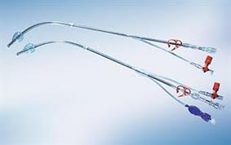
Bi-caval double lumen canula
AVALON ELITE Catheter

Slide 63
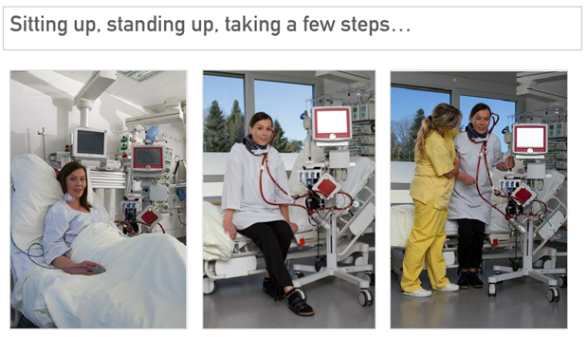
Awake and mobile ECMO

Slide 64
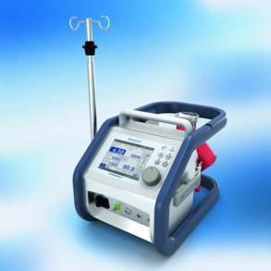
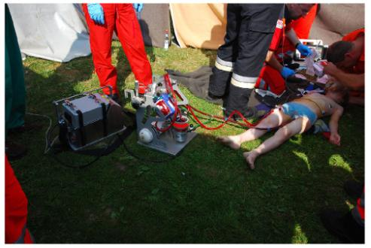
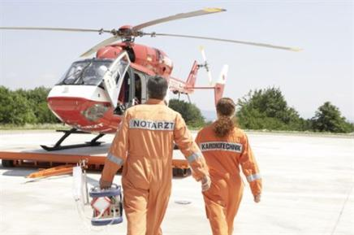
Automated portable ECMO
Cardiohelp
  - CE appoval: 2010
  - US approval: 2012

Slide 65
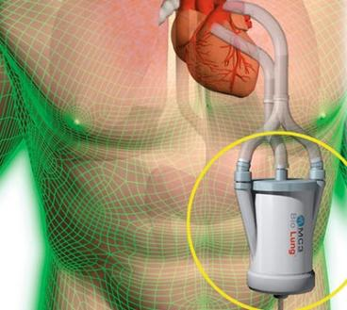
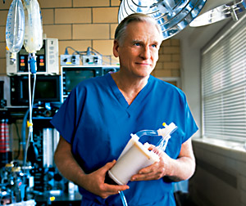
Implantable artificial lung
Animal experiment (in Michigan and Osaka)
Paracorporeal oxygenator (+/- pump) : PA→ LA
3 ~ 6months, ambulation

Slide 66
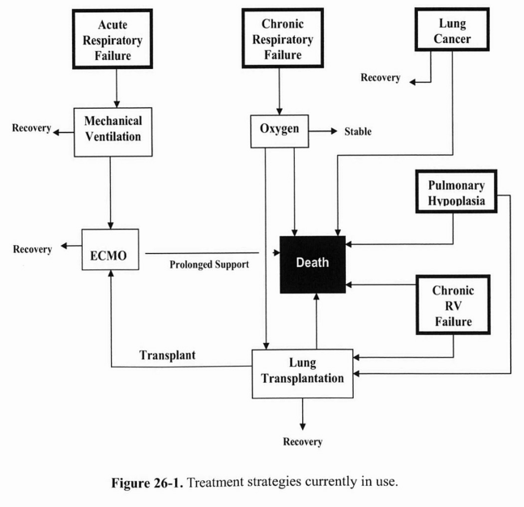

Slide 67
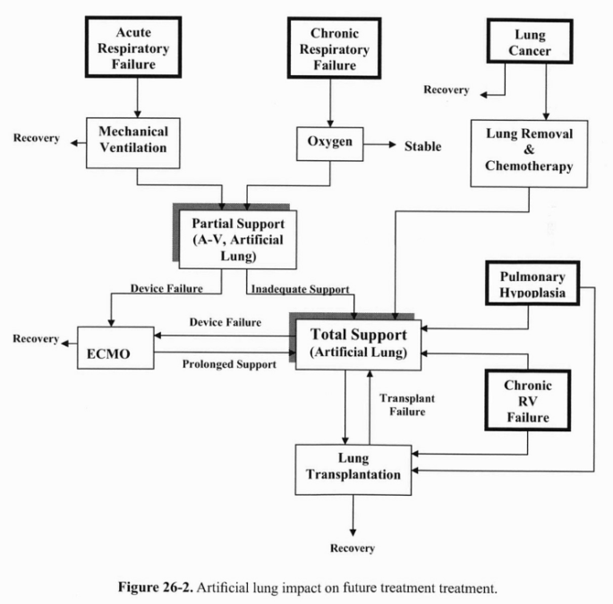

Slide 68
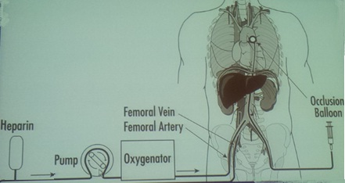
DCD organs preservation
Extracorporeal support of abdominal organ donation
in cardiac death (DCD)

Slide 69
Michigan experience for DCD
2000 ~ 2008
  - 48 Donor
  - 36 recovered
 | Kidney | Liver | Pancreas
EDCD recovered | 67 | 19 | 2
Transplanted | 44 | 12 | 1

Slide 70
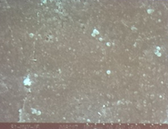
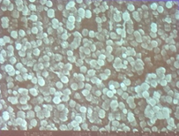
Circuit without systemic anticoagulation
NO release Surface
Control Surface
Michigan University. in rabbit
Fewer platelet aggregation to surface of NO-coating circuits
when compared to the control circuits

Slide 71
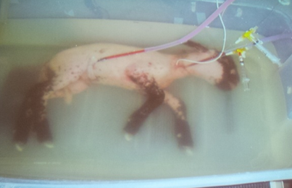
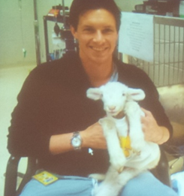
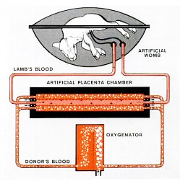
Artificial Placenta
Michigan University, April. 2012
Fetal lamb
4 days after 3 days Artificial placenta

Slide 72
Back to the Jun. 2006

Slide 73
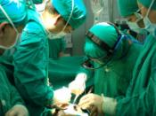
2006년 제 1차 신입 전공의 오리엔테이션
나의 흉부외과 수련 과정
CNUH
Thoracic & Cardiovascular Surgery
전남대학교병원 흉부외과
전공의 4년차
정 인 석

Slide 74
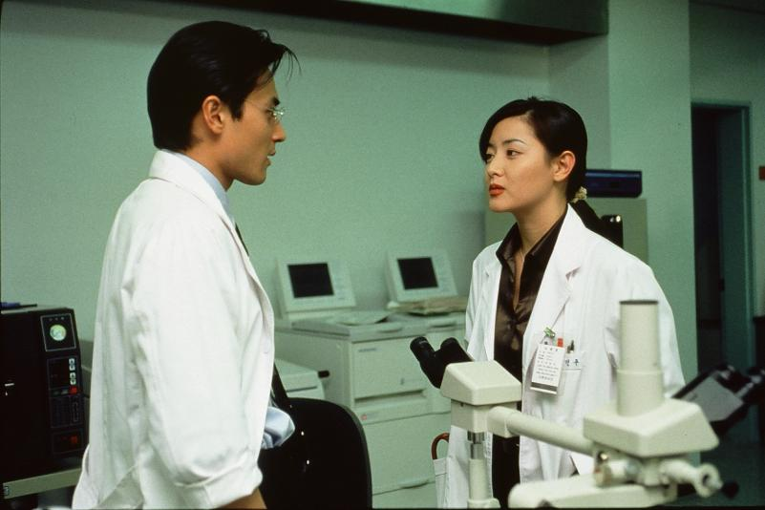
이런 드라마도 있었는데!

Slide 75
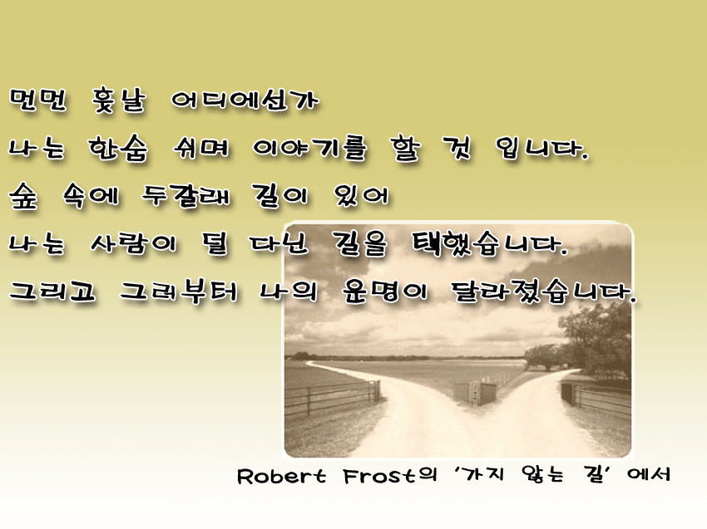

Slide 76



여자의 손처럼
섬세하게
독수리의 눈처럼
예리하게
사자의 심장처럼
용기있게

Slide 77

그래도 후회는 없다!

Slide 78
To be summarized

Slide 79
Thoracic and cardiovascualr surgeon is the ‘leader’

Slide 80


ECMO is the leadership?

Slide 81
In my future

Slide 82



Slide 83


ECMO Reunion
in Boston Children’s Hospital

Slide 84


Slide 85




Slide 86





ECMO Camp at CNUH

